Slide 1
Wish / If only
1
Wish/ If only + past simple
Talking about the present – things that haven’t come true now and things that might come true in the future:
I wish I could speak French.

Slide 2
Wish / If only
2
Wish/ If only + past perfect
Talking about the past – things you regret doing/not doing:
I wish I hadn’t been so rude to my mother last night.

Slide 3
Wish / If only
3
Wish/ If only + would
Talking about irritating habits – things which are annoying you:
I wish it would rain. The garden really needs some water.

Slide 4
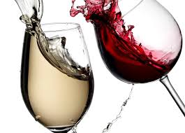

Wish
I wish I had some wine.
‘Wish’ in present moment
I wish I had studied more in school.
‘Wish’ about the past

Slide 5
Wish
4
Wish + to inf.
Want + to inf.
It can be used to talk about past, present or future.
Napoleon wished to keep his battle plans a secret until the very last moment.
Please be quiet. The Director wishes to say a few words.
I’m sure she’ll wish to thank you for your gift.

Slide 6
Hope
Note that when people talk about their wishes for the future, it is unusual to use the verb wish; the verb hope is usually used.
I hope you enjoy your stay in our town.
I hope she wins the election.

Slide 7
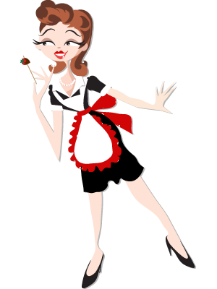
Hope Vs Wish
usually takes a present tense with a future meaning. When we use we usually don’t know or can’t tell the outcome, whereas with we do know the facts and they are the opposite of what we want.
Hope
hope
wish

Slide 8
It’s time
It’s time + to infinitive
It’s time to go home now.
It’s time for + object + to infinitive
It’s time for us to go home now.

Slide 9
It’s time
It’s time + subject + past simple
(a little more formal)
It’s time we went home now.
It’s time + subject + past continuous (more colloquial)
It’s time we were going home now.

Slide 10
It’s time
To say that something should have been done already, about time and high time can be used.
It’s about time we went home.
It’s high time we went home.

Slide 11
Would rather/ would sooner
Prefer to + infinitive
ชอบที่จะ ..มากกว่า
1. Would rather / would sooner + inf
To express a preference about general situation or event or about a possible future situation or event.
I’d rather/ I’d sooner travel the world than go to university.

Slide 12
2. Would rather / would sooner +subject + present simple / past simple
To express a preference for another person or thing to do or not do something generally or in the future.
I would rather she works than does nothing.
The use of past simple expresses the preference a little more politely
He’d sooner you didn’t tell anyone about the interview yet.

Slide 13
3. In formal contexts the subjunctive is used. Instead of the present simple we use the infinitive without to; past subjunctive is the same as past simple except for be, where the past subjunctive always uses were
I’d rather he go now.
I’d sooner she were happy in her work.

Slide 14
4. Would rather / would sooner+ have + past participle
When he was young, he’d rather have been a photographer than an actor.
5. Would rather / would sooner + subject + past perfect
I’d rather you had asked me before you borrowed the car yesterday.
I’d rather it hadn’t rained all through the holiday.

