Slide 1
VOCABULARY UNIT 6

Slide 2
MYSTERIES.

Slide 3
La Llorona
El Chupacabras
La Sucia
The Bermudas Triangle

Slide 4
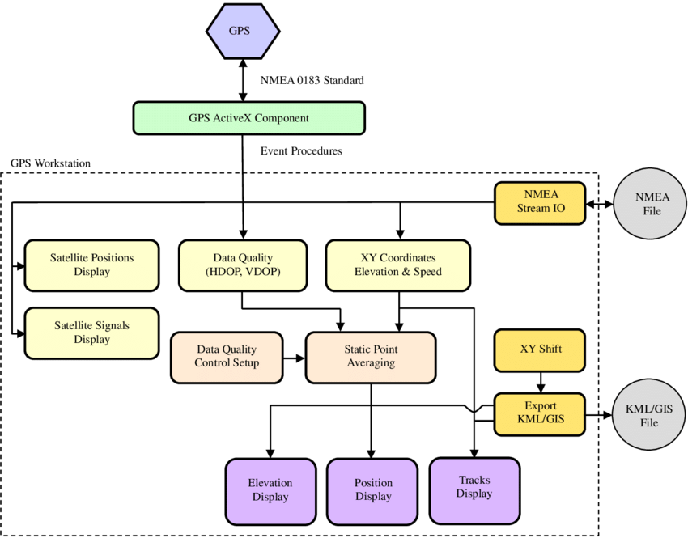
diagram

Slide 5
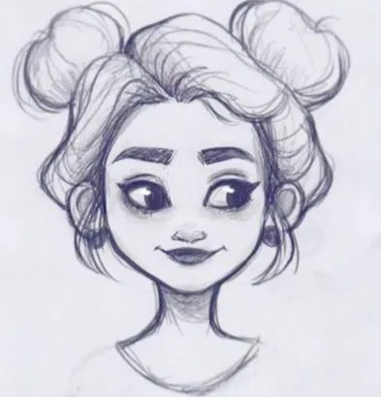
drawing

Slide 6
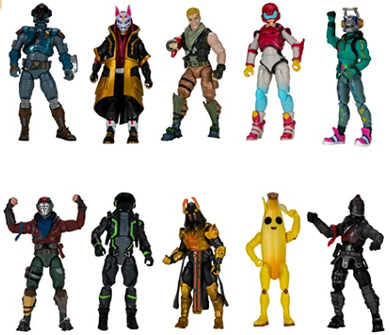
figure

Slide 7
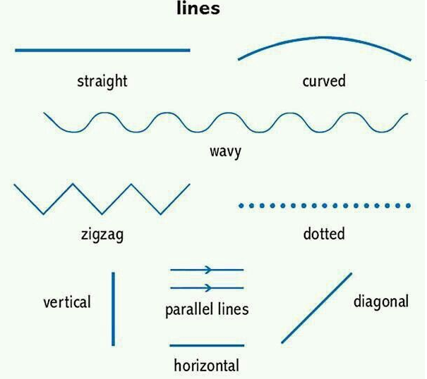
lines

Slide 8



pattern

Slide 9
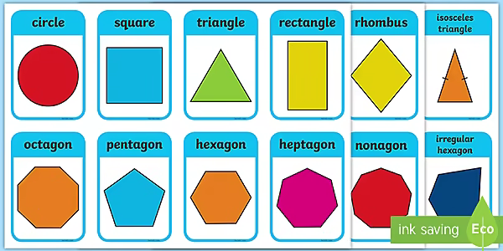
shapes

