Slide 1
There is… / There are…

Slide 2
Answer the following questions.
When do we use there + be?
When do we use there is?
When do we use there are?

Slide 3
ANSWERS.
We use there + be to show that something is present or exists.
We use there is with SINGULAR subjects.
We use there are with PLURAL subjects.

Slide 4
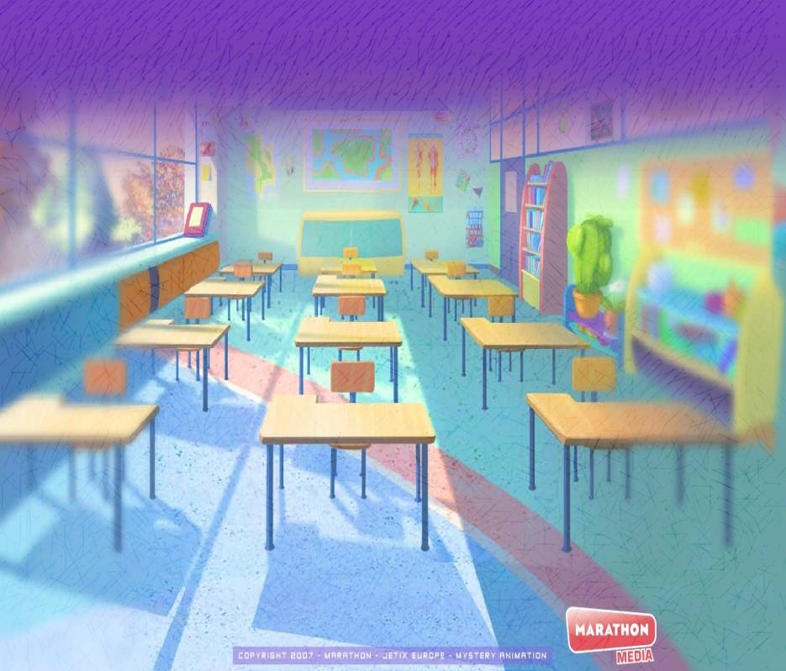
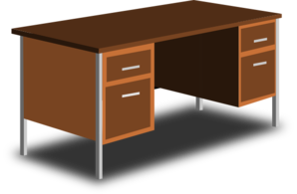
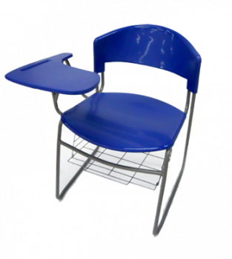

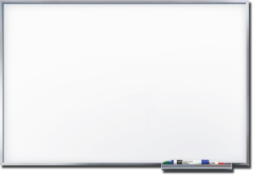


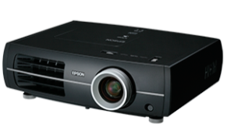
What can we find in this classroom?
There is a desk.
There are 2 school chairs.
There is not a computer.
There is a whiteboard.
There aren’t 3 backpacks.
There isn’t a beamer.

Slide 5




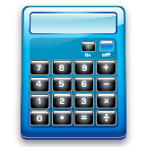

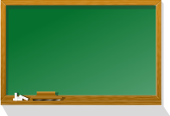
What can we find in this classroom?
There’s not a binder.
There are 5 books.
There’s an eraser.
There are not 2 calculators.
There are 9 chalks.
There are 2 chalkboards.

Slide 6
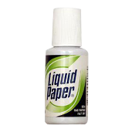



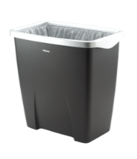

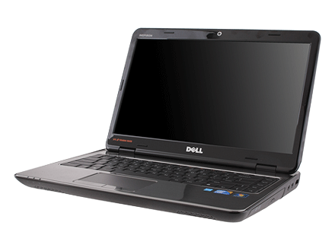
What can we find in this classroom?
There are 6 liquid papers.
There are 2 loudspeakers.
There is a wastebasket.
There aren’t 8 markers.
There aren’t color pencils.
There is a laptop.

Slide 7
It is more formal to use ANY in negative plural sentences.
There aren’t any curtains. There aren’t any animals.
There aren’t any beds.

Slide 8
Questions using there is/are
- use verb be first
Is there a desk in the room?
Yes, there is.
Is there a car in the room?
No, there isn’t.
Are there any chairs in the room?
Yes, there are.
Are there any cats in the room?
No, there aren’t.

Slide 9
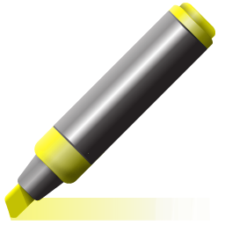


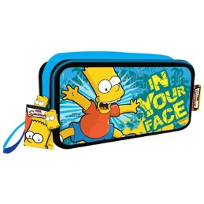
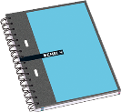



What can we find in this classroom?
Is there a highlighter?
  No, there isn’t.
Are there any pencils?
  Yes, there are.
Is there a pencil case?
  Yes, there is.
Are there any notebooks?
  Yes, there are.
Are there any thumbtacks?
  No, there aren’t.
Is there a sharpener?
  Yes, there is.

Slide 10
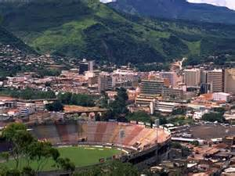
What’s there in Tegucigalpa?

Slide 11
-There’s an airport.
-There’s a presidential house.
-There’s a zoo.
-there isn’t a lake.
-There are malls.
-There are universities.
-There aren’t any trains.
-there aren’t any beaches.

