Slide 1
Complete the conversation
A:Hello. I’m Pancracia. What’s your name?
B: Hello. My name is (Panchito). Where are you from?
A: I’m from Canada.
B: Oh! You are a Canadian. I am from Honduras.
A: Nice to meet you.
B: Nice to meet you, too. Are you married?
A: Yes, I am. My family is big.
B: How old are you?
A: I’m 25 years old/ I’m 25.
B: What’s your last name?
A: Arenales.
B: Could you spell it, please?
A: A - r – e – n – a -l- e - s
B: What do you do?
A: I am a teacher.
B: Great! I am sorry. I am in a hurry. I’m very pleased talking with you.
A: So am i. Good night.
B: Good bye.

Slide 2
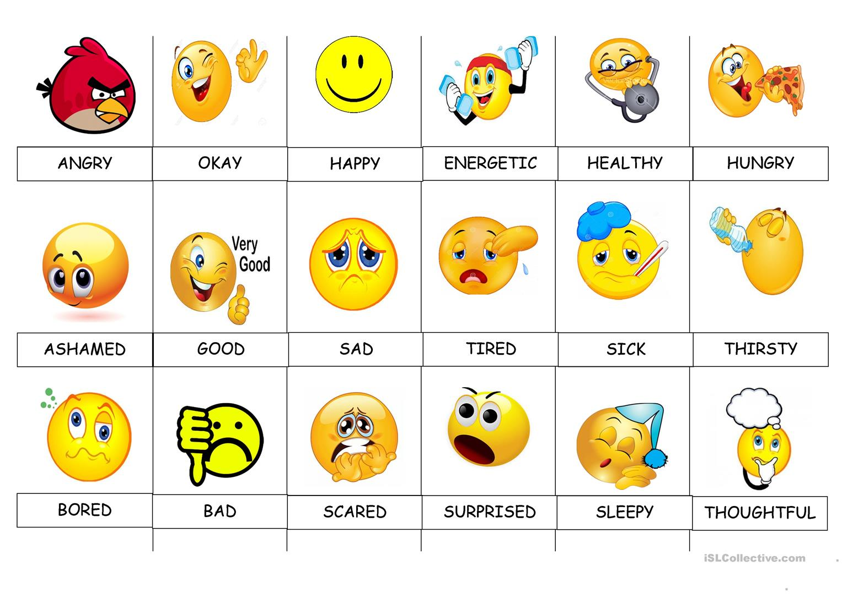

Slide 4
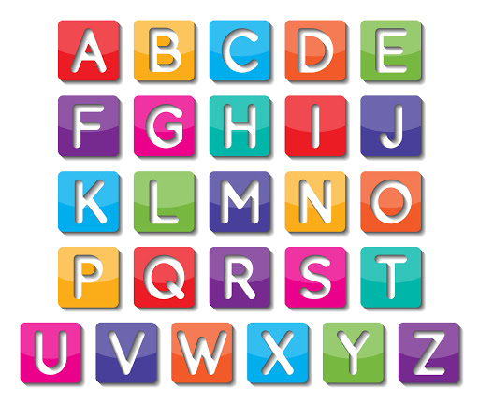

Slide 5
Spell the folowing words.
1. Doctor
2. Student
3. Lawyer
4. Assistant
5. Teacher
6. Electrician
7. System engineer
8. Biologist
9. Physician
10. Attorney
11. advocate

