Slide 1
RELATIVE CLAUSES

Slide 2


Slide 3
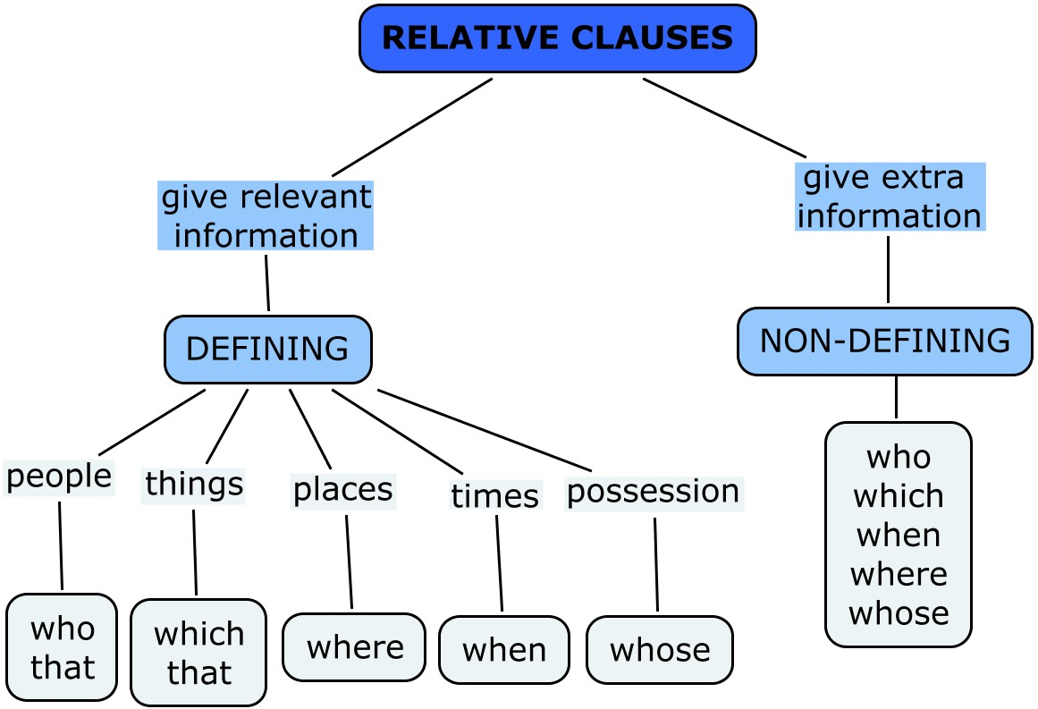

Slide 4
DEFINING
Essential information
No commas
“That”
Omission of relative (when it's NOT the subject)

Slide 5
NoDEFI
DEFINING RELATIVE CLAUSE
The woman who lives next door is a doctor.
(that)
The woman who I wanted to see is away.
(that)
(Ø)

Slide 6


Slide 7
Relative clauses as sentence modifiers
When a relative clause begins with “which”, we can use it to comment on the whole sentence.
They didn’t bring any food, which is unusual, since they always bring snacks.
She called me at midnight, which was rude, because she knows I work early mornings.

Slide 8
The house, the roof of which is broken, should be mended
The English book, the exercises of which are a bit hard, gives a through explanation about the g
rammar.
Instead of whose , can also be used.
I have two sisters, both of whom are teacher.
Susan has bought clothes, most of which were second-hand.
of which
note: used in formal language

Slide 9


Slide 10
How do you reduce an adjective clause to an adjective phrase?
If there is a to be (am, is, are, etc), delete the to be and the relative pronoun (who/which/that)
The car which is parked there is the director’s car.
The car parked there is the director’s car.
If there is no to be (am, is, are, etc), delete the relative pronoun (who/which/that) and change the verb to Ving.
The man who escaped from the prison was a bank robber.
The man escaping from the prison was a bank robber.

Slide 11

EXERCISES
1The nurse who is looking after my mother is very kind to her.
2. Luggage that is left unattended will be taken away by police.
3. Who’s that good-looking man who is talking to Alice?
4. All the rubbish that is thrown away in the sea is a real danger to health.
5. Do you know the man who is standing near the door?

Slide 12
1.The nurse looking after my mother is very kind to her.
ANSWERS
2. Luggage left unattended will be taken away by police.
3. Who’s that good-looking man talking to Alice?
4. All the rubbish thrown away in the sea is a real danger to health.
5. Do you know the man standing near the door?

Slide 13

Join the sentences on the left with those on the right using who or which
He has broken into my house
That surprised everyone.
He /She deals with exports.
It isn’t working.
It needs to be eaten.
It sells good coffee.
They last for years.
She could mend that chair.
They can go in the microwave.
He is driving that taxi.
1. Do you know a shop?
2. I know somebody.
3. I want some plates.
4. I was at school with the man.
5. I’d like to speak to the person.
6. She’s won the competition
7. The police haven’t found the man.
8. There’s some cheese in the fridge.
9. We’ve got some light bulbs.
10. This is the switch.

Slide 14

And... that's all!

