Slide 1
QUANTIFIERS
How to “count” in English…

Slide 2
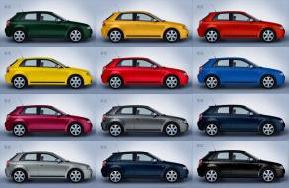
COUNTABLE NOUNS
(CAR / CARS)
Have singular & plural
You can count them (a car/ three cars / some cars)

Slide 3
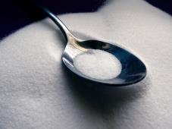
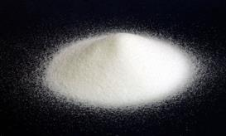
UNCOUNTABLE NOUNS
SUGAR
Singular (no plural)
You can’t count them (3 sugars)
We need quantifiers to count them ( a bit of sugar, two spoons of sugar)

Slide 4
A / AN, SOME / ANY
 | Countable | Uncountable
(+) We need | _______ apple ________ apples | _______ butter.
(-) We don’t need | ______ tomato ________ tomatoes | _______ rice.
(?) Do we need | _______ orange? _______ oranges? | _______ sugar?
An
some
some
A
Any
Any
An
Any
Any

Slide 5
QUANTIFIER | COUNTABLE | UNCOUNTABLE
Many | Plural countables. I have many books.
Much |  | Uncountables (-) I don’t have much time.
A lot of | Plural countables I have a lot of books. | Uncountables. I have a lot of time.
(A) little |  | Uncountables. I have (a) little time.
(A) few | Countables I have (a) few books.
A lot. | Only use it after a verb not followed by a noun. I like running a lot. I have a lot of friends.

Slide 6


MANY
With plural countable nouns.
I have many books.

Slide 7
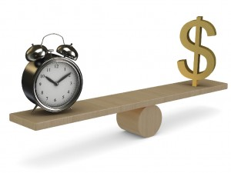
MUCH
With uncountable nouns. (normally negative)
I don’t have much time or money but I’m happy.

Slide 8
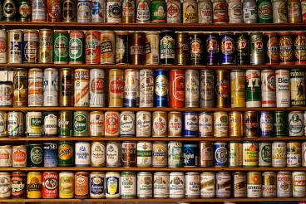
A LOT OF
With countable or uncountable nouns.
I have a lot of books.
I don’t have a lot of time or money.
Do you have a lot of luck?

Slide 9

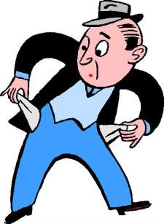
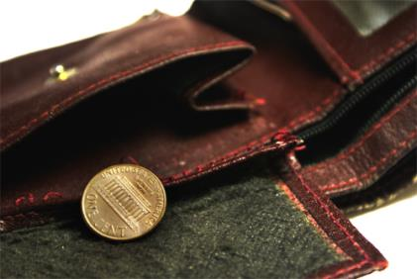
(A) LITTLE
With uncountable nouns.
He has (a) little money.

Slide 10
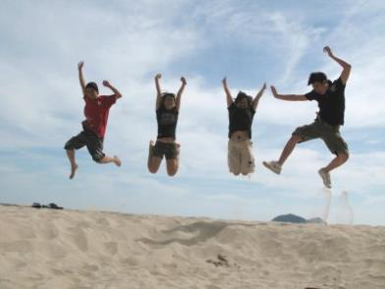
(A) FEW
With countable nouns.
I have (a) few friends.

Slide 11

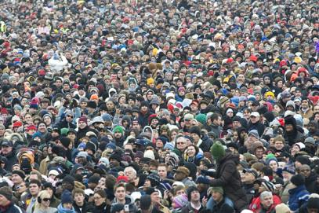
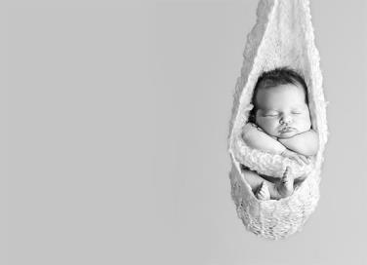
A lot of vs. a lot.
A lot of + NOUN. (A lot of people).
VERB + a lot. (I sleep a lot. ) ( I sleep a lot of).

Slide 12

TOO, TOO MANY, TOO MUCH.
I’m stressed. I have too much work.
My diet is really unhealthy. I eat too many pizzas.
I don’t want to go out. I’m too tired.
TOO: “more than is good”.
Too much + uncountable noun (coffee, time) or after a verb. (I smoke too much)
Too many + countable noun (people, cars).
Too + adjective (NOT I’m too much tired).

Slide 13
ENOUGH
Do you eat enough vegetables?
She doesn’t sleep enough.
My fridge isn’t big enough.
Enough: “all that is necessary”
Enough + noun
Verb + enough
Adjective / adverb + enough

Slide 14
TOO, TOO MUCH, TOO MANY or ENOUGH?
I’m not very fit. I don’t do _______ exercise.
I can’t walk to school. It’s _______ far.
There are ________ cars on the roads today.
I spend _____ time on the computer – it gives me headaches.
I don’t sleep __________ - only 5 or 6 hours, but i really need 8.
I was _______ ill to go to work yesterday.
There were ________ people at the party, so it was impossible to dance.
I always have ________ work and not ____________ free time.
ENOUGH
TOO
TOO MANY
TOO MUCH
ENOUGH
TOO
TOO MANY
TOO MUCH
ENOUGH

