Slide 1
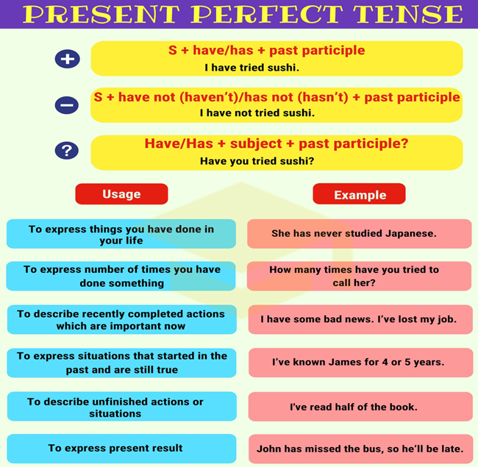

Slide 3
PRESENT PERFECT | SIMPLE PAST
Unfinished actions | Finished actions
Key words: today, this, since, for, up to now, yet, ever, never, in the last, just, still, already, lately, recently, so far. Have you seen her today? I haven’t slept enough this week. I’ve seen him twice since new year. I haven’t eaten anything for 6 hours. Have you ever eaten snake? She has never ridden an elephant. I have been to Paris three times. They have just left. Have you found it yet? They still haven’t arrived. He has already finished. I haven’t driven much lately. What have you done so far? | Key words: yesterday, last, ago, in,the day before yesterday Did you see her yesterday? I didn’t sleep enough last week. I lived in my old house for 5 years. I saw them when I was in Paris. When did they leave? We found it 10 minutes ago. They arrived in September. We finished at 6:00 pm. She didn’t sleep well last Friday.

