Slide 1
Means of Transportation.

Slide 2
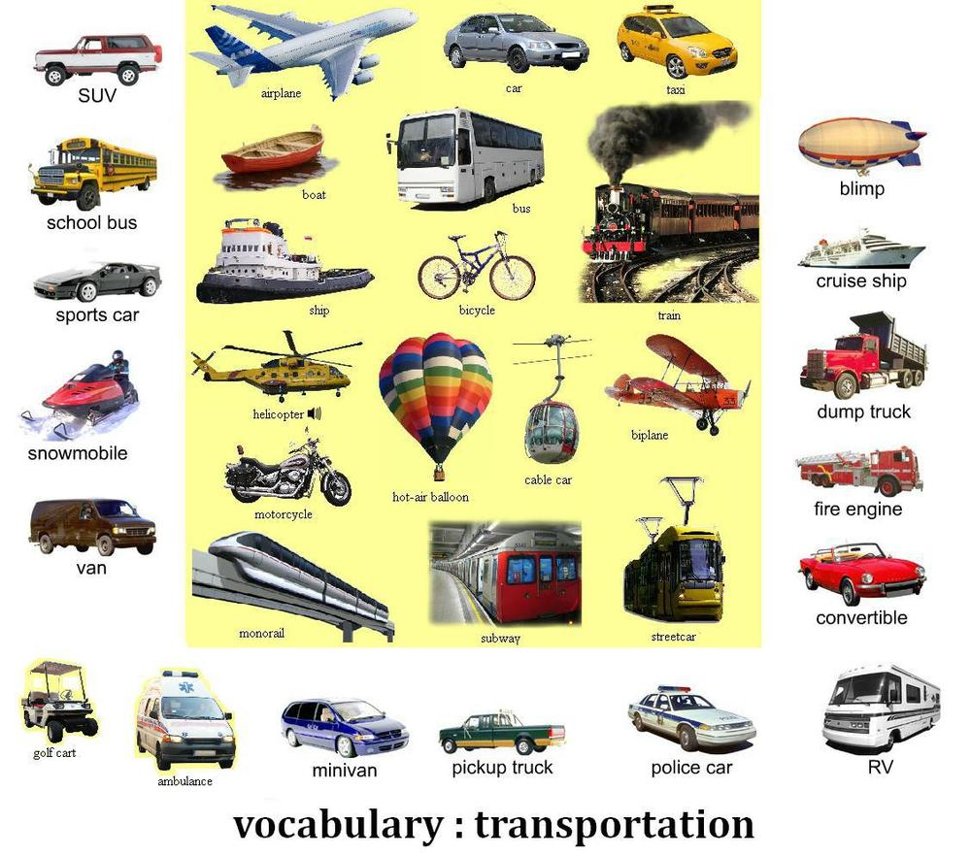

Slide 3
