Slide 1
Gerunds and Infinitives
What are they?
How do you use them?

Slide 2
What is a gerund??
GERUND
Verb + | ing = | Gerund
work + | ing = | working
play + | ing = | playing
study + | ing = | studying
Spelling note
Always keep the “Y” when adding -ing

Slide 3
What is “the infinitive form??
INFINITIVE
To + | Verb = | Infinitive
To + | work = | to work
To + | play = | to play
To + | study = | to study

Slide 4

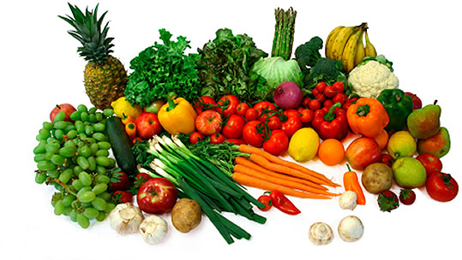
A reminder about gerunds (-ing) . . .
Rules we’ve studied:
We use the gerund form of the verb when it serves as the subject of the sentence:
Examples:
Watching too much TV could be bad for our kids.
Eating fruits and vegetables is good for you.
Swimming is my favorite sport.
Learning English is tough!

Slide 5

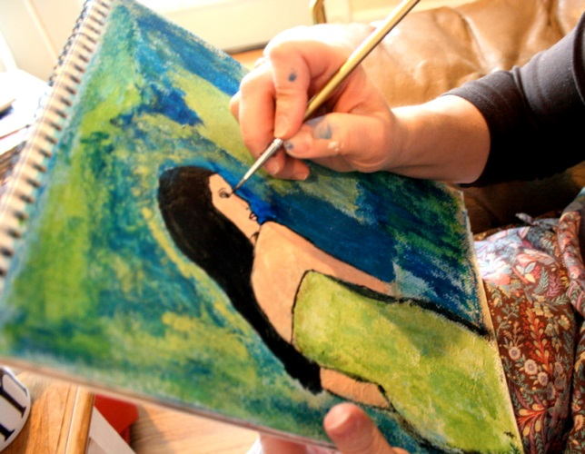

A reminder about gerunds (-ing) . . .
Rules we’ve studied:
We use the gerund form of the verb after a preposition!!
Examples:
She apologized for yelling at her boyfriend.
I’m interested in taking an art class.
My mom is thinking about taking a vacation.

Slide 6
Some verbs in English can be followed by either the gerund or the infinitive form
These are Flexible verbs
examples

Slide 7
Some Flexible Verbs
=can be followed by gerund/infinitive
(this is not the complete list!)
like | can’t stand
love | prefer
hate | continue
Memorize Them!

Slide 8
Flexible Verbs: Example sentences
Verb | Gerund | Infinitive
like | I like swimming. | I like to swim.
love | They love going to the amusement park. | They love to go to the amusement park.
hate | She hates doing the dishes. | She hates to do the dishes
can’t stand | We can’t stand listening to loud music. | We can’t stand to listen to loud music.
prefer | Many teenagers prefer texting. | Many teenagers prefer to text.
continue | I hope you continue learning English. | I hope you continue to learn English.

Slide 9
Verbs that can ONLY be followed by a gerund:
examples

Slide 10
Verbs that require gerunds AFTER them…
(this is not the complete list!)
enjoy | avoid
stop | dread
regret | practice
Memorize Them!

Slide 11

Verbs followed by gerunds:
Example Sentences
Verb | Gerund | Infinitive
enjoy | She enjoys teaching. | She enjoys to teach.
stop | He stopped eating red meat many years ago. | He stopped to eat meat many years ago.
regret | Tom regrets dropping out of high school. | Tom regrets to drop out of high school.
avoid | Some people avoid driving on the freeway. | Some people avoid to drive on the freeway.
dread | Most people dread going to the dentist. | Most people dread to go to the dentist.
practice | He should practice playing the piano more often. | He should practice to play the piano more often.

Slide 12
Verbs that can ONLY be followed by the infinitive:
examples

Slide 13
Verbs that require the infinitive AFTER them…
(this is not the complete list!)
want | need
would like | decide
learn | refuse
Memorize Them!

Slide 14
Verbs followed by infinitives:
Example Sentences
Verb | Gerund | Infinitive
want | I want studying French. | I want to study French.
would like | I would like traveling to Italy someday. | I would like to travel to Italy someday.
learn | She learned swimming. | She learned to swim.
need | The teacher needs leaving class early today. | The teacher needs to leave class early today.
decide | They decided moving. | They decided to move.
refuse | She refused helping me. | She refused to help me.

Slide 15
PRACTICE!

Slide 16
Practice! Gerund, Infinitive, or either?
to get / getting
1. She wants _____________ married in June.
2. The doctor said to avoid ____________ salt.
3. Please stop _______________ so much noise!
4. I can’t stand ___________ in crowded places.
5. The suspect refused ______________ the questions.
6. The kids love ___________ to Disneyland.
7. Tourists enjoy ______________ San Diego.
8. Celia has learned _____________ a bike.
to eat/ eating
to make/ making
to be/ being
to answer/ answering
to go/ going
to visit/ visiting
to ride/ riding

Slide 17
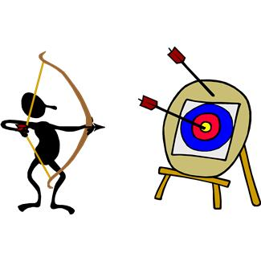
Need more practice?
Go to our class website!
Remember…
Practice
makes perfect!

