Slide 1
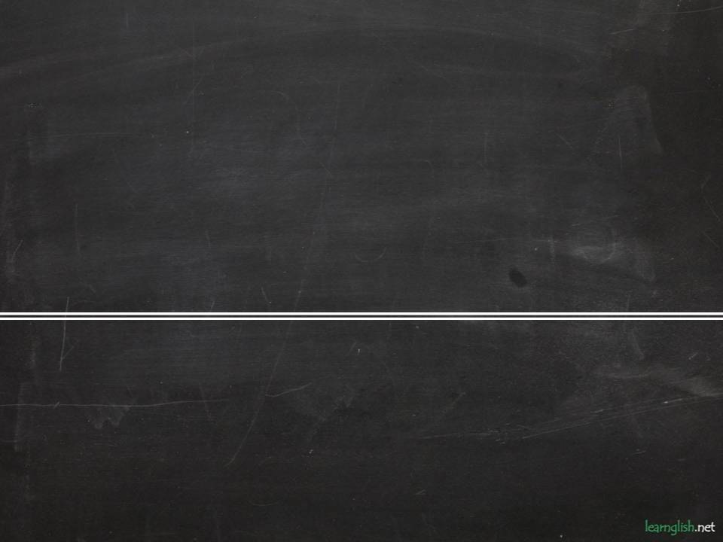
Future forms
Predictions, Decisions, Plans

Slide 2
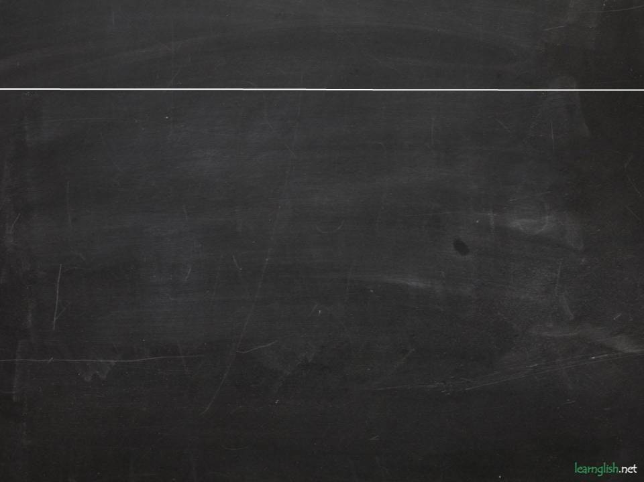


PREDICTIONS
GOING TO
We can see the future in the present. We see things coming. There is present evidence.
WILL
We think or believe things about the future.
Look out! You are going to break that glass! (I can see it now)
Do not give him your watch. He’ll break it. (I think, because I know him)

Slide 3
DECISIONS
GOING TO
Decisions are already made when we speak.
WILL
We are making the decision at the moment of speaking. It’s an instant decision.
You have a lot of emails to answer. I know, I’m going to answer them tonight.
You have an email from John.
Ok, I’ll answer it.

Slide 4
PLANS
GOING TO
Going to and Present Continuous are often both possible for future plans.
We use Going to express the idea of intention.
PRESENT CONTINUOUS
Going to and Present Continuous are often both possible for future plans.
We use present continuous for fixed plans with a definite time and/or place. Arrangements.
I’m going to see Ann sometime soon.
I think John is going to study biology.
I’m meeting Paul at the cinema at 8.
Sarah is starting University on September 25th.

Slide 5
PREDICTIONS
Choose the best form.
Mary is going to / will have a baby.

Slide 6
PREDICTIONS
Choose the best form.
Mary is going to / will have a baby.
Mary is going to have a baby.

Slide 7
PREDICTIONS
Choose the best form.
Perhaps we are going to/ will meet again one day.

Slide 8
PREDICTIONS
Choose the best form.
Perhaps we are going to/ will meet again one day.
Perhaps we will meet again one day.

Slide 9
PREDICTIONS
Choose the best form.
Be careful, or you are going to / will fall.

Slide 10
PREDICTIONS
Choose the best form.
Be careful, or you are going to / will fall.
Be careful, or you will fall.

Slide 11
PREDICTIONS
Choose the best form.
Look. Andy is going to / will fall off his bike.

Slide 12
PREDICTIONS
Choose the best form.
Look. Andy is going to / will fall off his bike.
Look. Andy is going to fall off his bike.

Slide 13
PREDICTIONS
Choose the best form.
I think you are going to / will love Scotland.

Slide 14
PREDICTIONS
Choose the best form.
I think you are going to / will love Scotland.
I think you will love Scotland.

Slide 15
DECISIONS
Choose the best form.
I’ve decided I am going to / will stop smoking.

Slide 16
DECISIONS
Choose the best form.
I’ve decided I am going to / will stop smoking.
I’ve decided I am going to stop smoking.

Slide 17
DECISIONS
Choose the best form.
I don’t want to cook tonight. Ok, I am going to/ will cook.

Slide 18
DECISIONS
Choose the best form.
I don’t want to cook tonight. Ok, I am going to/ will cook.
Ok, I‘ll cook.

Slide 19
DECISIONS
Choose the best form.
Oh, I don’t have any money. No? Ok, I am going to / will pay.

Slide 20
DECISIONS
Choose the best form.
Oh, I don’t have any money. No? Ok, I am going to / will pay.
Ok, I’ll pay.

Slide 21
DECISIONS
Choose the best form.
Do you want to go out tonight? No, I am going to / will clean the house.

Slide 22
DECISIONS
Choose the best form.
Do you want to go out tonight? No, I am going to / will clean the house.
No, I am going to clean the house.

Slide 23
DECISIONS
Choose the best form.
That shirt is dirty! Oh, yes. I am going to / will wash it.

Slide 24
DECISIONS
Choose the best form.
That shirt is dirty! Oh, yes. I am going to / will wash it.
Oh, yes. I’ll wash it.

Slide 25
PLANS
In three of these sentences, the present progressive is possible. Which three?
Jack is going to arrive at 4.00.
I'm going to learn Spanish one of these days.
I'm going to fly to Glasgow tomorrow.
Alan's going to tell me about his problems.
We're going to spend next week in Ireland.
Are you going to answer those letters?

Slide 26
PLANS
In three of these sentences, the present progressive is possible. Which three?
Jack is going to arrive at 4.00.
I'm going to learn Spanish one of these days.
I'm going to fly to Glasgow tomorrow.
Alan's going to tell me about his problems.
We're going to spend next week in Ireland.
Are you going to answer those letters?
Answer:
John is arriving at 4.00.
I’m flying to Glasgow tomorrow.
We are spending next week in Ireland.

