Slide 1
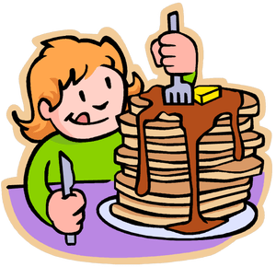
When, as soon as, unless, until and before.

Slide 2

“CONJUNCTIONS”

Slide 3
Remember:
CONJUNCTIONS connect TWO sentences.

Slide 4
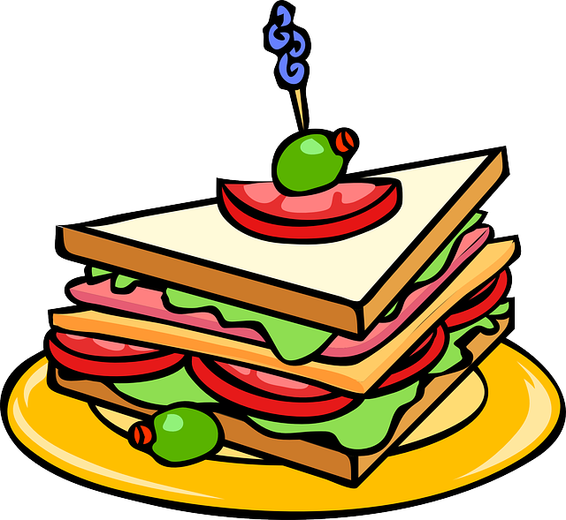
when

Slide 5
We use when as a conjunction meaning ‘at the time that’

Slide 6
When I was young, there were no houses here.
Nobody spoke when she came into the room.
ABOUT THE FUTURE:
When I graduate, I will look for a nice job.
When she gets a new phone, she will call him.

Slide 7

UNLESS

Slide 8
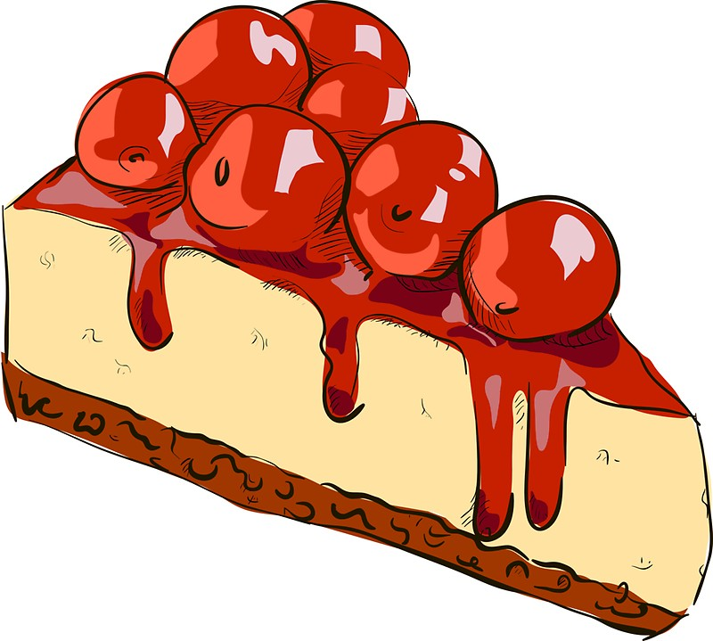
Unless means the same as if...not.

Slide 9
With If | Equivalent with Unless
You will be sick if you don't stop eating. | You'll be sick unless you stop eating.
I won't pay if you don't provide the goods immediately. | I won't pay unless you provide the goods immediately.
If you don't study diligently, you'll never understand trigonometry. | Unless you study diligently, you'll never understand trigonometry.

Slide 10

as soon as…

Slide 11
We use as soon as to show that something happens immediately, i.e. ‘at the very moment another action is completed’, or ‘shortly after another action is completed’.

Slide 12
I’ll call you as soon as I arrive.
[= ‘I will arrive and then I’ll call you immediately.’]
As soon as I have the information, I’ll tell you.
[= ‘I’ll get the information and then I’ll tell you immediately.’]

Slide 13
As soon as I will . . .
We do not use will with as soon as when speaking about the future:

Slide 14
I’m going to have a shower as soon as I will get home.
He will be back tomorrow; I’ll give him the message as soon as I will see him.

Slide 15
NOTE:
Use the SIMPLE PRESENT after these conjunctions.

Slide 16
As soon as I get home,…
When we see you,…
Unless you give a ride,…
Before you leave,…
Until she studies,…

