Slide 1
WEEKEND ACTIVITIES

Slide 2
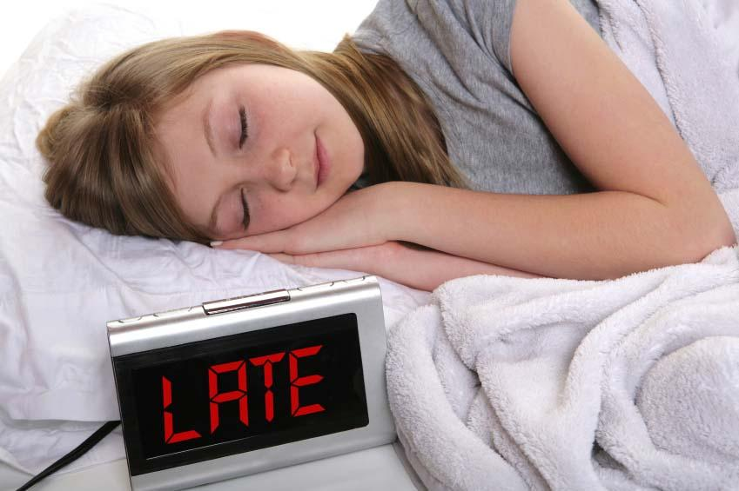
GET UP LATE

Slide 3

Go shopping

Slide 4

Go out/ hang out

Slide 5
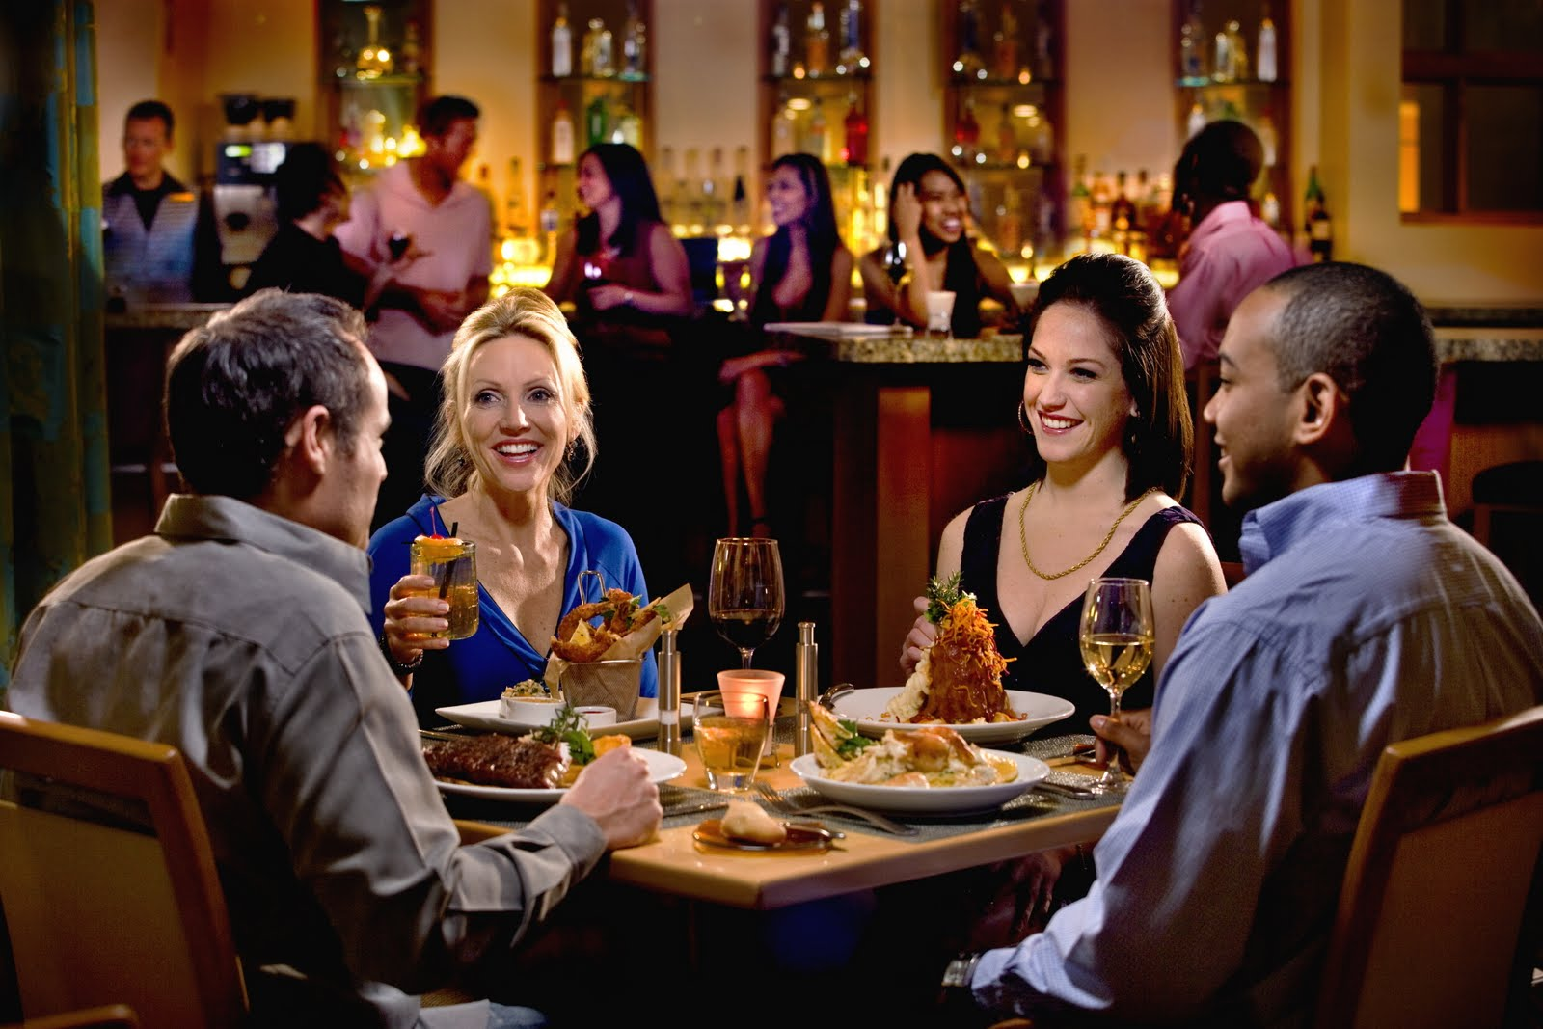
Go out to eat

Slide 6
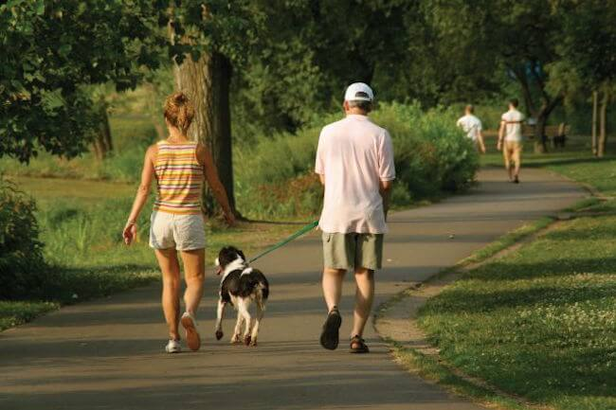
Go for a walk

Slide 7

Go to the movies

Slide 8
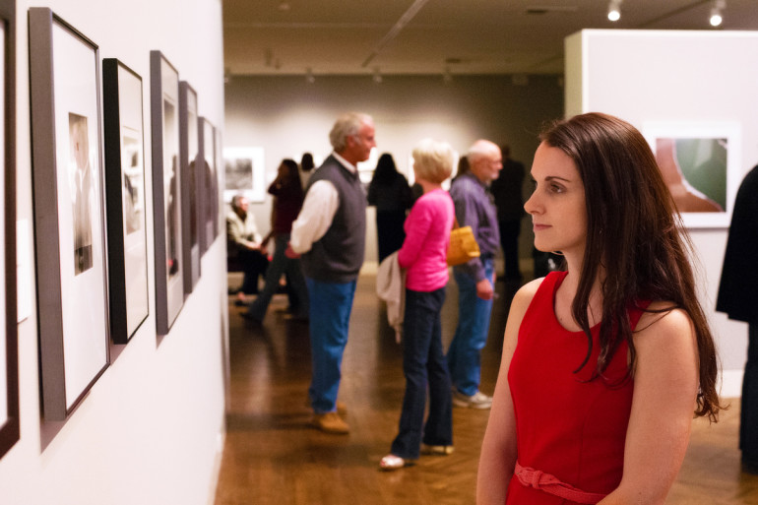
Go to the museum

Slide 9
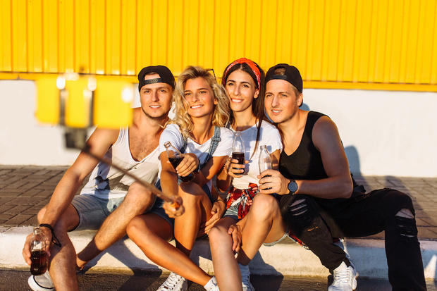
Meet friends

Slide 10
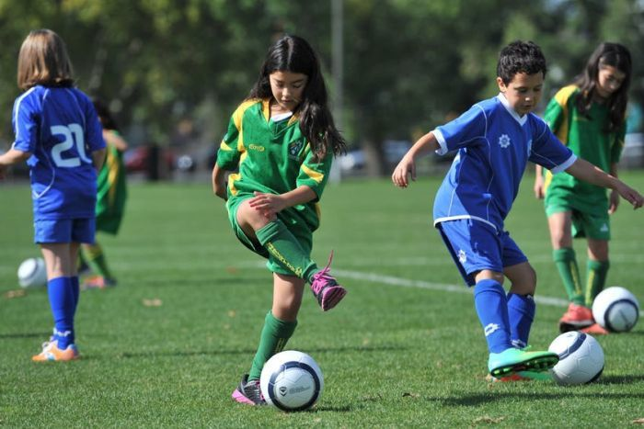
Play soccer

Slide 11
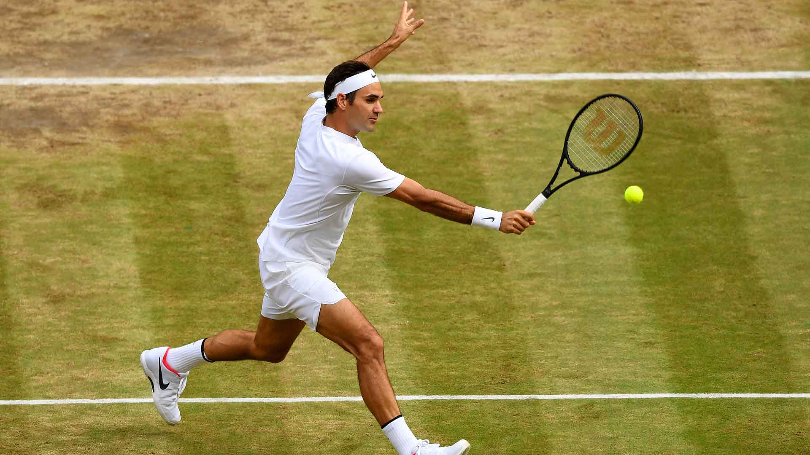
Play tennis

Slide 12

Read the newspaper

Slide 13
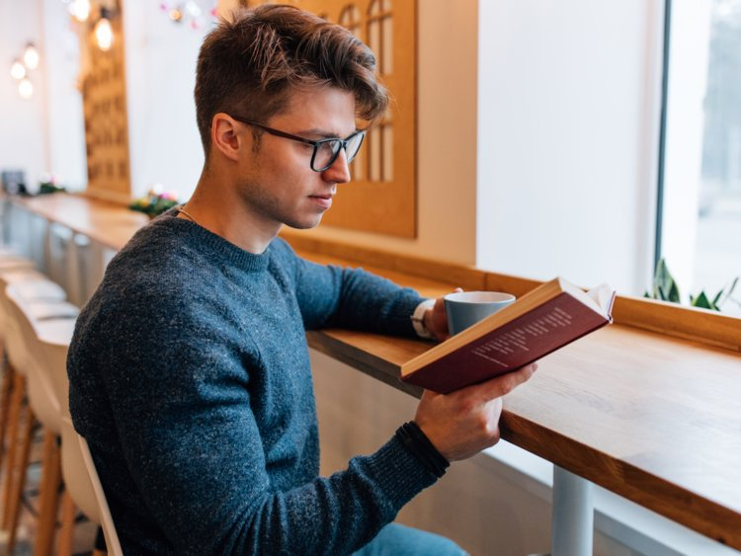
Read a book

Slide 14
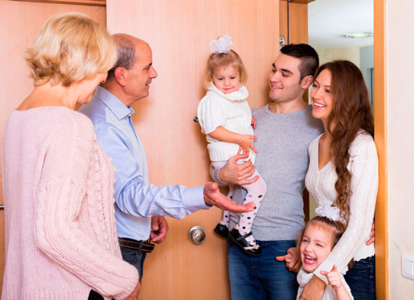
Visit family

Slide 15
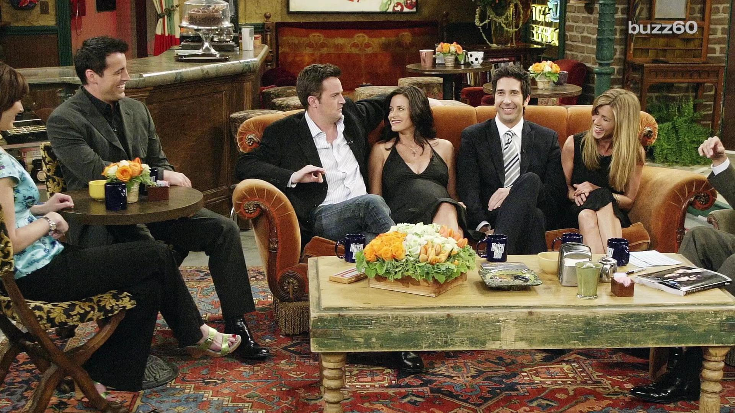
Visit friends

