Slide 1
REPORTED SPEECH

Slide 2
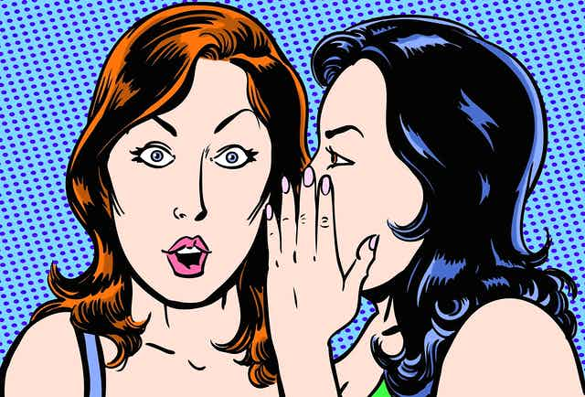
TO SAY WHAT OTHER PEOPLE SAID Or told you.

Slide 3
We use these verbs in the reported speech: Tell told say said ask asked

Slide 4
REPORTED SPEECH STATEMENTS

Slide 5

Direct message | Reported speech
MARIO: I LOVE APPLES. MARIO: I DON’T LOVE APPLES. | MARIO SAID (THAT) HE LOVED APPLES. MARIO SAID THAT HE DIDN’T LOVE APPLES.
3. KEYLA: I AM TAKING A CLASS NOW. 4. KEYLA: I AM NOT TAKING A CLASS. | SHE TOLD US (THAT) SHE WAS TAKING A CLASS. SHE TOLD US THAT SHE WASN’T TAKING A CLASS.
5. OSCAR: I ATE BREAD IN THE MORNING. 6. OSCAR: I DIDN’T EAT BREAD IN THE MORNING. | HE TOLD US THAT HE HAD EATEN BREAD THAT… HE TOLD US THAT HE HADN’T EATEN BREAD…
7. EYMI: MY FRIENDS AND I HAVE EXERCISED. 8. SHE: MY FRIENDS AND I HAVEN’T EXERCISED. | SHE SAID THAT HER FRIENDS AND HER HAD EXERCISED. SHE SAID THAT THEY HADN’T EXERCISED.
9. CIRO: I WILL GO TO THE CHURCH. 10. HE: I WON’T GO TO THE CHURCH. | HE SAID THAT HE WOULD GO TO THE CHURCH. HE SAID THAT HE WOULDN’T GO TO THE CHURCH.
11. MAGDIEL: I AM GOING TO HELP MUM… 12. HE : I AM NOT GOING TO HELP MUM… | HE SAID THAT HE WAS GOING TO HELP MUM… HE SAID THAT HE WASN’T GOING TO HELP MUM…

Slide 6
modals
JOSUE: I CAN PLAY VIDEO GAMES. | HE SAID THAT HE COULD PLAY VIDEO GAMES.
JOSE: I MAY GO TO THE MALL TODAY. | HE TOLD CIRO THAT HE MIGHT GO TO THE MALL.
MARIO: MY WIFE HAS TO CLEAN THE HOUSE. | HE TOLD US THAT HIS WIFE HAD TO CLEAN THE HOUSE.
ISIS: MY CHILDREN MUST DO THE HMWK. | SHE SAID THAT HER CHILDREN HAD TO DO THE HWMK.

Slide 7
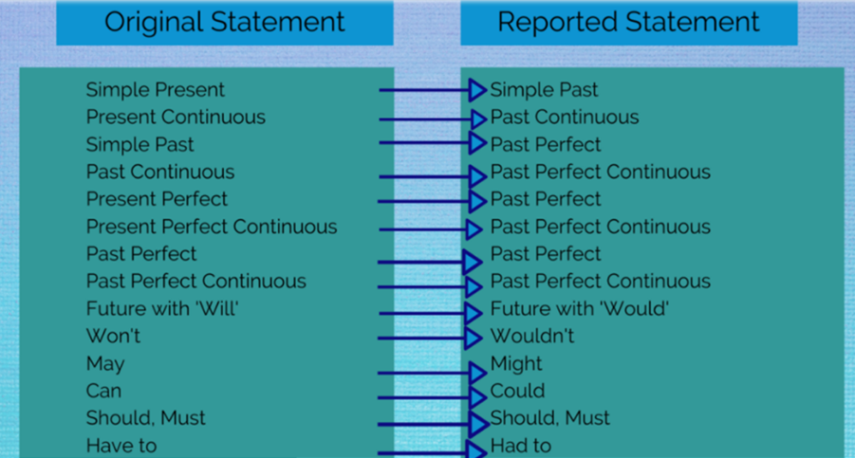

Slide 8
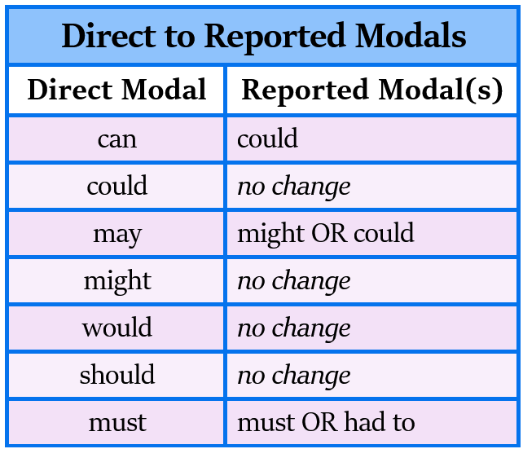

Slide 9
VOCABULARY UNIT 11

Slide 10
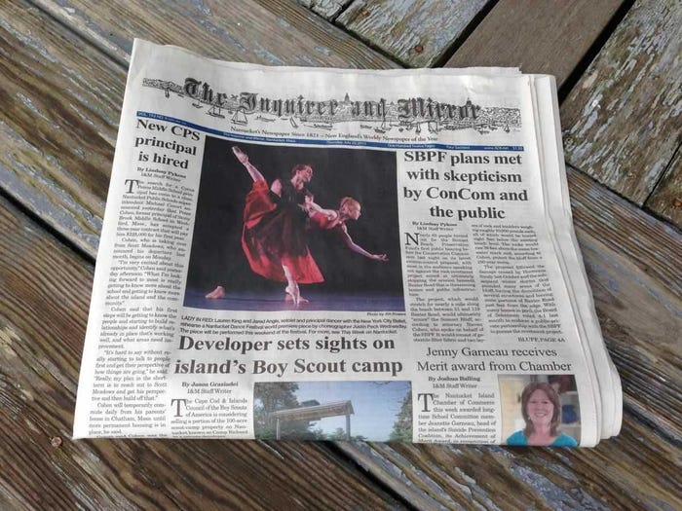
A NEWSPAPER

Slide 11
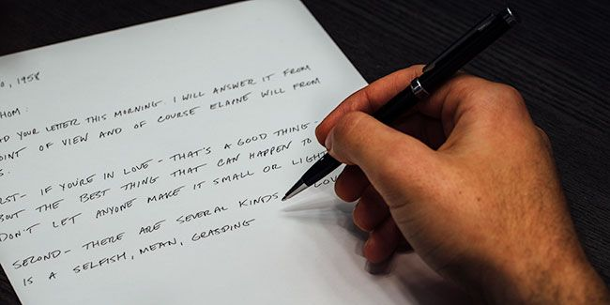
A letter

Slide 12

A card

Slide 13
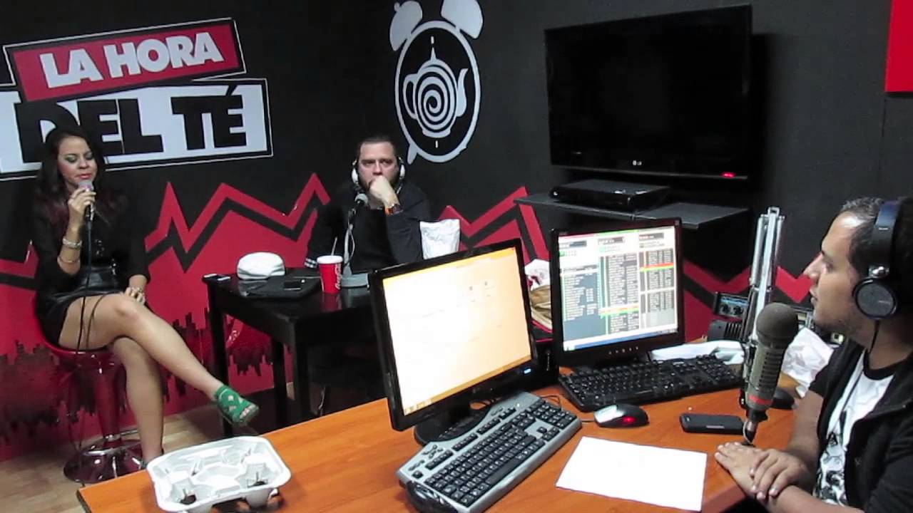
A radio program

Slide 14
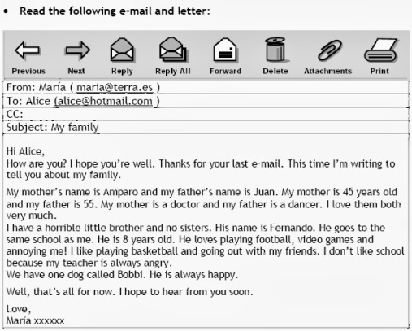
An email

Slide 15

A sticky note

Slide 16
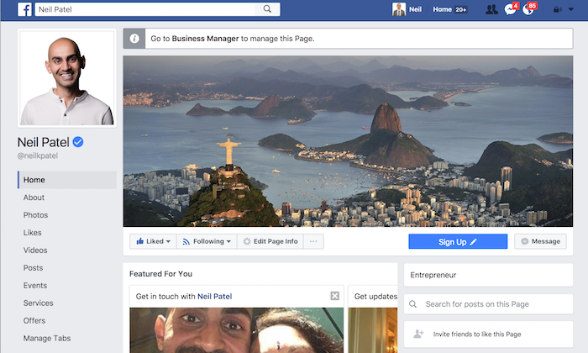
A Facebook page

Slide 17
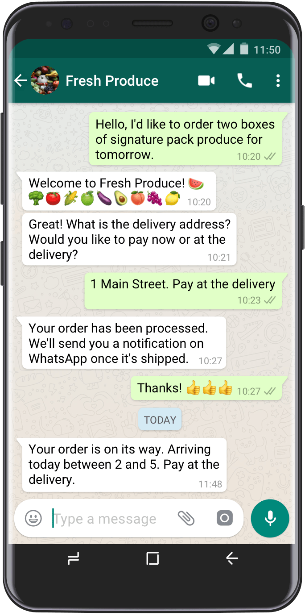
A WHATSAPP MESSAGE

Slide 18
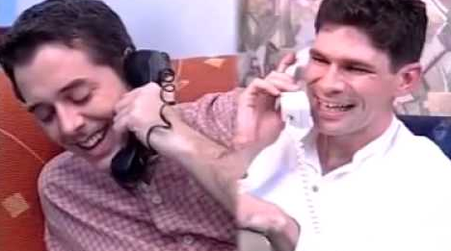
A PHONE CONVERSATION

Slide 19
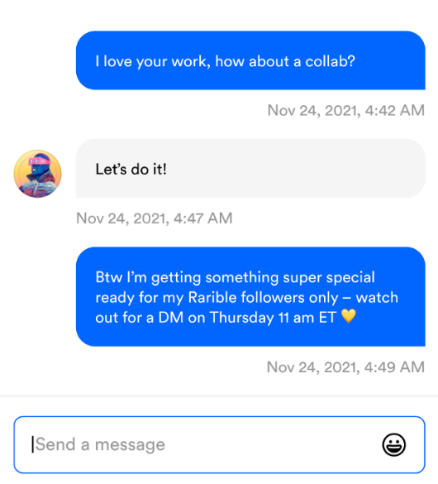
A dm (direct message)

