Slide 1
VOCABULARY UNIT 9

Slide 2
Vacation
destinations

Slide 3

CHECK IN

Slide 4

TIP

Slide 5

Stay at a hotel

Slide 6
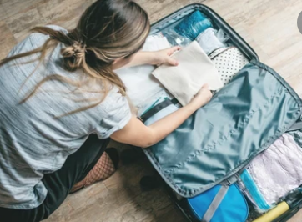
Pack our bags

Slide 7
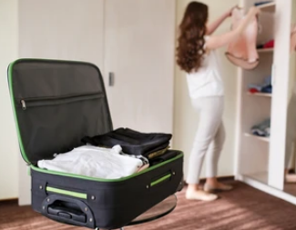
Unpack our bags

Slide 8

Rent a car

Slide 9
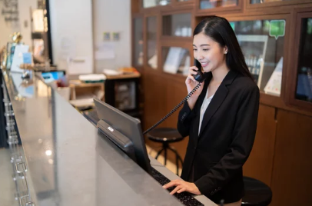
Call reception

Slide 10

Go overseas

Slide 11
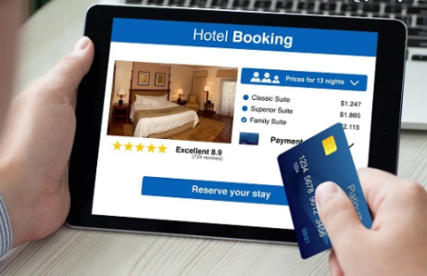
Book a hotel

Slide 12
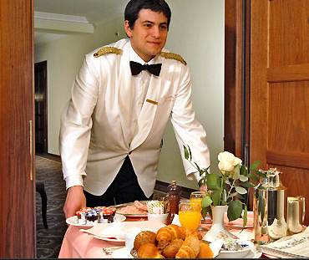
Room service

