Slide 1
VERB TO BE
Mr. Alexis Baca

Slide 2
VERB TO BE
Subject Pronouns | VERB BE (am, is, are)
I | AM
YOU | ARE
HE | IS
SHE | IS
IT | IS
WE | ARE
THEY | ARE

Slide 3
VERB TO BE
SINGULAR | PLURAL
I AM | WE ARE
YOU ARE | YOU ARE
HE, SHE, IT IS | THEY ARE

Slide 4
VERB TO BE (contractions)
SUBJECT PRONOUN + VERB BE | CONTRACTION
I AM | I’M
YOU ARE | YOU’RE
HE IS | HE’S
SHE IS | SHE’S
IT IS | IT’S
WE ARE | WE’RE
THEY ARE | THEY’RE

Slide 5
VERB TO BE (Positive Sentences)
Subject Pronoun | Verb To Be | Nationality
I | am | Honduran
You | are | Mexican
She | is | American
He | is | Spanish
It | is | French
We | are | Germans
They | are | Italians

Slide 6
VERB TO BE (Negative Sentences)
Subject Pronoun | Verb To be | Not | Nationality
I | am | not | Honduran
You | are | not | Mexican
She | is | not | American
He | is | not | Spanish
It | is | not | French
We | are | not | Germans
They | are | not | Italians

Slide 7
VERB TO BE (Yes/no Questions)
Verb To Be | Subject Pronouns | Nationality | ?
Am | I | Honduran | ?
Are | You | Mexican | ?
Is | She | American | ?
Is | He | Spanish | ?
Is | It | French | ?
Are | We | Germans | ?
Are | They | Italians | ?

Slide 8
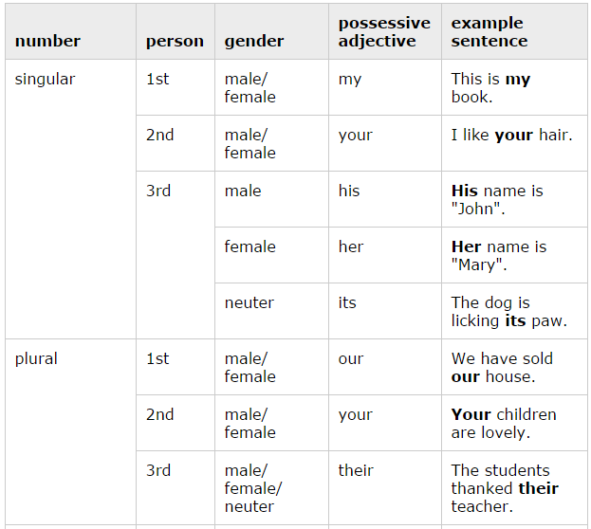
POSSESSIVE ADJECTIVES

