Slide 1
VACATIONS.

Slide 2
WHERE TO GO

Slide 3
-ING AND –ED WORDS CAN BE ADJECTIVES.

Slide 4
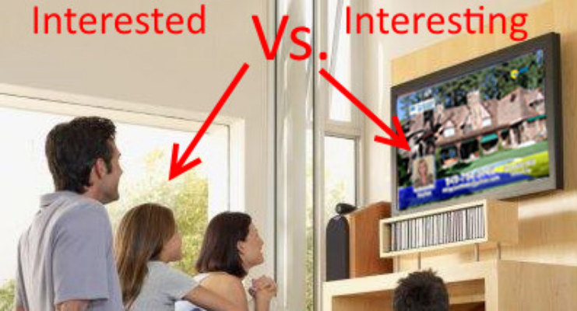

Slide 5
-ING | -ED
INTERESTING | INTERESTED
AMAZING | AMAZED
TIRING | TIRED
BORING | BORED
RELAXING | RELAXED
TOUCHING | TOUCHED
ANNOYING | ANNOYED
EMBARRESSING | EMBARRASSED

Slide 6
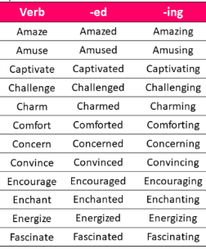
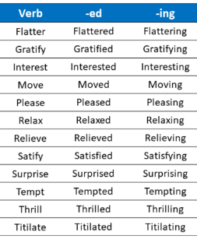

Slide 7
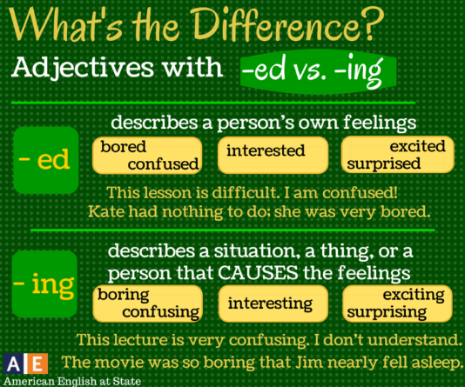

Slide 8
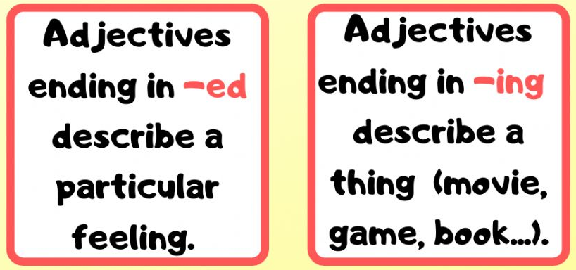

Slide 9
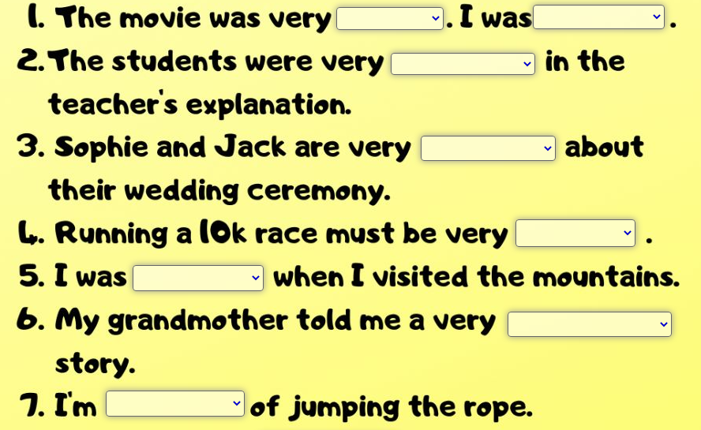

Slide 10
EXAMPLES (-ED)
I feel so frustrated because I didn’t pass my class.
The children are tired. They went to bed very late last night.
We are going to Orlando this Summer. We are so excited about the trip.
Isis saw her ex boyfriend last night. She was really irritated.
Henry is amazed with the new Project.

Slide 11
EXAMPLES (-ING)
1. I don’t like to listen to Shakira. Her music is irritating.
2. This weather is so fascinating. The sun is shining and the sky is great.
3. Carlos received some surprising news today. Apparently, he won the lottery.
4. The report they sent to me, wasn’t so convincing.
5. I think my History teacher is very boring.
https://www.youtube.com/watch?v=S53pWjyNj04

