Slide 1
USED TO
Habitual Past

Slide 2
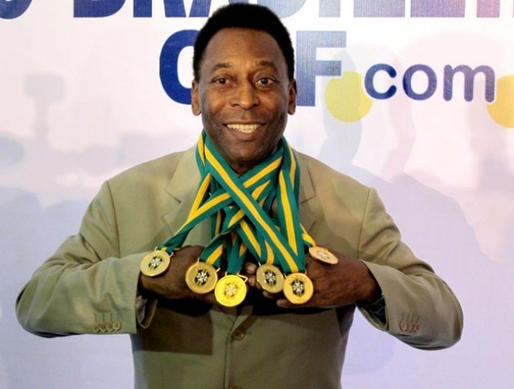
PELE
Pele used to play soccer really well.
He didn’t use to do drugs.

Slide 3
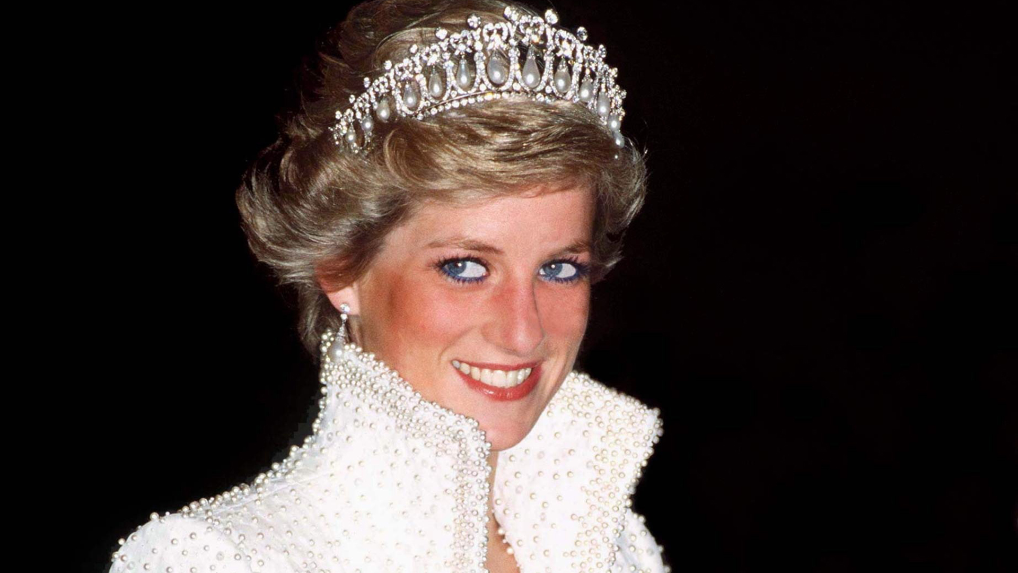
LADY DIANA
She used to be a good person.
She used to be married to Carlos.

Slide 4
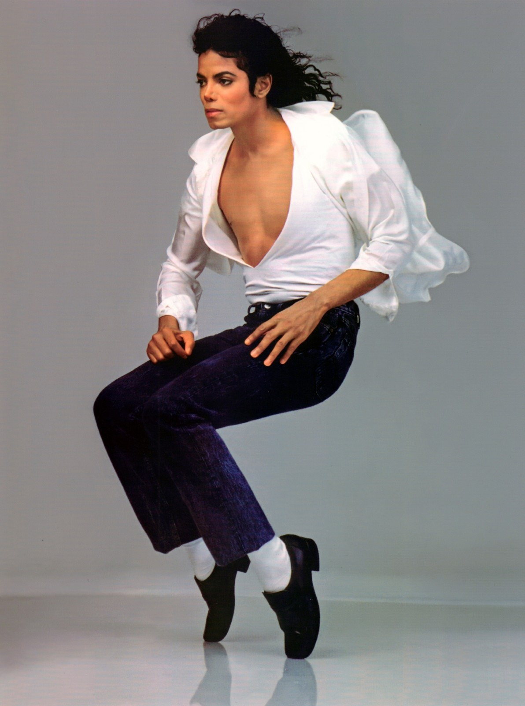
MICHAEL JACKSON
He used to sing pop music.
He didn’t use to sing Bachata.

Slide 5
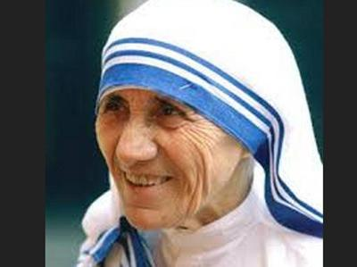
MOTHER TERESA
She used to help people in need.
She didn’t use to ignore people.

Slide 6
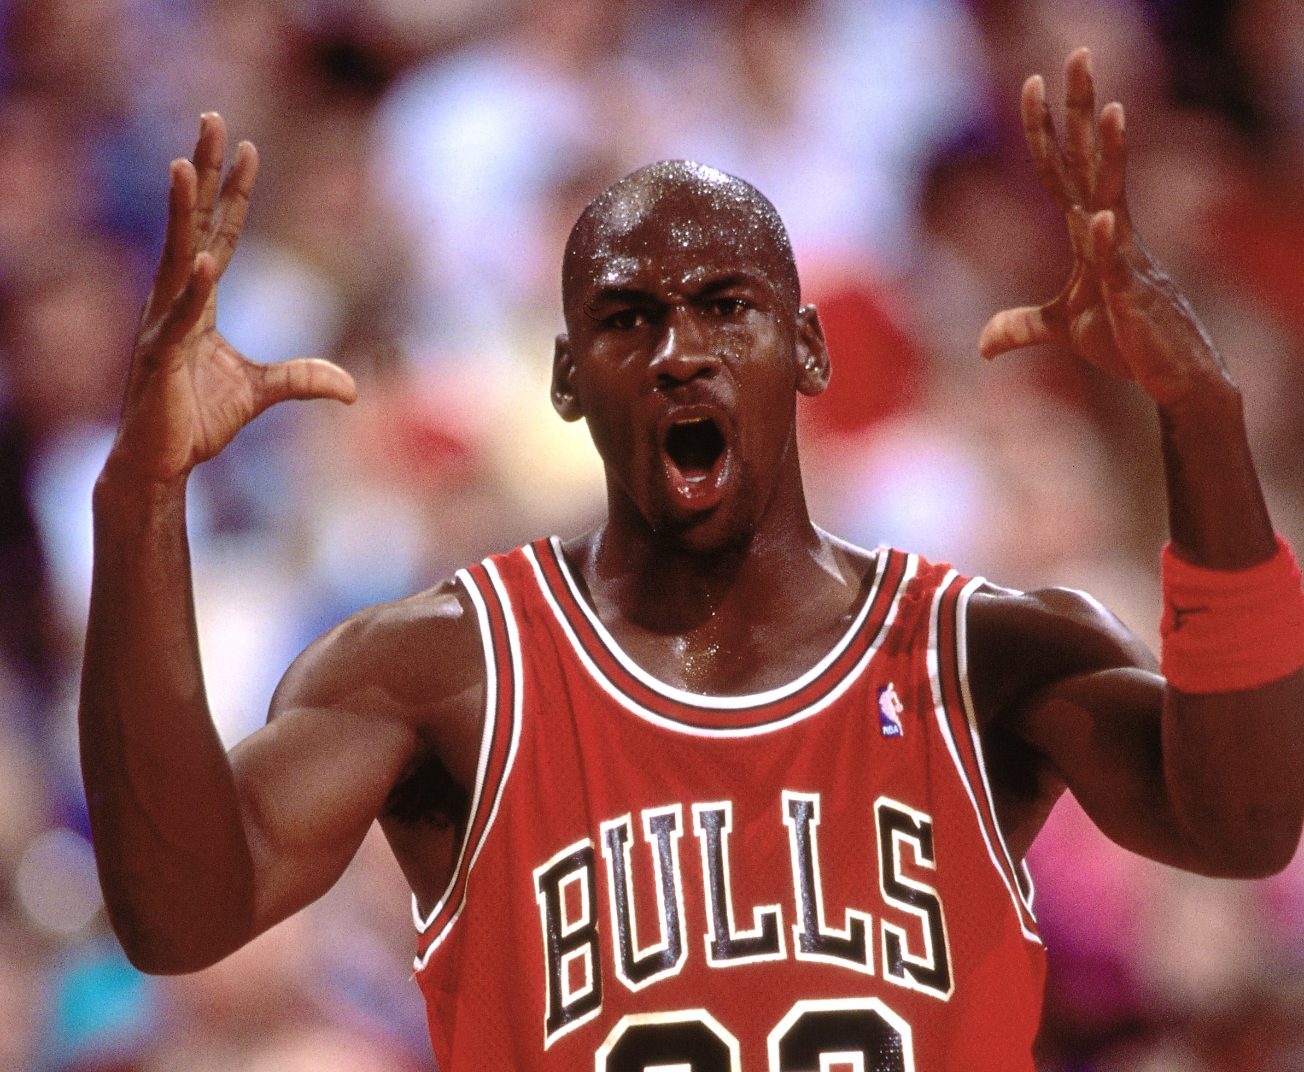
MICHAEL JORDAN
He used to play basketball.
He didn’t use to play soccer.

Slide 7
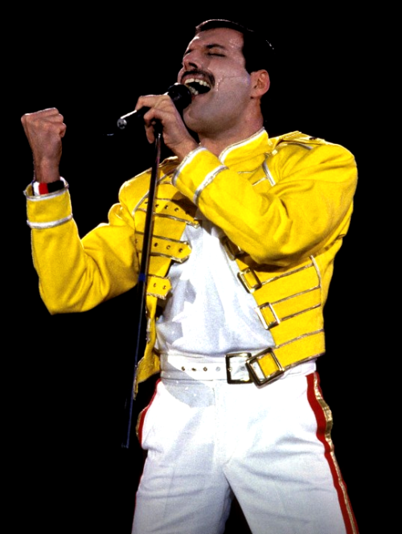
FREDDIE MERCURY
He used to sing with “Queen”.
He didn’t use to sing la Gasolina.

Slide 8
Positive sentences.
I
You
He
She used to watch The Transformers.
It
we
they

Slide 9
NEGATIVE SENTENCES.
I
You
He
She didn’t use to watch The Transformers.
It
we
they

