Slide 1
UNIT 9 REVIEW
ENTERTAINMENT

Slide 2
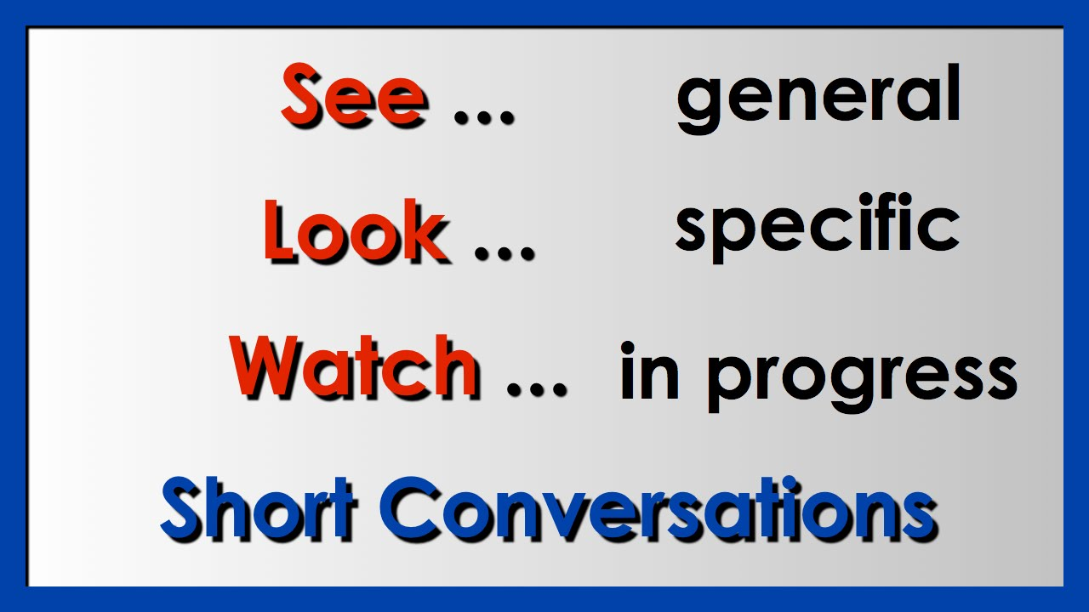
SEE-LOOK-WATCH look, watch, and SEE are usually used when you are talking about paying attention to what you see

Slide 3
SEE=visit=can
I can see a cat in the window.
“See” means to notice or become aware of someone or something by using your eyes. Can also mean to visit.
She will see the doctor today.

Slide 4
LOOK
I can see a cat in the window.
“Look” means to direct your eyes in a particular direction. Look is used to say something about where you are directing your attention.
Look! The bus is coming!
She looked at the bill before she paid it.
Don´t look down while dancing.

Slide 5
WATCH
Watch is used to say that you are paying attention to something by looking at it for a period of time.
I’m going outside for a minute. Would you please watch my bag? (The friend wants you to pay attention to the bag for a period of time)
We will watch the game on TV. (Movement and attention)

Slide 6
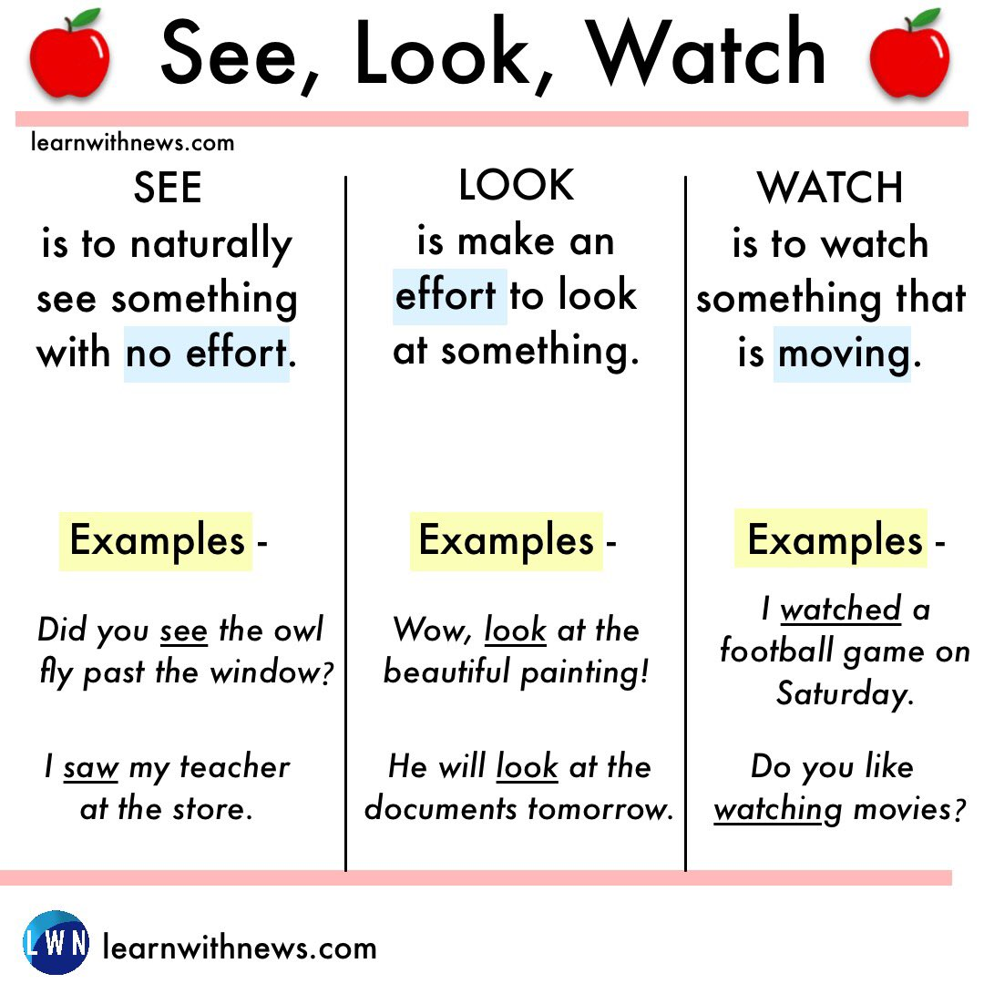
summary
SEE
LOOK
WATCH

Slide 7
APPLICATION
Susana sees the sun coming in through the window and knows it is morning. [=she notices the sunlight with her eyes]
Susana looks towards the window because she wants to know if it is morning yet. [=she directs her attention towards the window]
Susana watches the sun come up in the morning. [=she pays attention to the rising sun for a period of time]

Slide 8
PRACTICE
SEE-LOOK-WATCH

Slide 9
CHOOSE THE CORRECT FORM
I _________a little bird on top of the tree.
Tom _________ at the picture and smiled.
Sarah ________ her sister dancing all night long.
We are going to _______ a new movie next week.
They will _______ their favorite series tonight.
Did you ever ________ the live concert of Michael J?
Alicia __________ James last week.
I want to _______ my family and friends soon.
Have you ________ TV all night long?
Have you ________ Manuel today?
Have you ________ at the new teacher?

Slide 10
Will vs going to
FUTURE TENSE

Slide 11
WILL=immediate decisions
Will is used to express future actions decided at the moment of speaking. Without planning it.
I will take a plane to Hawaii.
I will marry that man!

Slide 12
WILL=PERSONAL OPINION
Will to express opinion without having evidence, a prediction.
She will say “yes” to José.
Manchester will win the game.

Slide 13
WILL=FUTURE FACT
Will to express a future fact. A command!
The sun will rise tomorrow.
You will take that test!

Slide 14
GOING TO
FUTURE TENSE

Slide 15
GOING TO=FUTURE PLANS
Express future plans decided before the moment of speaking.
I am going to study for this test today.
She is going to take a bus home instead.

Slide 16
GOING TO=PREDICTION WITH EVIDENCE
Express a prediction with evidence.
Look at the sky! It is going to be a perfect day.
I woke up late. I am going to miss the plane!

Slide 17
GOING TO=OBVIOUS REASONS
Express or predict future events that are about to happen.
Luis is drunk. He is going to be kicked out of the bar.
We didn´t study for the test. We are going to fail!

Slide 18
INFINITIVES OF PURPOSE
TO AND FOR

Slide 19
Infinitives of Purpose We can use to + infinitive to say why we do something. it tells the other person the reason. We need to have a normal verb as well
EXAMPLES:
I went on a holiday to relax.
I went on holiday (this is what I did) to relax (this is why I did it).
I studied all night to pass the test
. We use “to”+ infinitive. TO goes before a VERB.
we need to we need to use ‘to + infinitive’. we need to use ‘to + infinitive’.to use ‘to + infinitive’.

Slide 20
FOR+ infinitive=for before a noun
EXAMPLES:
I went to the shop for milk. / I went to the shop to buy milk.
Manuel drove his car for pleasure. / Manuel drove his car to feel pleasure.
He ate his lunch for satisfaction. / He ate his lunch to feel satisfied.
Mom made this cake for Karla´s birthday. / Mom made this cake to celebrate Karla´s birthday
FOR + A NOUN

Slide 21
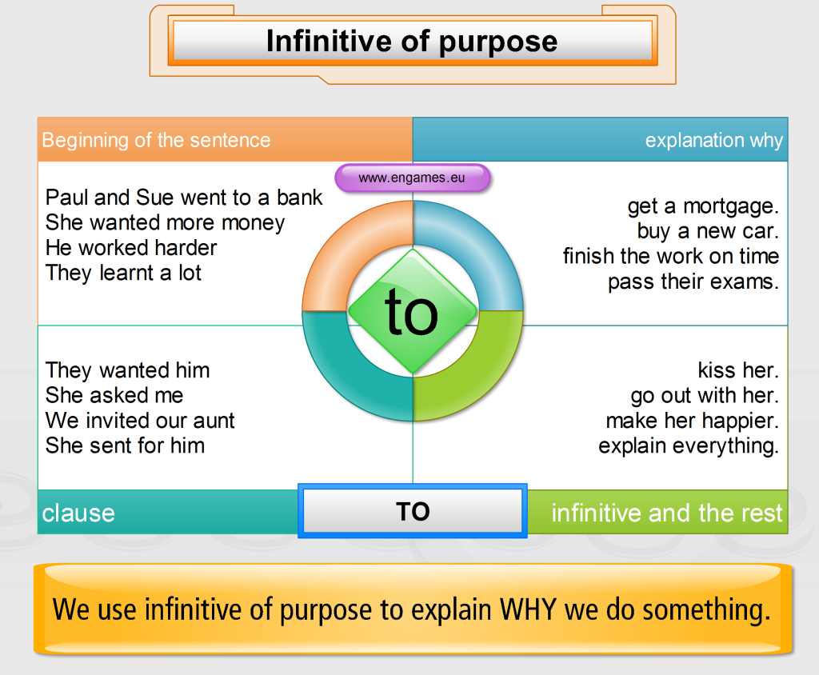
LET´S PRACTICE
TO + INFINITIVE VERB

Slide 22
FOR + NOUN
FOR + NOUN
She went to the mall for a dress. (to buy a dress)
We will open the bottle for the celebration. (to celebrate)
They entered the class for knowledge. (to learn new things)
Isabel washed her face for a good hygiene. (to get clean)
I wear sun block for protection. (to protect my skin)
INFINITIVES OF INTENTIONS

