Slide 1
UNIT 6

Slide 2

BABY

Slide 3

ADOLESCENT

Slide 4

TEENAGER

Slide 5

CHILD

Slide 6

YOUNG ADULTS

Slide 7

MIDDLE AGED

Slide 8
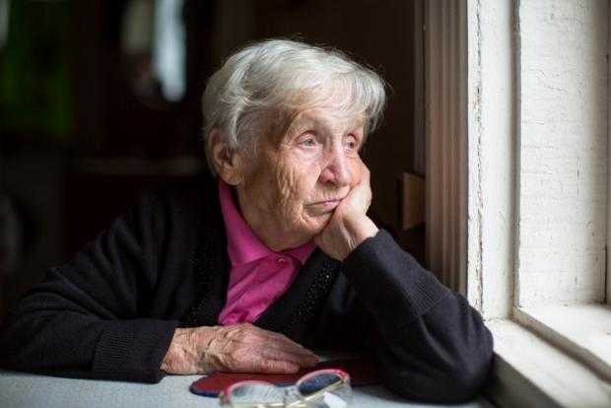
ELDERLY/ SENIOR

Slide 9

RETIRE

Slide 10
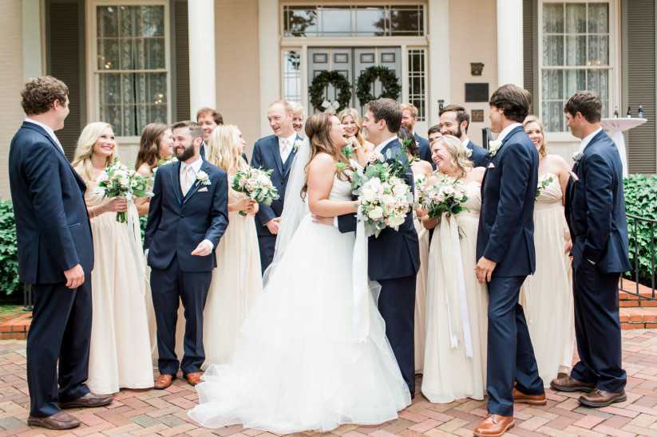
GET MARRIED

Slide 11

GET ENGAGED

Slide 12

START A FAMILY

Slide 13

GO TO COLLEGE

