Slide 1
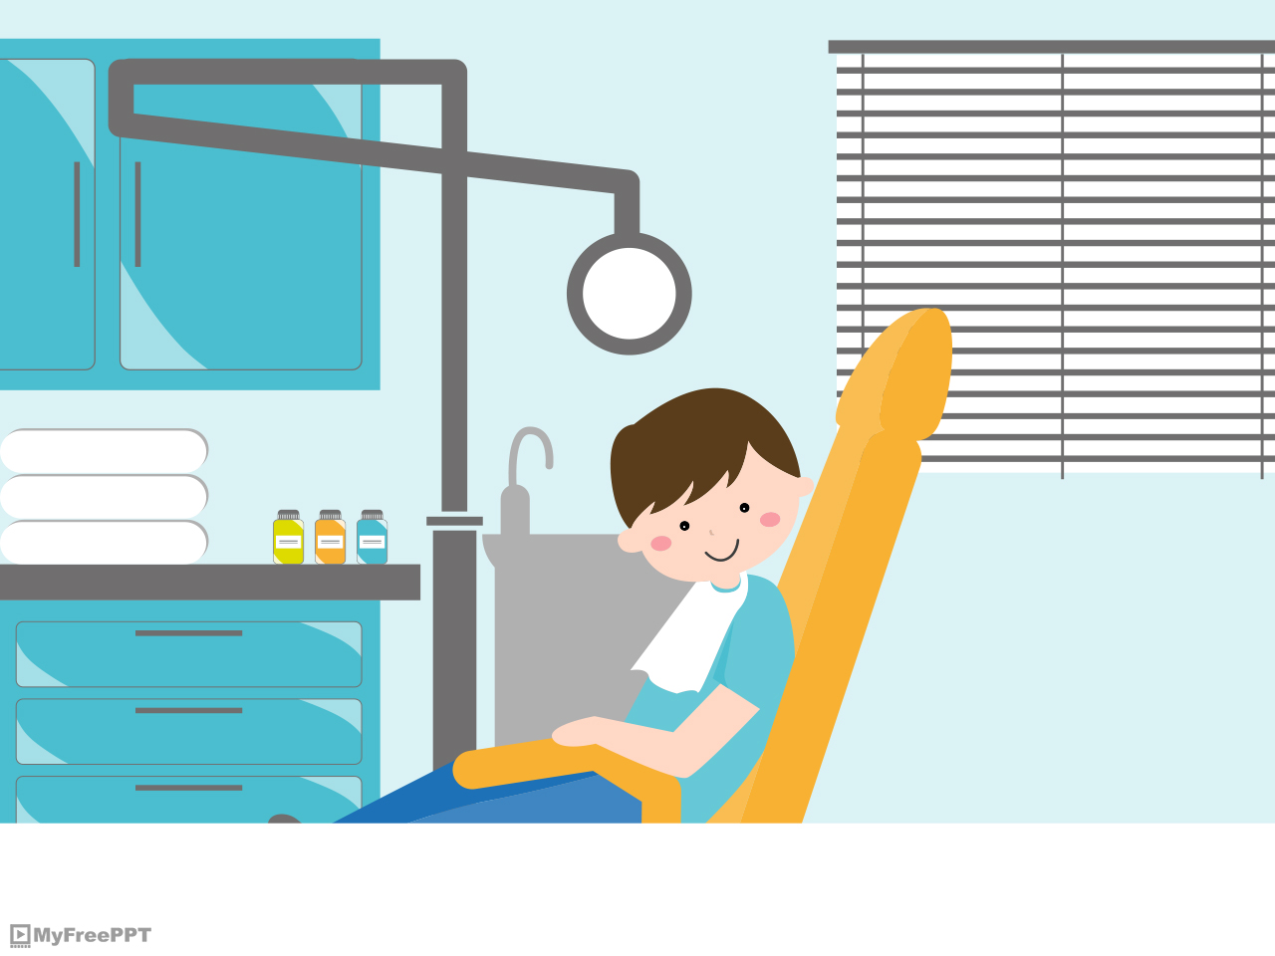
UNIT 5 LESSON C

Slide 2
HAVE / HAS

Slide 3
POSITIVE SENTENCES
I have
YOU
HE
SHE has a bike.
IT
WE have
THEY

Slide 4
NEGATIVE SENTENCES
I don’t have
YOU
HE
SHE doesn’t have a bike.
IT
WE
THEY don’t have

Slide 5
Complete the exercise

Slide 6
1. Jessy __________an Ipod.
2. Oscar __________a new car.
3. Rosa ___________a cat.
4. The students _________the textbooks.
5. The children __________many toys.
6. The classroom ________a computer.

Slide 7
1. I ___________a house.
2. The teacher _________classes today.
3. The doctor ________patients.
4. My room __________a big TV.
5. El Chapo _________money.

Slide 8
REALLY AND VERY

Slide 9
Really +++++
Very ++

Slide 10
«Really» and «very» are always before an ADJECTIVE.
1. Really good
adjective
2. Very interesting
adjective

Slide 11
REALLY
«It’s more relevant»
The house is really big.
Natalie Portman is really interesting.
Scarlett Johansson is really sexy.
This class is really quiet.
Latin people are really noisy.

Slide 12
VERY
«It’s more NEUTRAL»
The Catholic university is very big.
El Chavo is very stupid but Quico is more stupid.
Arnold Schwarzenegger is very tall. Jordan is taller.
Norma de Callejas is very elegant.
The English class is very boring.

