Slide 1
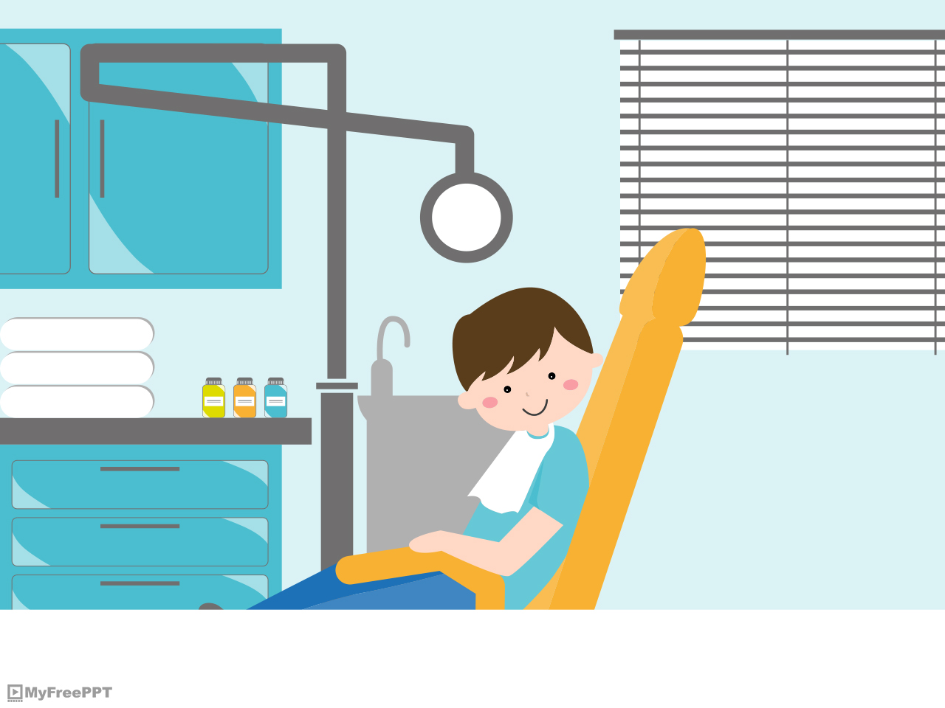
UNIT 5 LESSON C

Slide 2
HAVE / HAS

Slide 3
A. Do you have a car? B. Yes, I have a car./ No, I don’t have a car. A. Does Jhony have a dog? B. Yes, he has a dog. / No, he doesn’t have a dog.

Slide 4
A. What do you have? B. I have a big family. A. What does Emilio have? B. He has a BMW.

Slide 5
POSITIVE SENTENCES I have YOU HE SHE has a bike. IT WE have THEY

Slide 6
NEGATIVE SENTENCES I don’t have YOU HE SHE doesn’t have a bike. IT WE THEY don’t have

Slide 7
Complete the exercise

Slide 8
1. Jessy __________an Ipod. 2. Oscar __________a new car. 3. Rosa ___________a cat. 4. The students _________the textbooks. 5. The children __________many toys. 6. The classroom ________a computer.

Slide 9
1. I ___________a house. 2. The teacher _________classes today. 3. The doctor ________patients. 4. My room __________a big TV. 5. El Chapo _________money.

Slide 10
REALLY AND VERY

Slide 11
«Really» and «very» are always before an ADJECTIVE.
1. Really good
adjective
2. Very interesting
adjective

Slide 12
REALLY «It’s more relevant»
The house is really big.
Natalie Portman is really interesting.
Scarlett Johansson is really sexy.
This class is really quiet.
Latin people are really noisy.

Slide 13
VERY «It’s more NEUTRAL»
The Catholic university is very big.
El Chavo is very stupid but Quico is more stupid.
Arnold Schwarzenegger is very tall. Jordan is taller.
Norma de Callejas is very elegant.
The English class is very boring.

Slide 14
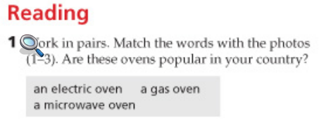
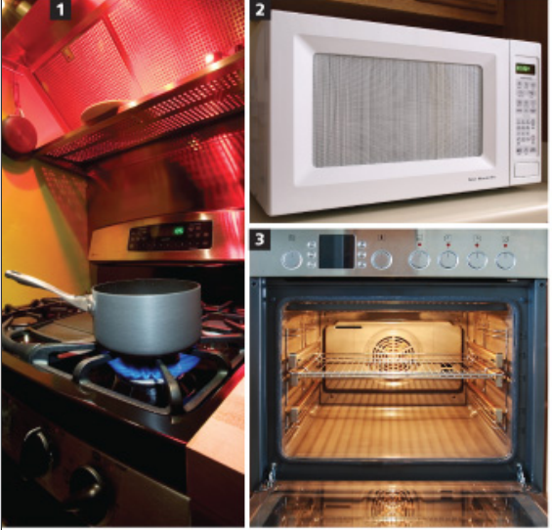
Textbook pag: 62

Slide 15
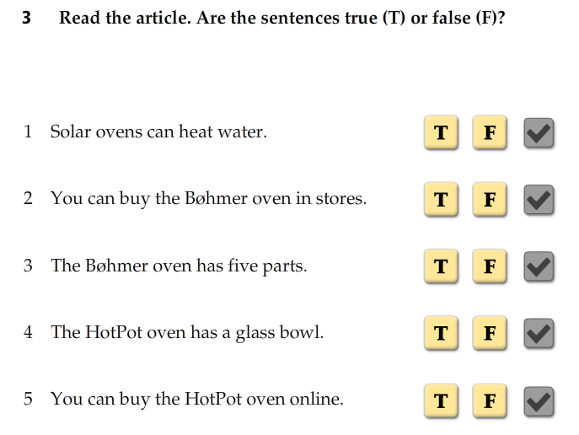

Slide 16
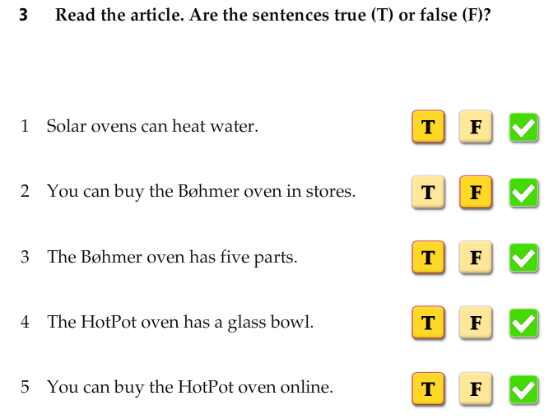

Slide 17
Listen to the prices:
80.00 18.00
45.00 25.00
140.00 114.00
25.00 35.00
6.00 16.00
70.00 17.00

