Slide 1
UNIT 2
LESSON E.

Slide 2
LISTEN AND CHECK THE WORDS I SAY.
1. ITV ATV
2. 17 70
3. UAE USA
4. 0118723459 0118623459
5. CNN CSN
6. BMW BMX
7. 50 15

Slide 3
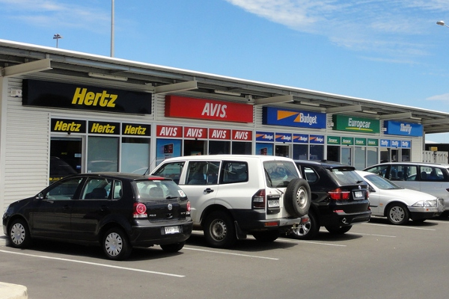
CAR RENTAL

Slide 4
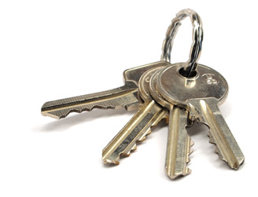
KEYS

Slide 5
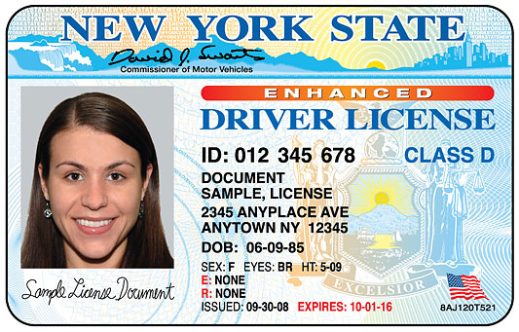
Drivers license

Slide 6
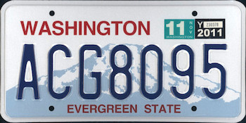
LICENSE PLATES

Slide 7
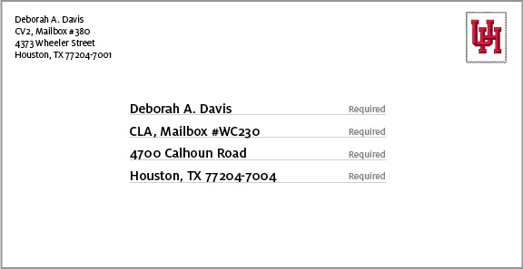
ADDRESS

Slide 8
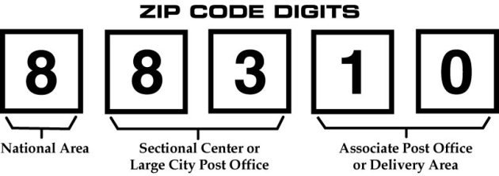
ZIP CODE

Slide 9
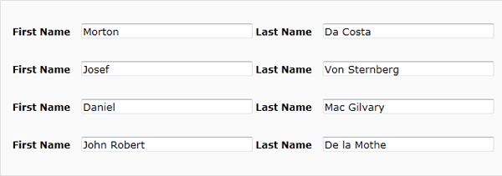
First name last name

Slide 10


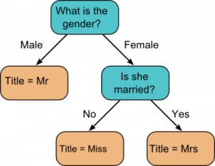
titles

Slide 11
