Slide 1
The Weather

Slide 2
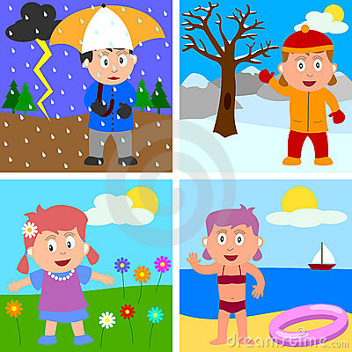
seasons

Slide 3





Slide 4
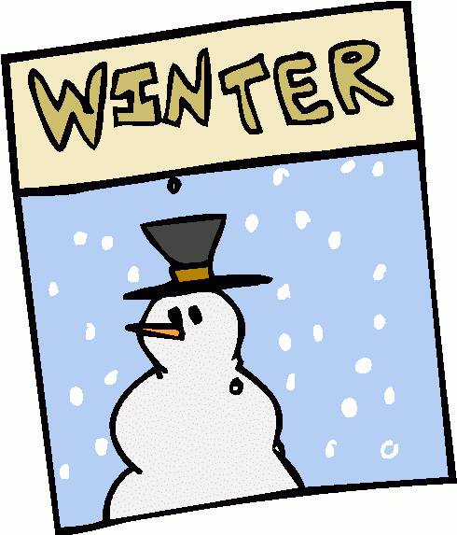


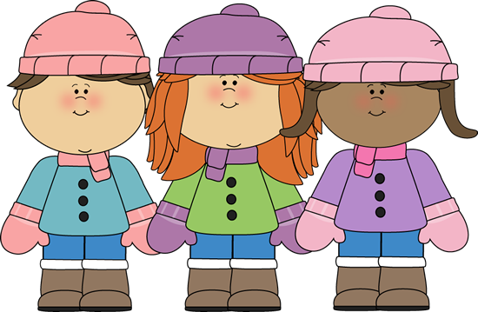

Slide 5





Slide 6





Slide 7

sunny

Slide 8
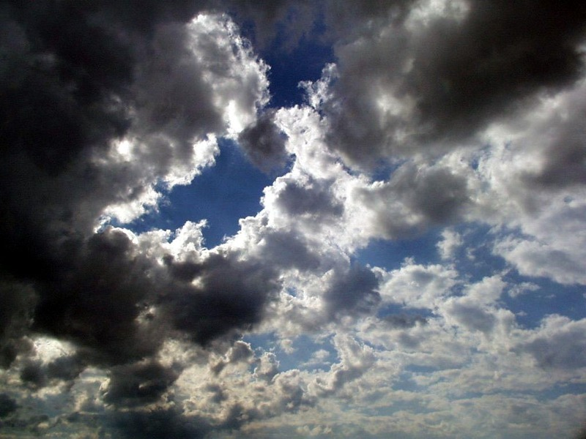
claudy

Slide 9
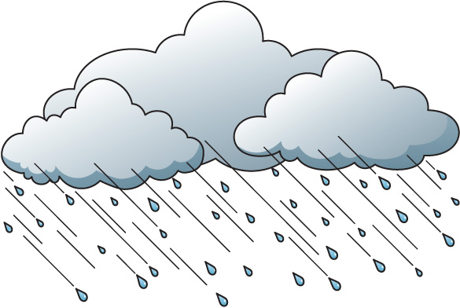
rainy

Slide 10

snowy

Slide 11

windy

Slide 12
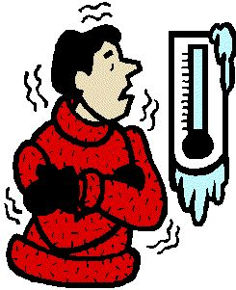
cold

