Slide 1
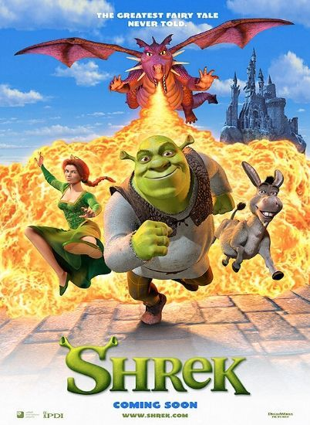
Shrek
Year of release: 2001
Genre: animated
Setting: a fantasy land in present time/undefined
Cast ( voices)
Shrek-Mike Myers
Donkey- Eddie Murphy
Princess Fiona-Cameron Díaz
Awards: Academy Award For Best Animated Feature
Worldwide box office: $484,409,218

Slide 2
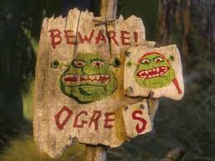
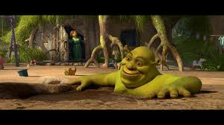
Plot
Shrek is a story about an ogre who lives in a swamp

Slide 3
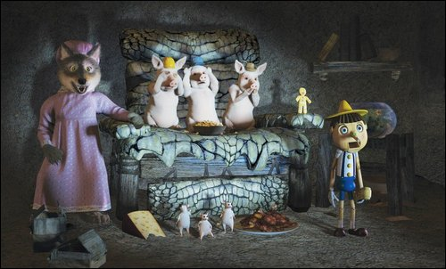
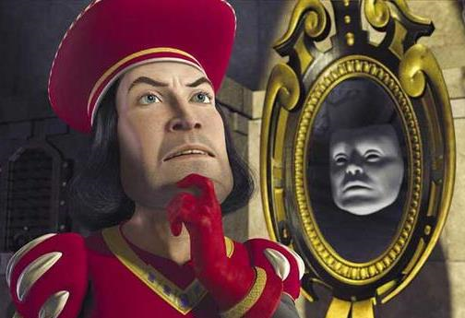
One day he finds out that fairy tale creatures had invaded his swamp. He complains about this with Lord Farquaad and they make a deal: if Shrek rescues his future wife, Princess Fiona; he will send the fairy tale creatures out his swamp.

Slide 4
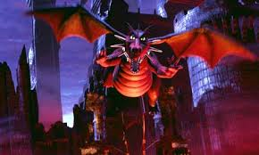
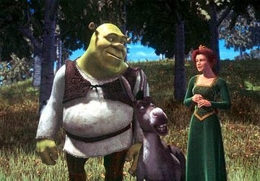
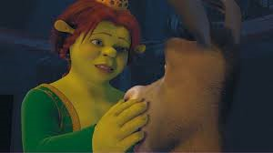
Shrek rescues Princess Fiona with the help of Donkey from the castle she was locked and guarded by a dragon. Donkey discovers that Fiona has a secret: She was cursed and at sunset she turns into an ogre and only her true love's kiss will return her to her "love's true form".

Slide 5
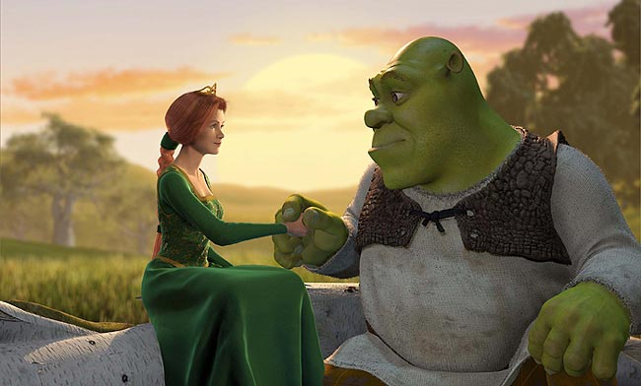
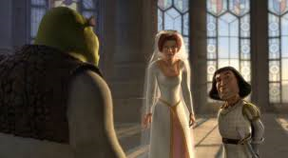
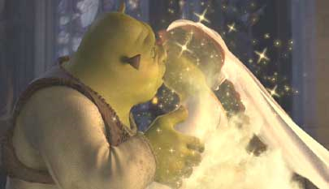
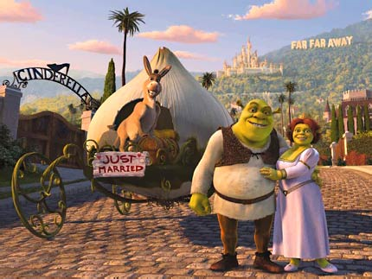
Shrek falls in love with Fiona. When Fiona is about to marry Lord Farquaad, Shrek interrups the wedding and kisses Fiona. The curse is broken, and Fiona remains an ogre. Shrek and Fiona get married and live happily ever after.

