Slide 1
Say hello
Hello! I’m Yolany.
What’s your name?
My name is/I’m __________.
Nice to meet you.
Nice to meet you too!
Greetings:
Hello/hi
Good morning. (5:00am to 11:59am)
Good afternoon (12:00 pm to 5:59 pm)
Good evening (6:00pm to :::::)
Good night (when we are leaving or going to bed)
Good bye/ bye/
A: How are you? /how’s it going?/how’s everything?
B: i’m ok , I’m sick, / so-so/ i’m pretty good. / I’m fine./fine thanks.

Slide 3
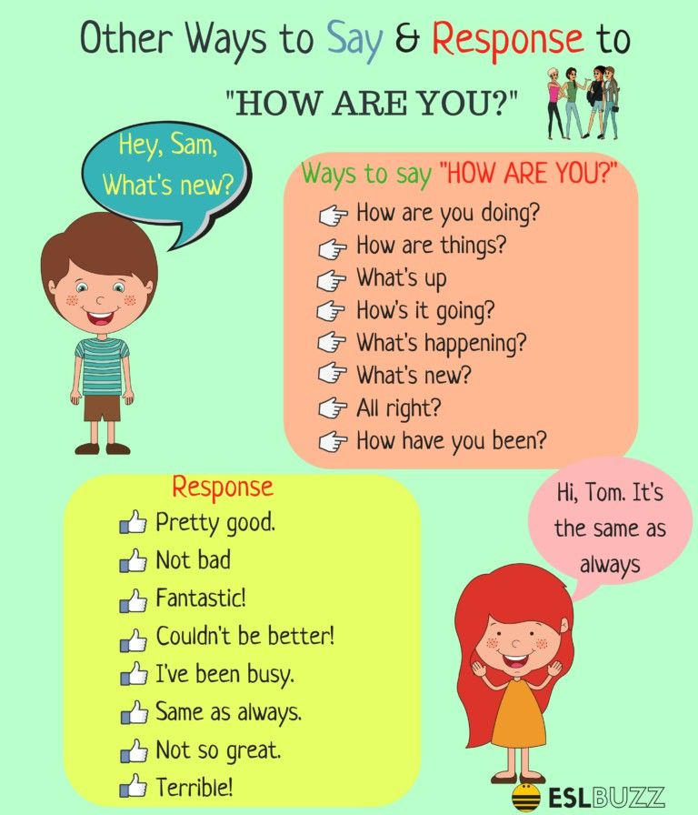

Slide 4
Personal information
Questions:
A: What’s your name?
B: My name is…
A: Where do you live?
B: I live in ….
A: What do you do?
B: I’m a …….
A: How old are you?
B: i´m (27 years old)
A: Are you married or single?
B: I’m (married/single)

Slide 5
VERB TO BE (am, is, are)
PRONOUN | AFFIRMATIVE | NEGATIVE | Y/N QUESTION
I | I AM (I’M) | I AM NOT (I’M NOT) | AM I …?
YOU | YOU ARE (YOU’RE) | YOU ARE NOT (YOU AREN’T) | ARE YOU….?
HE | HE IS (HE’S) | HE IS NOT (HE ISN’T) | IS HE…..?
SHE | SHE IS (SHE’S) | SHE IS NOT (SHE ISN’T) | IS SHE…..?
IT | IT IS (IT’S) | IT IS NOT (IT ISN’T) | IS IT…..?
THEY | THEY ARE (THEY’RE) | THEY ARE NOT (THEY AREN’T) | ARE THEY….?
WE | WE ARE (WE’RE) | WE ARE NOT (WE AREN’T) | ARE WE…..?

Slide 7
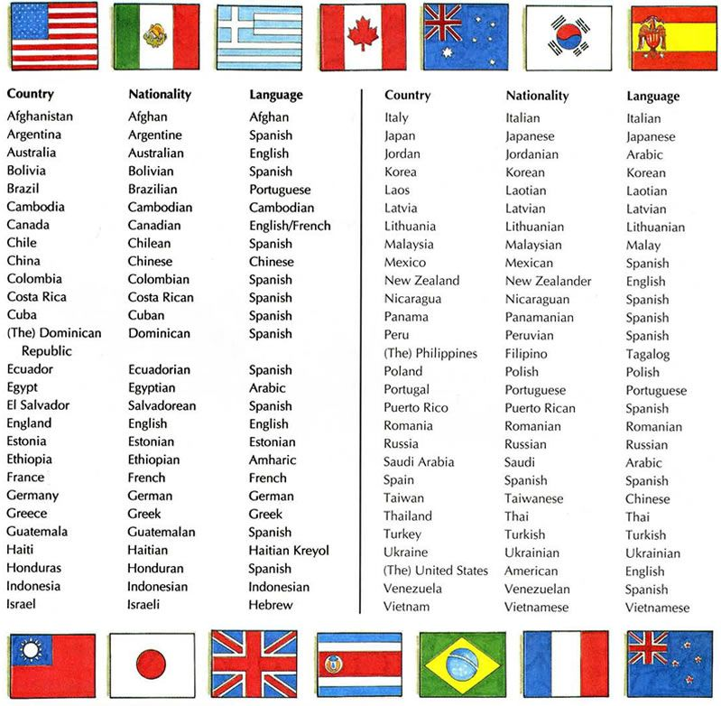
Countries Nationalities and languages.

