Slide 1
Presentation
Talk about a song you like

Slide 2
Guidelines
Choose a song you like in English
Talk about the performer or composer of that song
3. Give some general information about the song
4. Explain what the song is about and tell why you like it
5. Play an excerpt of the song

Slide 3
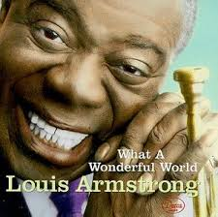
Sample Presentation
1. Choose a song you like in English:
What a Wondeful World by Louis Armstrong

Slide 4
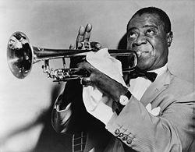
2. Talk about the performer or composer
Louis Armstrong was born in New Orleans, USA in 1901. He was an American jazz trumpeter, singer, and an influential figure in jazz music. Renowned for his charismatic stage presence and voice almost as much as for his trumpet-playing, Armstrong's influence extends well beyond jazz music, and by the end of his career in the 1960s, he was widely regarded as a profound influence on popular music in general.

Slide 5
3. Give some general information about the song
It was first recorded by Louis Armstrong and released as a single in 1967. The song was not initially a hit in the United States, where it sold fewer than 1,000 copies, but it was a major success in the United Kingdom, reaching number one on the UK Singles Chart. As of April 2014, Louis Armstrong's 1967 recording has sold 2,173,000 downloads in the US after it was released digitally.

Slide 6
4. Explain what is the song about and why you like it
Nowdays, people are obsessed with making money and so hung up with technology, that they have forgotten to enjoy nature and the company of family and friends. I like this song because it has a positive message and invites people to appreciate the simple things in life, which are free, by the way. There are many evils in this world, but there are so many beautiful things as well. After all, it’s a wonderful world!

Slide 7
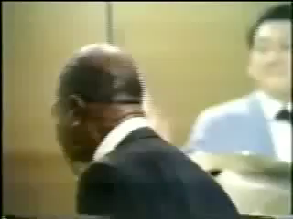
Play an excerpt of the song

