Slide 1
Present Perfect Tense
G 9.1

Slide 2
The Present Perfect Tense structure
Affirmative:
Subject + Have / Has + Past Participle
Negative:
Subject + Haven't / Hasn't + Past Participle
Question:
Have / Has + Subject + Past Participle

Slide 3
Affirmative Sentences
Subject | Have | Past Participle | Rest of the Sentence
I | have | studied | for the exam.
You | have | bought | a new computer.
He | has | eaten | my chocolate.
She | has | written | an e-mail.
It | has | been | cold this month.
We | have | won | the championship.
You | have | tried | to learn a lot.
They | have | forgotten | my birthday.

Slide 4
Contractions
The contracted form of the perfect tense is quite common:
We use contractions a lot when we are speaking.
Have | Contraction | Examples
I have | I've | I've spent all my money.
You have | You've | You've worn that dress before.
He has | He's | He's slept all morning.
She has | She's | She's lost her purse.
It has | It's | It's fallen off the wall.
We have | We've | We've chosen you for the job.
You have | You've | You've begun to annoy me.
They have | They've | They've drunk too much.

Slide 5
Negative Sentences
The contraction of the perfect tense in negative form is: Have not = Haven't Has not = Hasn't
Subject | Have | Past Participle | Rest of the Sentence
I | haven't | studied | for the exam.
You | haven't | bought | a new computer.
He | hasn't | eaten | my chocolate.
She | hasn't | written | an e-mail.
It | hasn't | been | cold this month.
We | haven't | won | the championship.
You | haven't | tried | to learn a lot.
They | haven't | forgotten | my birthday

Slide 6
Questions
Have | Subject | Past Participle | Rest of the Sentence
Have | I | been | chosen for the team?
Have | you | bought | a new car?
Has | he | eaten | my sandwich?
Has | she | written | the letter?
Has | it | started | on time?
Has | we | won | a trophy?
Have | you | kept | my secret?
Have | they | driven | there?

Slide 7
When do we use the Present Perfect Tense?

Slide 8
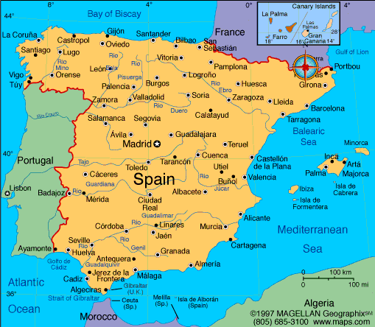
Unspecified point in the past
Example:
I have been to Spain three times.
(At some unspecified time in the past, I went to Spain).
Compare with the simple past:
I went to Spain three times in 2005.
(specified time in the past - the year 2005)

Slide 9

An action that occurred in the past, but has a result in the present (now)
Example
We can't find our luggage. Have you seen it?
(The luggage was lost in the past, do you know where it is now?)

Slide 10

Talking about general experiences (ever, never)
It usually refers to an event happening at some moment in your life.
Has she ever tried Chilean wine before?
(in her life)
I've never eaten monkey brains before.
(in my life)

Slide 11
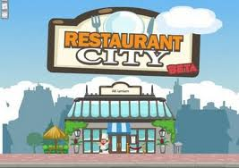
Events that recently occurred (just)
Do you want to go to a restaurant with me? No, thanks. I've just eaten lunch.
(I recently ate lunch.)

Slide 12
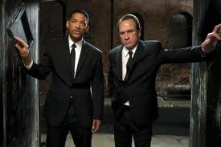
Events that have occurred up to now (yet)
Are Carlos and Rodrigo here?
No, they haven't arrived yet.
(they're still not here now)

Slide 13

Events that occurred before you expected (already)
I've already graduated from University.
(I expected to graduate at a later date.)

Slide 14
Events that began in the past and haven't changed (for, since)
Mike has worked at BAC for 3 years. (Mike started working at BAC 3 years ago and he still works there now.)
Julie has worked at BAC since September of last year. (Julie began working at BAC in September of last year, and that hasn't changed - she still works here now.)

