Slide 1
Possessive Adjectives
G 1.4

Slide 2
What is their job?
Possessive adjectives are used to show possession or ownership of something.
While we use them when we refer to people, it is more in the sense of relationship than ownership.

Slide 3
The possessive adjectives in English are as follows:
Subject | Possessive Adjective
I | My
You | Your
He | His
She | Her
It | Its
We | Our
You (pl) | Your
They | Their

Slide 4
The possessive adjective needs to agree with the
possessor and not with the thing that is possessed.
Examples:
My car is very old.
Her boyfriend is very friendly.
Our dog is black.
Their homework is on the table.

Slide 5
Like all adjectives in English, they are always located directly in front of the noun they refer to.
Possessive Adjective + Noun
My car
Your dog
His friend
Her book

Slide 6
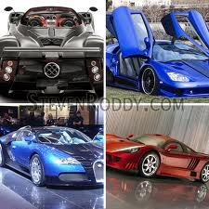
We do not include an S to the adjective when the noun is plural.
Examples:
Our cars are expensive. (Correct)
Ours cars are expensive. (Incorrect)

Slide 7
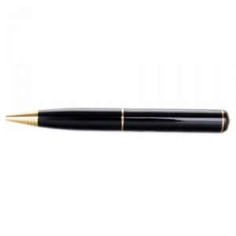

However, the verb that is used needs to be in agreement with the noun –
if the noun is singular then the verb is singular;
if the noun is plural then the verb is plural.
Examples:
My pen is black. (Singular)
My pens are black. (Plural)
Our child is intelligent. (Singular)
Our children are intelligent. (Plural)

Slide 8
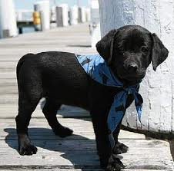
Its vs. It's
Be careful not to confuse its and it's.
Its = The possessive adjective for It.
Its name is Blackie
It's = a contraction of it is.
It's late, we better go home.

