Slide 1
Past Simple Questions and negative
G 7.4

Slide 2
Forming a negative
Negatives in the simple past are formed by adding didn't (informal) or did not (formal) before the simple form of the verb.
The verb BE is an exception to this; in the case of BE, we just add n't (informal) or not (formal) after "was" or "were":

Slide 3
Read the following chart:
Simple past statement | Informal negative | Formal negative
I had a car. | I didn't have a car. | I did not have a car.
You ate my toast. | You didn't eat my toast. | You did not eat my toast.
He was here yesterday. | He wasn't here yesterday. | He was not here yesterday.
They were in the park. | They weren't in the park. | They were not in the park

Slide 4
Forming a yes/no question
Yes/no questions are also created using the auxiliary did.
This time, the auxiliary is placed before the subject.
The verb BE is an exception; in this case, we move BE before the subject.

Slide 5
Here are the rules:
Simple past statement | Yes/no question
He brought his friend. | Did he bring his friend?
They had a party. | Did they have a party?
You were here. | Were you here?
She was sick. | Was she sick?

Slide 6
Forming a WH- question
WH- questions ("what", "when", and "where") are also created by putting the auxiliary did before the subject (or moving BE, as explained before). Then, you add the WH- word at the beginning.

Slide 7
Here are some examples:
Statement | Yes/no question | WH- question
The building fell down. | Did the building fall down? | Why did the building fall down?
They lived in Vancouver. | Did they live in Vancouver? | Where did they live?
The store was closed. | Was the store closed? | Why was the store closed?
They were wolves. | Were they wolves? | What were they?

Slide 8
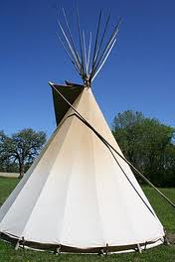
Simple Past: Negatives
Change each sentence into a negative.
Some First Nations people lived in tents.
Juan bought a new car.
The pot was expensive.
She drank all the wine.
We were on the beach

Slide 9
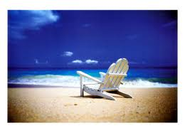
Check your answers
1. Some First Nations people didn't live in tents.
2. Juan didn't buy a new car.
3. The pot wasn't expensive.
4. She didn’t drink all the wine.
5. We weren’t at the beach.

Slide 10
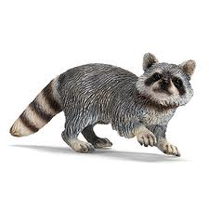
Simple Past: Yes/No Questions
Change each sentence into a yes/no question in the
past tense.
They talked about their homework.
They were happy together.
The soup was hot.
A raccoon ate Sally's lunch.
He played hockey every day.

Slide 11

Check your answers
Did they talk about their homework?
Were they happy together?
Was the soup hot?
Did a raccoon eat Sally's lunch?
Did he play hockey every day?

Slide 12
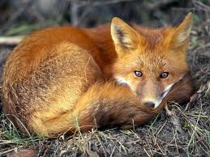
Simple Past: Wh- Questions
Change each sentence into a WH- question in the
past tense, using the question word in brackets.
They travelled across Canada by bike. (how)
She bought an old car. (what)
Jan studied for three hours (how long)
Beavers were common on Vancouver Island. (where)
The fox was in the garden. (where)

Slide 13
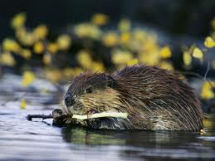
Check your answers
How did they travel across Canada?
What did she buy?
How long did Jan study?
Where were beavers common?
Where was the fox?

