Slide 1


Slide 2
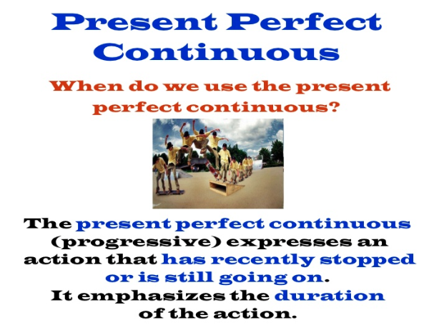

Slide 3

HAVE
BEEN -ING
HAS

Slide 4


Slide 5
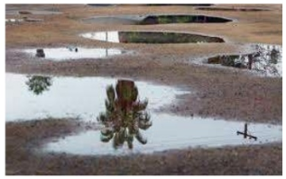

Slide 6

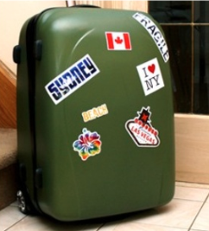

Slide 7



Slide 8



Slide 9

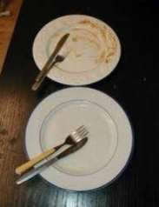

Slide 10

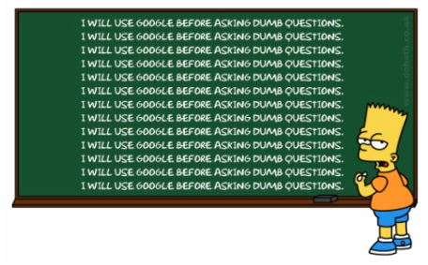

Slide 11



Slide 12



