Slide 1
Shopping
Experiences

Slide 2
Shopping…
Where/when/ what/ who with…?
Discuss with your partner…

Slide 3
PASSIVE VOICE.

Slide 4
The teacher copies the HMWK.
Subject verb object
The HMWK is copied by the teacher.
Object subject
to be + past participle

Slide 5
ACTIVE VOICE | PASSIVE VOICE
1. Rosa eats the apple. | The Apple is eaten by Rosa. (simple present)
2. Rosa is eating the apple. | The Apple is being eaten by her. (present progressive)
3. Rosa ate the apple. | The Apple was eaten by her. (simple past)
5. Rosa has eaten the apple. | The Apple has been eaten by her. (present perfect)
8. Rosa is going to eat the apple. | The Apple is going to be eaten by her. (future going to)
9. Rosa will eat the apple. | The Apple will be eaten by her. (future will)

Slide 6
MODALS
1. Rosa can eat the Apple. | The Apple can be eaten by Rosa.
2. She could eat the Apple. | The Apple could be eaten by her.
3. She may eat the Apple. | The Apple may be eaten by her.
4. She might eat the Apple. | The Apple might be eaten by her.
5. She must eat the Apple. | The Apple must be eaten by her.
6. She should eat the Apple. | The Apple should be eaten by her.

Slide 7
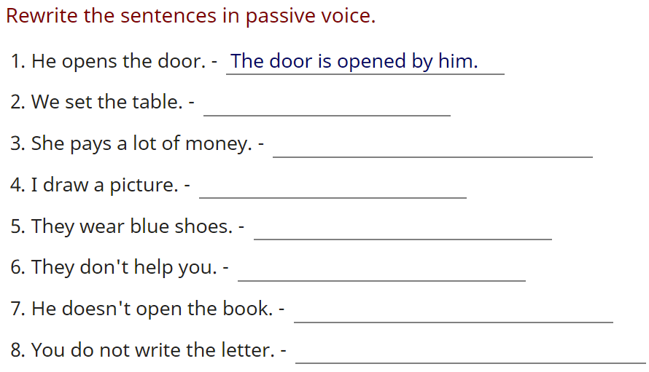

Slide 8
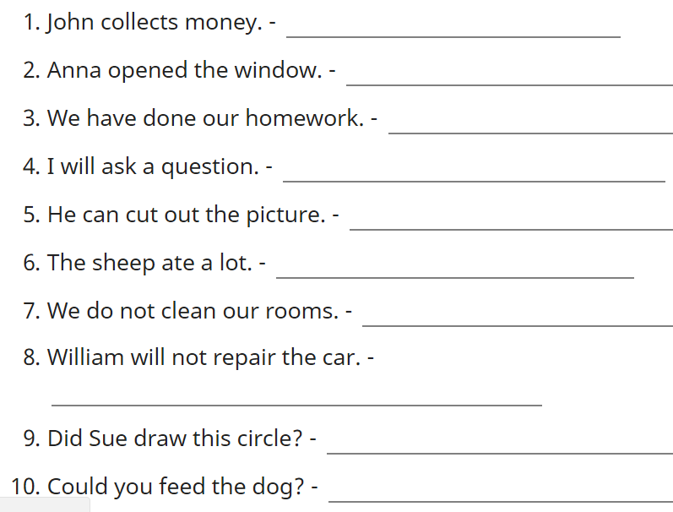

Slide 9
ACTIVE VOICE | PASSIVE VOICE
1. Sofia eats the apple. | The Apple is eaten by her.
2. Sofia is eating the apple. | The Apple is being eaten by her.
3. Sofia ate the Apple. | The Apple was eaten by her.
4. Sofia was eating the Apple. | The Apple was being eaten by her.
5. Sofia has eaten the Apple. | The Apple has been eaten by her.
6. Sofia had eaten the Apple. | The Apple had been eaten by her.
7. Sofia has been eating the Apple. | The Apple has been being eaten by her.
8. Sofia is going to eat the Apple. | The Apple is going to be eaten by her.
9. Sofia will eat the Apple. | The Apple will be eaten by her.

Slide 10
MODALS
1. Sofia can eat the Apple. | The Apple can be eaten by her.
2. She could eat the Apple. | The Apple could be eaten by her.
3. She may eat the Apple. | The Apple may be eaten by her.
4. She might eat the Apple. | The Apple might be eaten by her.
5. She must eat the Apple. | The Apple must be eaten by her.
6. She should eat the Apple. | The Apple should be eaten by her.

