Slide 1
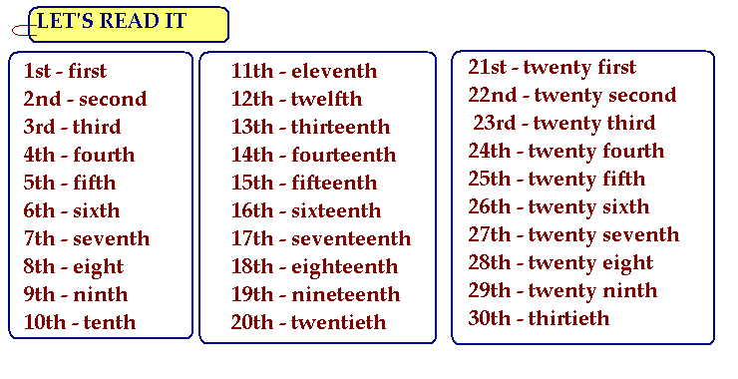
Ordinal Numbers

Slide 2
Exercise: Write the dates of the following holidays
1. Christmas’ Eve
2. Christmas’ Day
3. Mother’s Day
4. Lempira’s Day
5. Tree’s Day
6. Halloween
7. Morazan’s day
8. Father’s Day
9. Labor’s day
10. Women’s day
11. Your Birthday

