Slide 1
OTHER FUTURE FORMS
BE GOING TO I am going to study more. Natalia is going to start school next week. Manuel isn’t going to watch a movie. The students aren’t going to listen to rock. | WILL I think I will repair the new window tomorrow. Perhaps the class will finish late tomorrow. Maybe the child won’t play in the park. My niece will call me tomorrow night.
PRESENT PROGRESSIVE Elmer is taking and exam tomorrow. My sister is selling avocados in the store on friday. Emely is checking the patients at the hospital next month. Brad is calling the teacher after class. | SIMPLE PRESENT Gerald starts her new job tomorrow. Jorge takes 3 classes more this trimester. The class starts next year again. My parents don’t travel to europe next december.

Slide 2
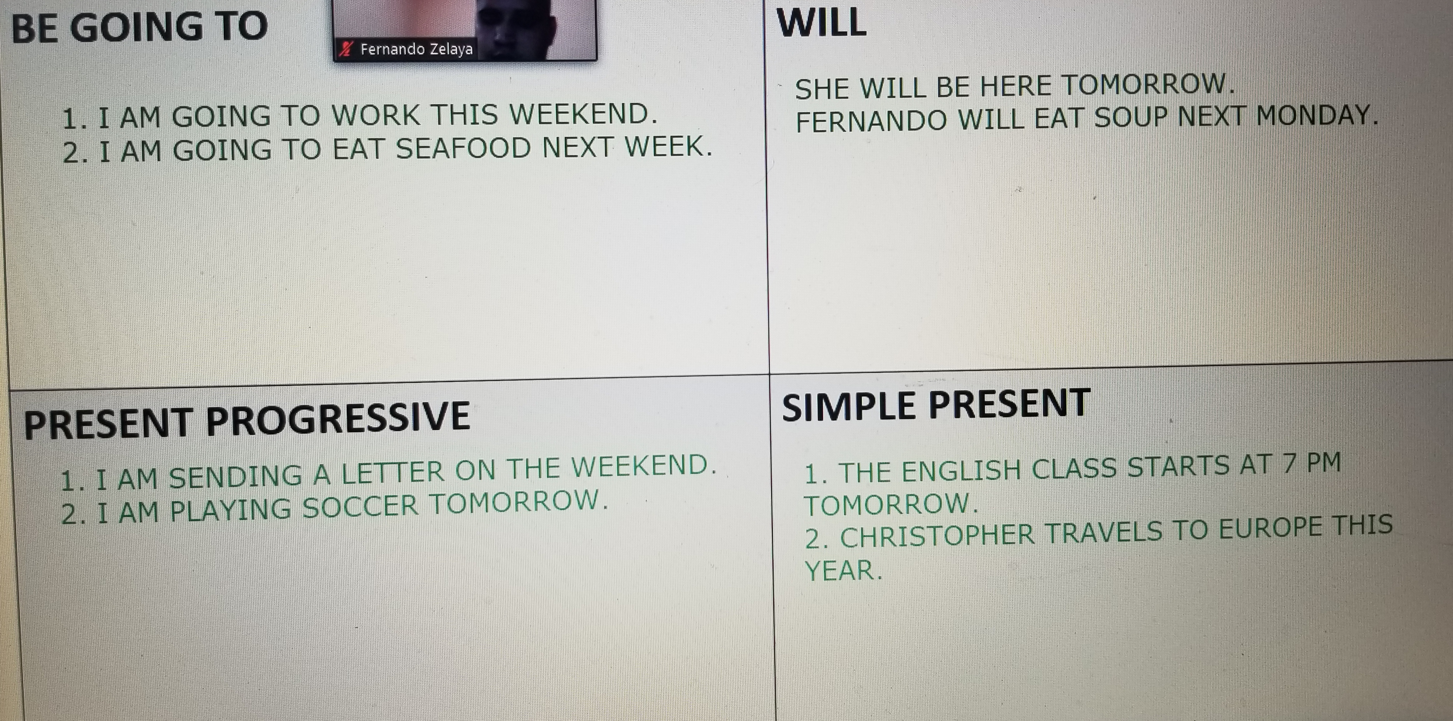

Slide 3
Just add a time expression in the future:
Tomorrow
Next week/month/year/ Monday…
In 2/3/4 days…
This semester/trimester/year…

