Slide 1

MY FAVORITE COLOR IS…

Slide 2

NAVY B L U E

Slide 3
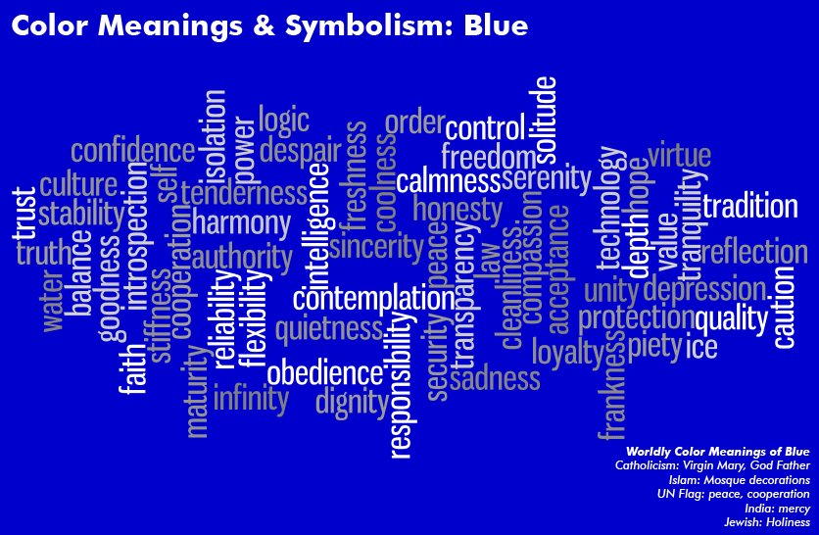

Slide 4


Slide 5
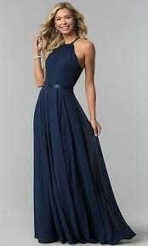
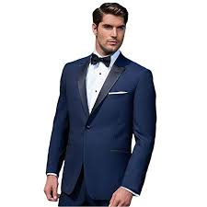
The navy blue is elegant ...

Slide 6
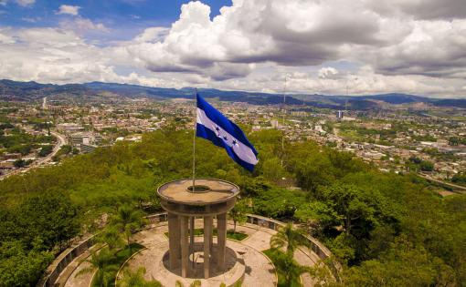
The navy blue color reminds me of the Honduran Flag …

Slide 7
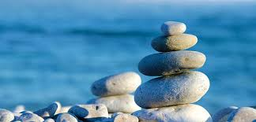
The navy blue gives me peace and tranquility ...

Slide 8
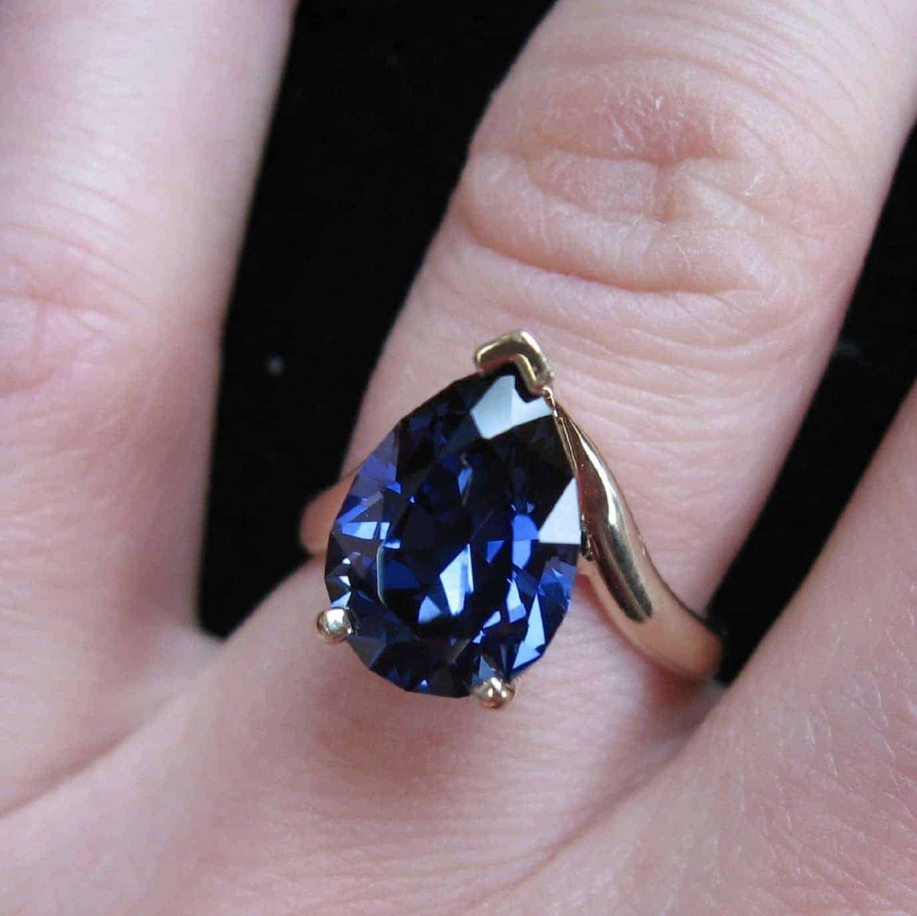
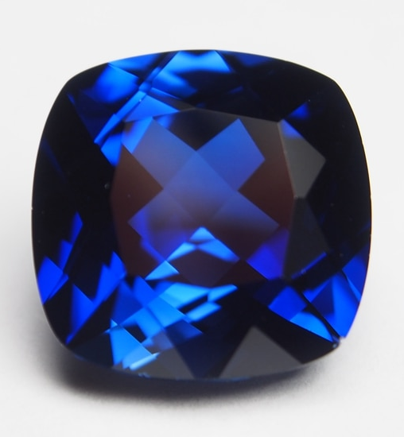
My favorite stone is ...

Slide 9
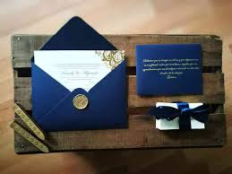
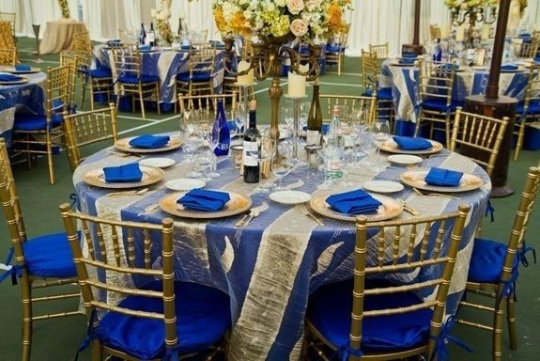
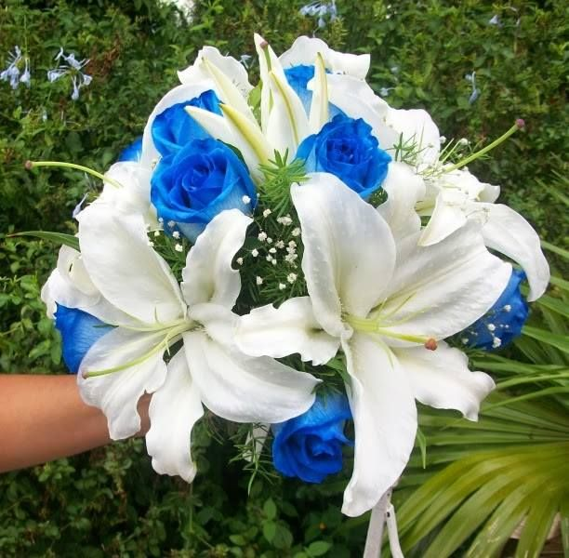
The details of my wedding were blue…
Invitation Cards
Table Decoration
Floral Bouquet

Slide 10

Thank For Your Attention…

