Slide 1
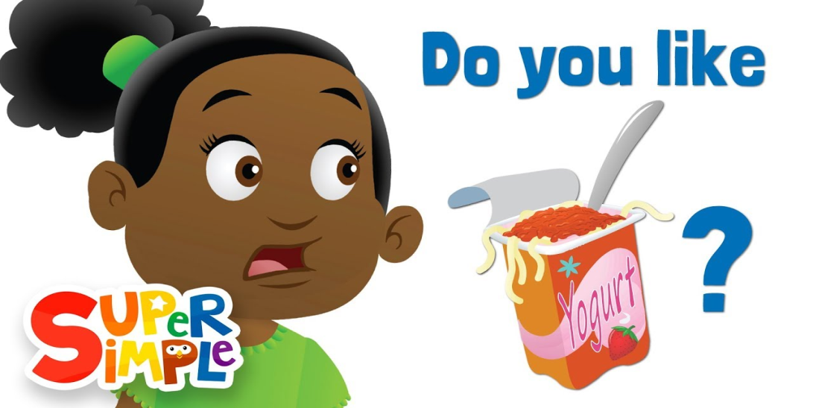
Like and Don’t Like
Mr. Fabricio Romeo Mejía

Slide 2
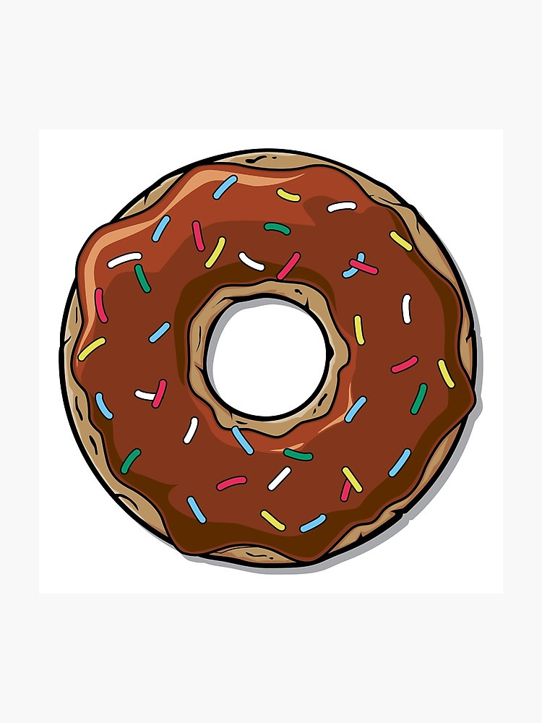
Like
We use like to tell that we enjoy something.
For example:
I like chocolate.

Slide 3

Other examples are:
We like vegetables.
They like the zoo!
She likes Korean Pop Music.

Slide 4
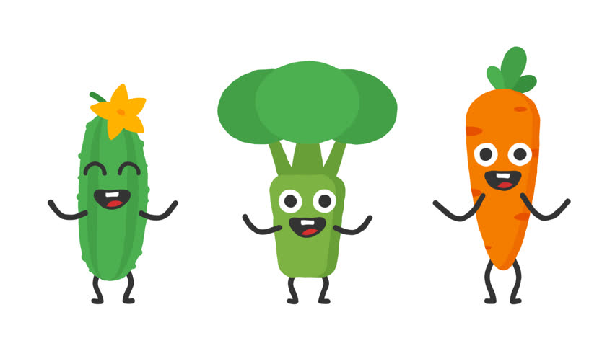
Negative Form
For negatives form add does or doesn’t:
I don’t like vegetables
She doesn’t like the zoo.
He doesn’t like vegetables.

Slide 5
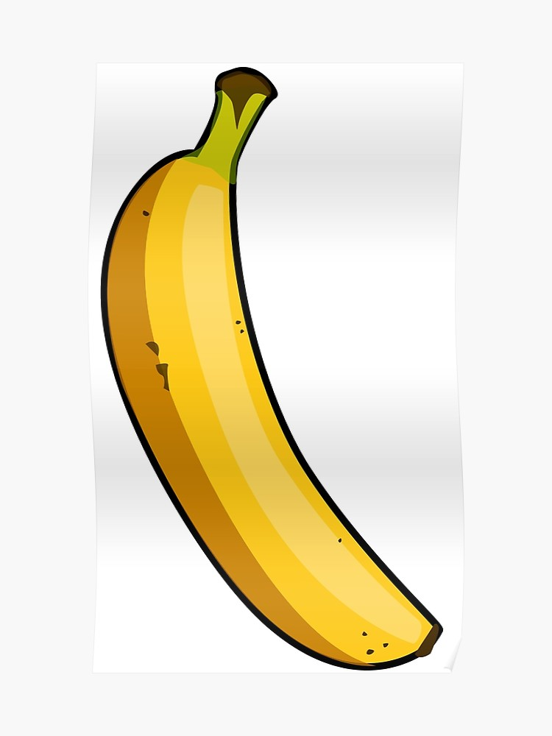
To ask Questions we say…
Do you like the beach?
Do you like bananas?
We answer…
Yes, I do.
No, I don’t.

Slide 6
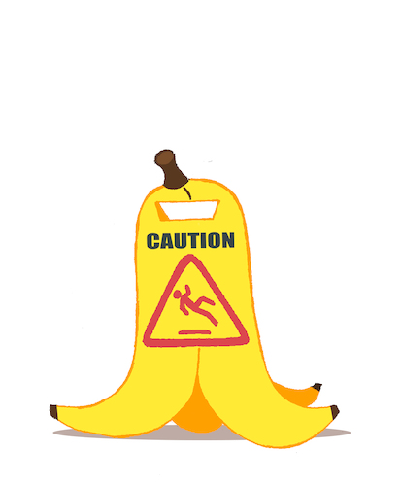
Be Careful!!
We say: Do you like cartoons?
NOT: You like cartoons.
We always use “do” at the beginning of each question.

Slide 7

Thank you kids!!

