Slide 1

Irregular ve=
IRREGULAR VERBS

Slide 2
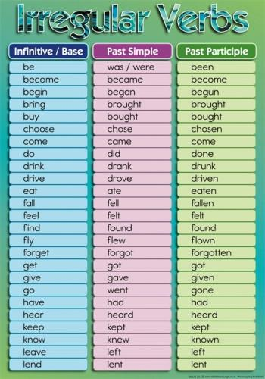

Slide 3
