Slide 1

Infinitives of Purpose.

Slide 2

What’s an infinitive?
to + the base form of the verb
to eat
to sleep
to go
to watch
to swim
to read

Slide 3

Infinitives of purpose answer questions with:
Why?????

Slide 4

Why are you learning English?
To get a promotion.
To travel abroad.
To communicate with people t work.
To watch and understand movies.
To listen to music in English.

Slide 5

We use Infinitive of purpose to say why we are going to do something.
Examples;
1. I’m going to go to the supermarket to buy groceries.
2. Carla is going to go to the concert to see Maluma.
3. The children are going to study to pass the class.
4. Juan is going to go to Zara to buy a shirt.

Slide 6

We can use infinitives of purpose with different verb tenses.
1. I come to class to learn English.
2. Hugo wants a TV to watch the news.
3. We eat to stay healthy.
4. Daniel went to Las Cascadas to buy a Sarita cone.
5. My mom came to Teguz to go to the Dr.
6. I’m eating to feel satisfy.

Slide 7
INCORRECT
I need a tent for go camping.
Maria needs a coffee for to stay warm.
Daysi is going to see a movie for have fun.

Slide 9
What do you know about?

Slide 10
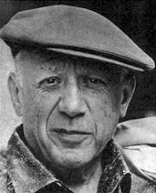

Pablo Picasso cubism

Slide 11
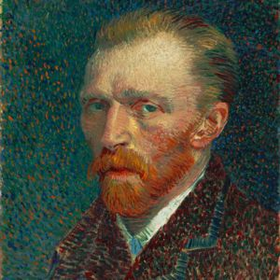

Vincent Van Gogh impressionism

Slide 12
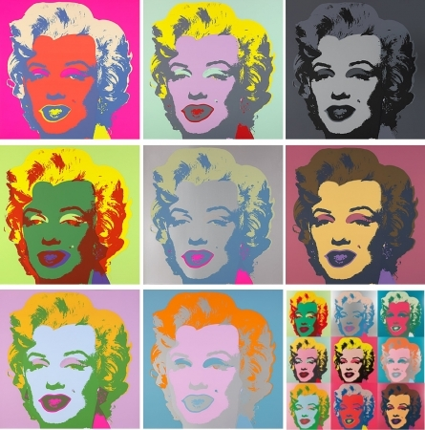
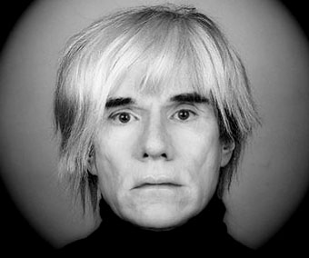
Andy Warhol
Modern art

Slide 13
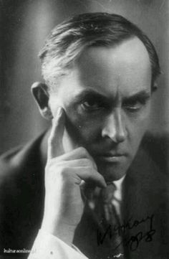

Stanislaw Ignacy Witkiewics expressionism

Slide 14
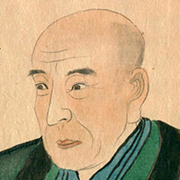

ando hiroshige lanscapes

Slide 15

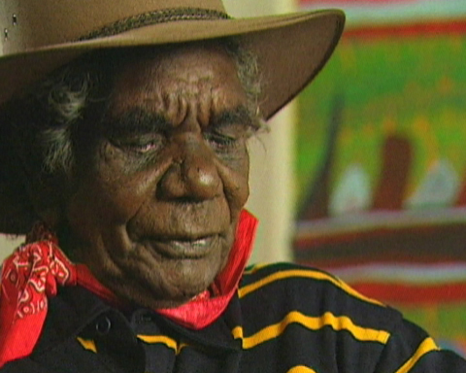
Ginger Riley Munduwalawala

Slide 16
More Art:
Graffiti
Fashion design
Pop music
Culinary arts
Modern dance
Lanscape design

Slide 17
Individually create 2 sentences.
1. I like______________________
2. I don’t like_________________
3. I prefer____________________

