Slide 1
Hello / Hi. I´m from………….
GB 1.1

Slide 2
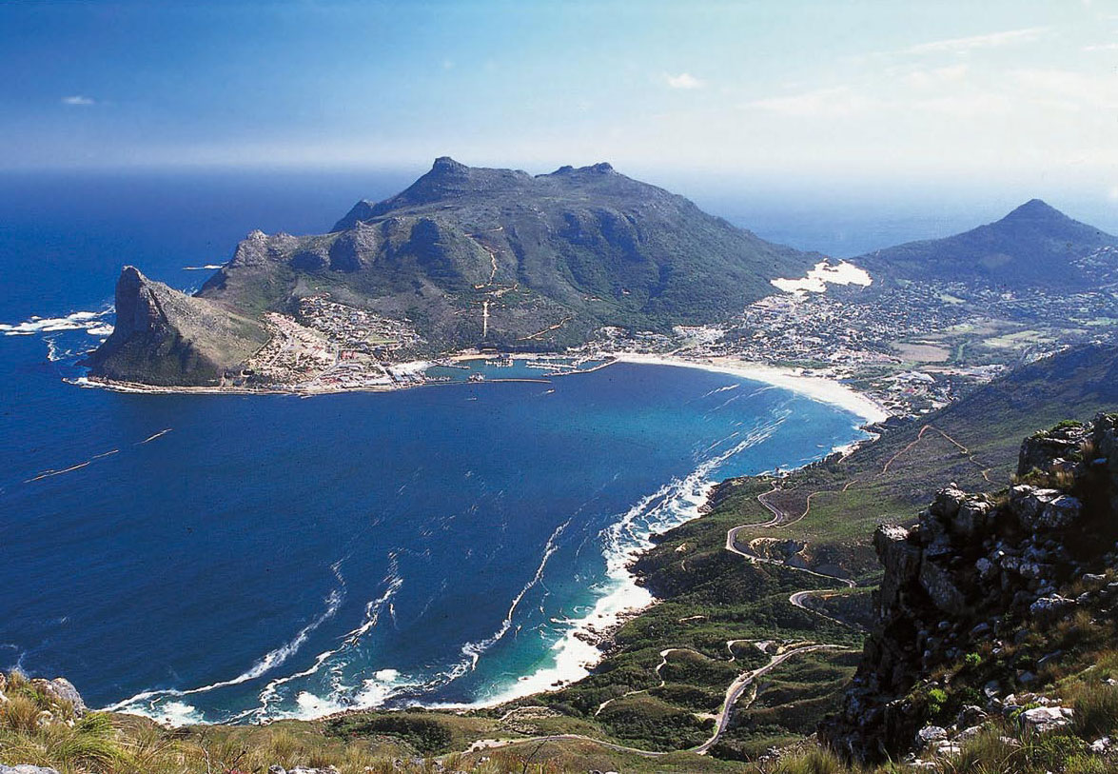
Cape Town, South Africa

Slide 3
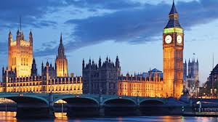
London, United Kingdom

Slide 4
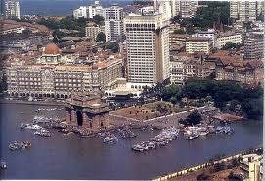
Mumbai, India

Slide 5
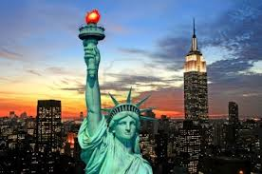
New York, United States

Slide 6
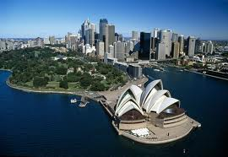
Sydney, Australia

Slide 7
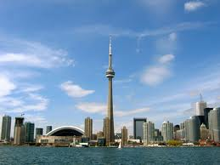
Toronto, Canada

Slide 8
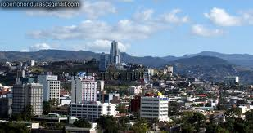
Tegucigalpa, Honduras

