Slide 1
HOBBIES

Slide 2

LISTENING TO MUSIC

Slide 3
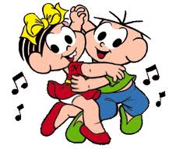
DANCING

Slide 4

WATCHING TV

Slide 5

SLEEP

Slide 6

GOING CAMPING

Slide 7

HANG OUT WITH FRIENDS

Slide 8
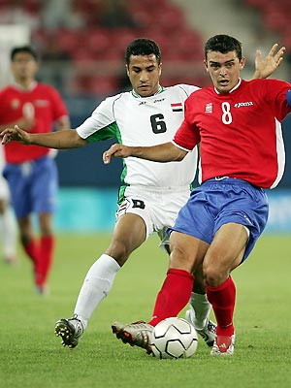

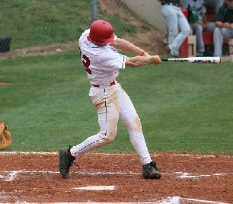

PLAY SOCCER PLAY TENNIS
PLAY BASEBALL PLAY VOLLEYBALL

Slide 9
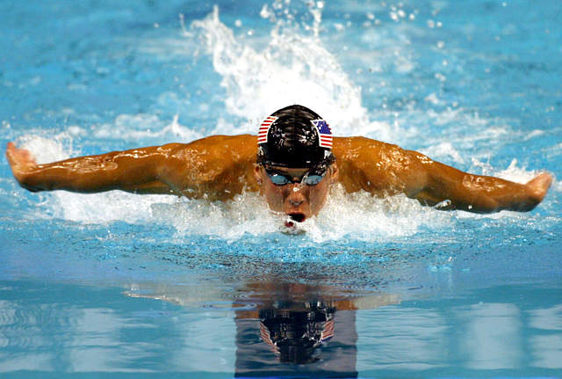
SWIMMNING

Slide 10
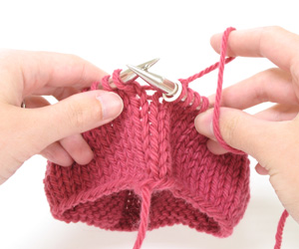
KNITTING

Slide 11
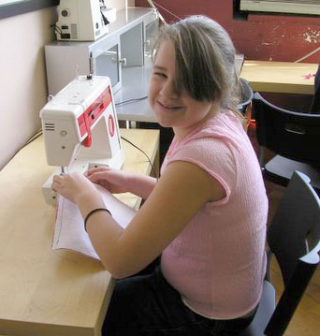
SEWING

Slide 12

TAKING PICTURES

