Slide 1


HAVE TO / HAS TO

Slide 2
We use have to / has to in affirmative sentences to express
“OBLIGATION.”
(WHEN SOMETHING IS NECESSARY).

Slide 3

I have to study every day.

Slide 4
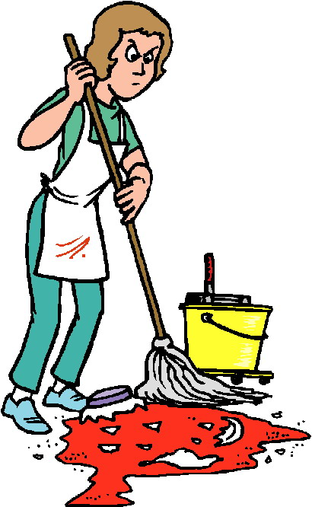
I don’t have to clean my room every day.

Slide 5

Patricia has to write her book.

Slide 6

Carlos doesn’t have to study every day.

Slide 7
I/YOU/WE/THEY HAVE TO HE/SHE/IT HAS TO
POSITIVE SENTENCES.
I have to brush my teeth three times a day.
Andrea has to brush her teeth three times a day.

Slide 8
I have to you have to he she has to work every day. It we have to they

Slide 9
I/YOU/WE/THEY DON’T HAVE TO HE/SHE/IT DOESN’T HAVE TO
NEGATIVE SENTENCES.
We don’t have to get up early on Sunday.
He doesn’t have to get up early on Sundays.

Slide 10
I don’t have to you don’t have to he she doesn’t have to work every day. It we don’t have to they

Slide 11
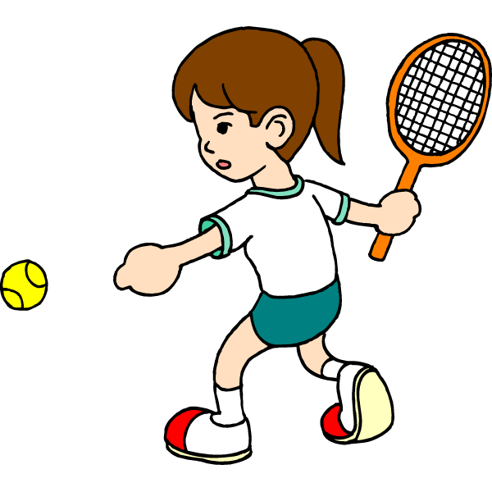
CAN & CAN’T.

Slide 12
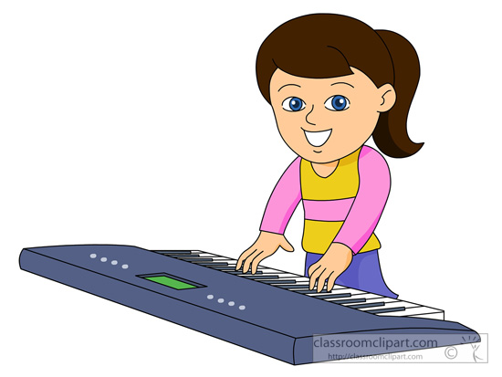
Can / Can’t is used to talk about ability and possibility, to ask for and give permission, and to make requests and offers.

Slide 13

I can swim in the pool.

Slide 14

People can’t smoke here.

Slide 15
I you he she can swim in the pool. It we they
POSITIVE SENTENCES.

Slide 16
I you he she can’t swim in the pool. It we they
NEGATIVE SENTENCES.

Slide 17
1. I can play tennis. 2. Kathia can’t sing. 3. Cesar can run a mile in four minutes. 4. María Fernanda can’t play tennis very well. 5. Pamela can speak French and English.
Ability.

Slide 18
*I can swim with dolphins in Roatan. *We can use dollars in El Salvador. *I can’t take pictures in the Louvre museum. *People can go to Times Square in New York. *You can visit The Lincoln Memorial in Washington DC. *You can’t practice your English in Lempira.
Possibility.

