Slide 1
Unit 1 Hello
Fundamentals I: First Day of Class

Slide 2
Say your name: Hi my name is: Karla Estrada! What’s your name? My Name is:_____________________ Nice to meet you. Nice to meet you too!

Slide 3
Greetings: Hello/ hi –informal Good morning 5:00 A.M to 11:59 A.M Good afternoon 12:00 P.M. to 5:59 P.M. Good evening 6:00 P. M. to 9:59 P.M. How are you?/ How’s it going?/How’s everything? I’m ok. So-so I’m sick. I’m pretty tired. - Nice to meet you. – Nice to meet you too. Good night when we go to bed Good bye Bye-bye

Slide 4
The Alphabet A -B - C -D -E- F- G -H -I J- K -L -M –N -O -P-Q-R S- T- U- V- W- X- Y- Z

Slide 5
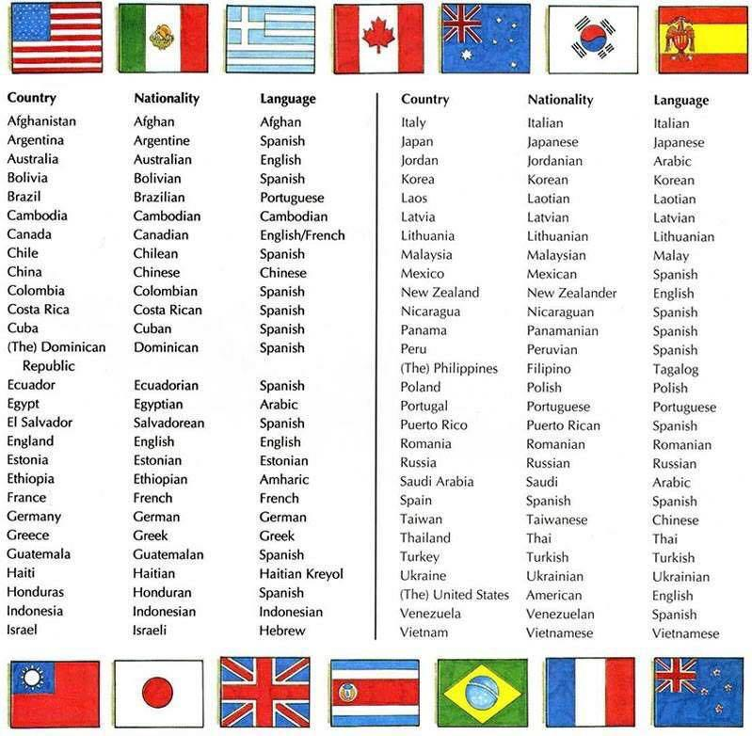
Countries and Nationalities

Slide 6
Verb to be
Be: am, is, are
Subject Pronouns + verb to be Contraction
I am I’m
You are You’re
He is He’s
She is She’s
It is It’s
We are We’re
You are You’re
They are They’re

Slide 7
Sentence Structure (+) Subject/ be/ complement/. (-) Subject/ be + not/ complement/. (?) Be/ subject/ complement/? (Wh) Wh/ be/ subject/complement/?

