Slide 1
FREE TIME ACTIVITIES
SPARE TIME ACTIVITIES

Slide 2

Play video games

Slide 3
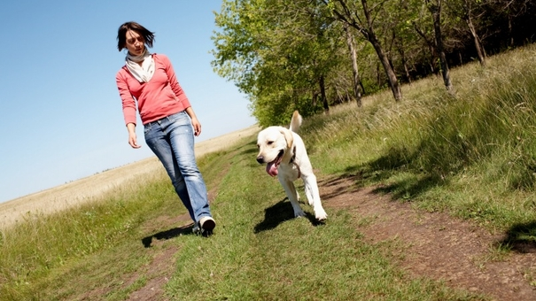
Take a walk

Slide 4

Listen to music

Slide 5
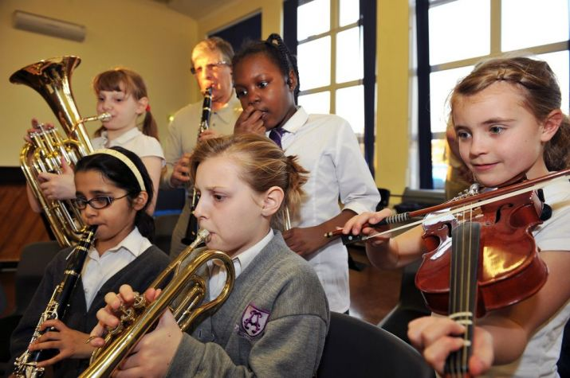
Play a musical instrument

Slide 6

Watch TV

Slide 7
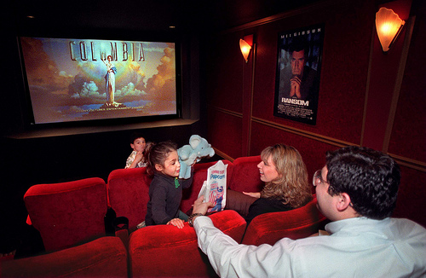
Watch movies

Slide 8
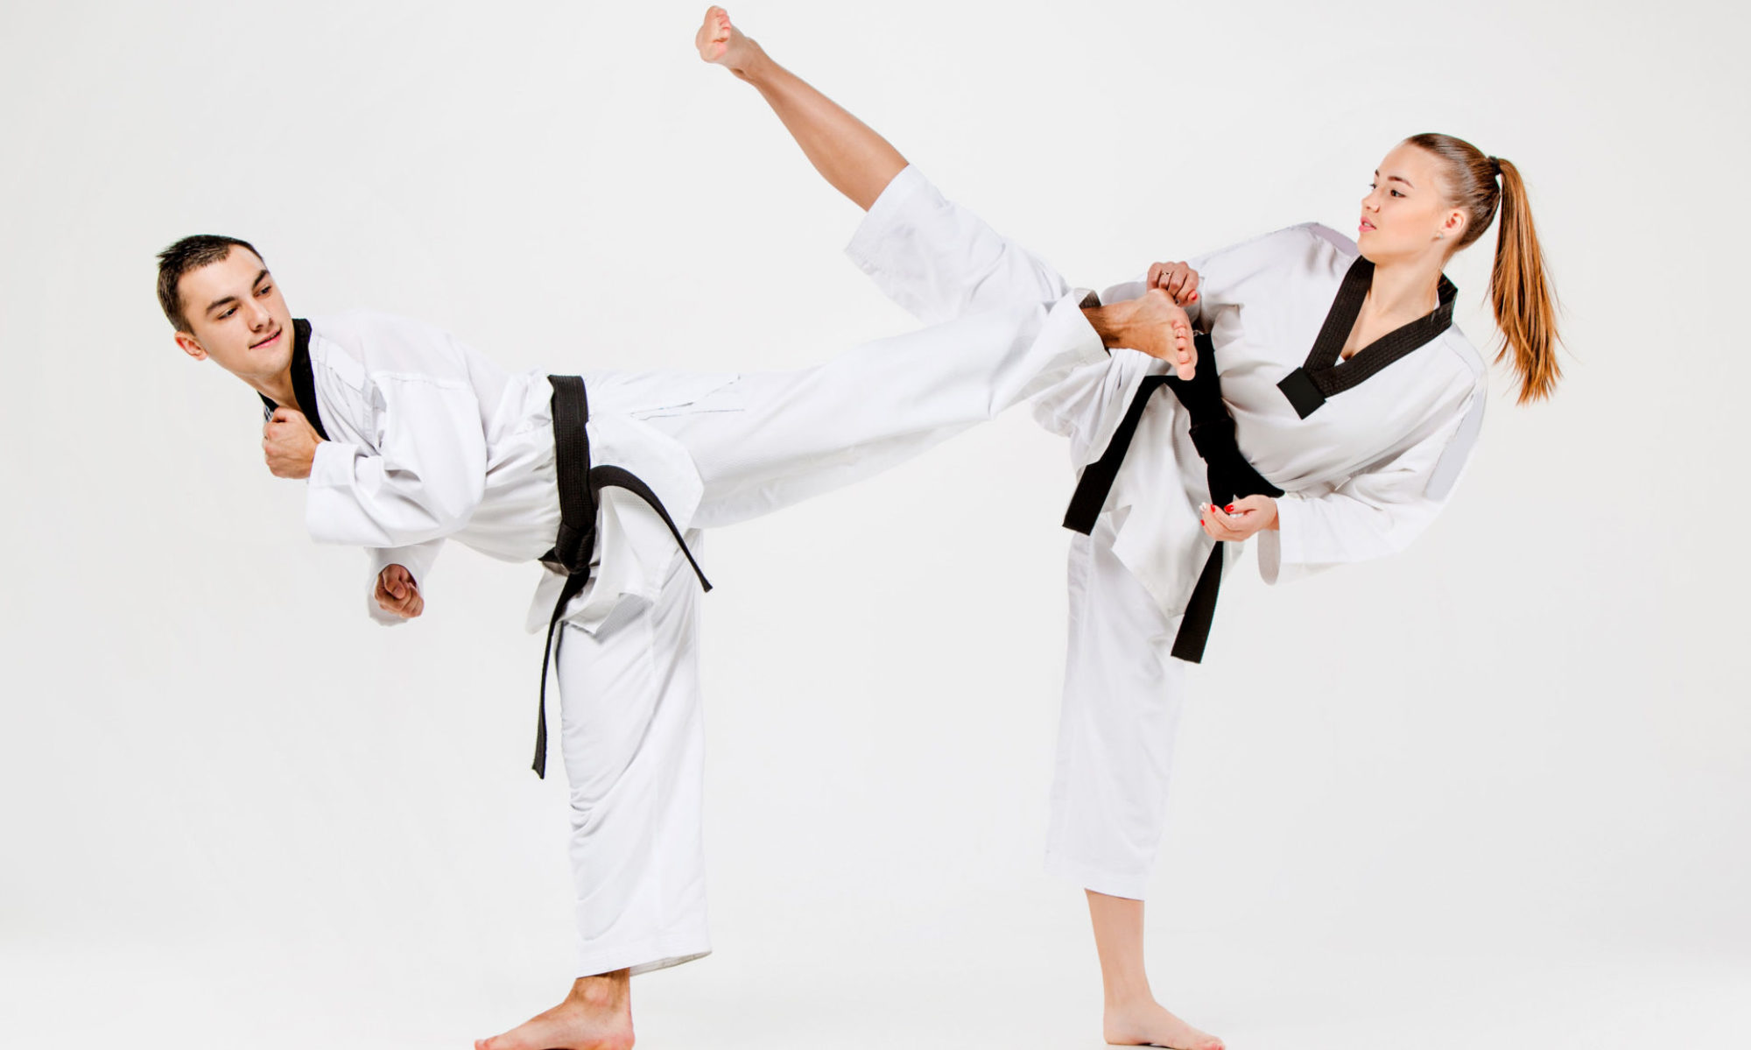
Do Tae Kwon Do

Slide 9
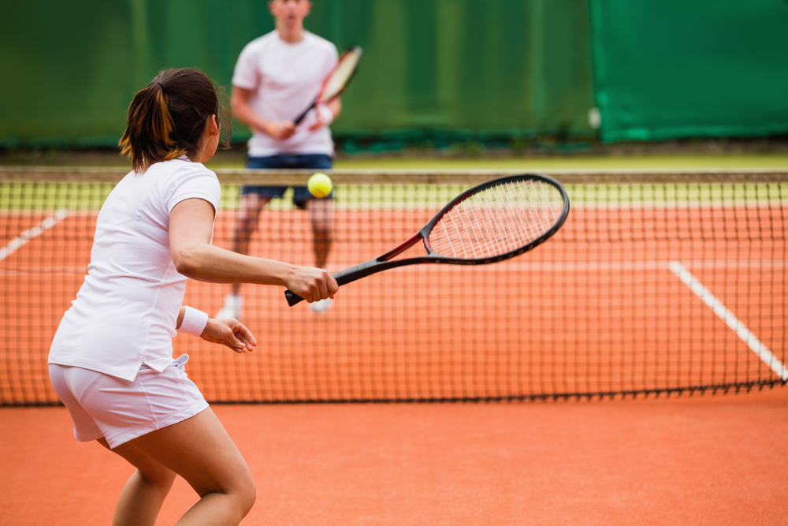
Play tennis

Slide 10
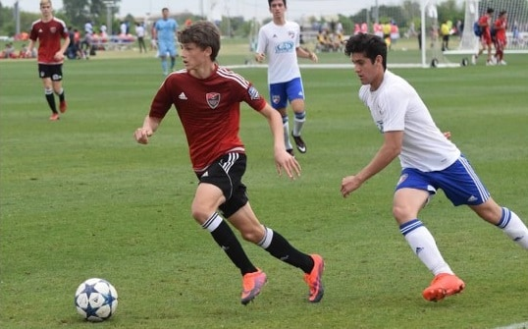
Play soccer

Slide 11
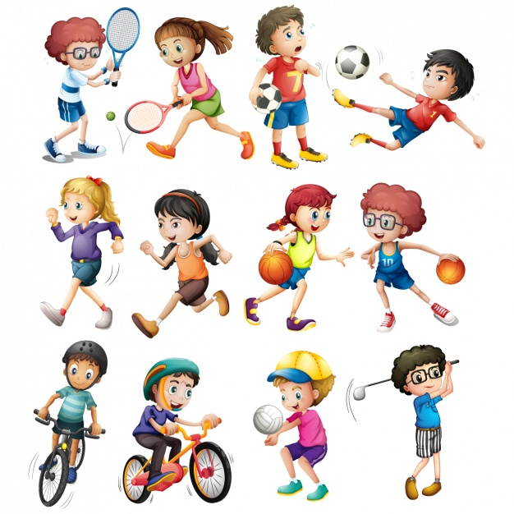
Play sports

Slide 12

Go to the gym

Slide 13

Do gardening

Slide 14

Read books

Slide 15
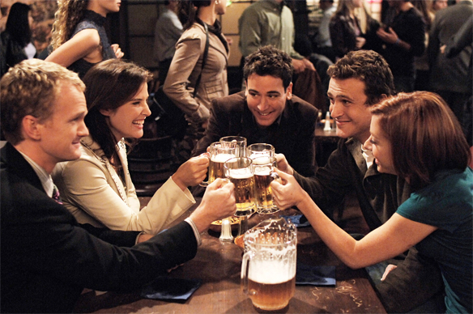
Hang out with friends

