Slide 1
FEELINGS AND PERSONAL STATES.

Slide 2

love

Slide 3

PASSION

Slide 4
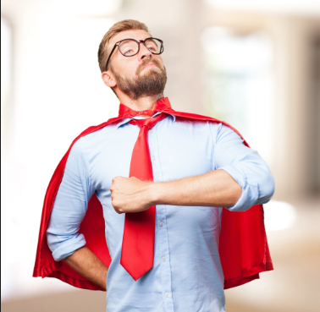
proud

Slide 5
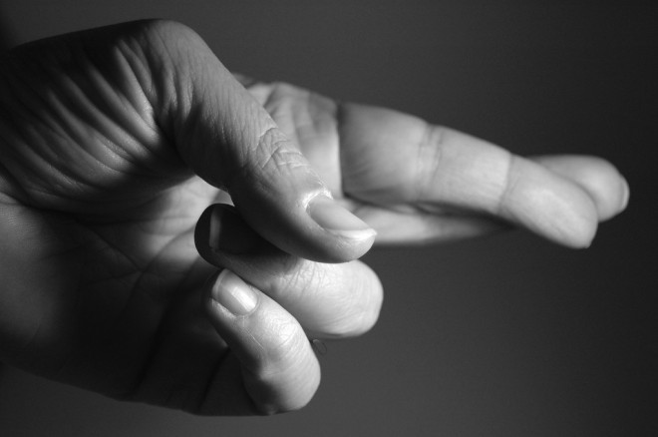
luck

Slide 6

ANGER

Slide 7

prosperity

Slide 8
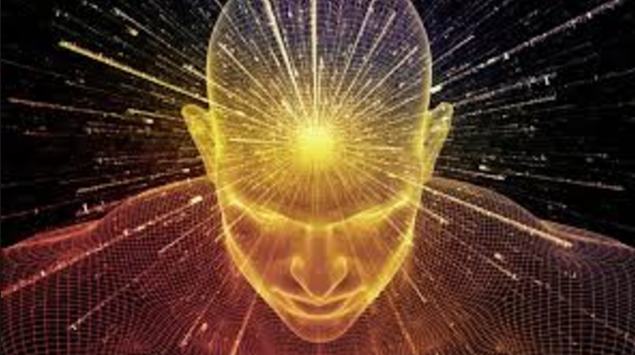
wisdom

Slide 9

COURAGE

Slide 10

HATRED/ anger

Slide 11

HAPPINESS

Slide 12
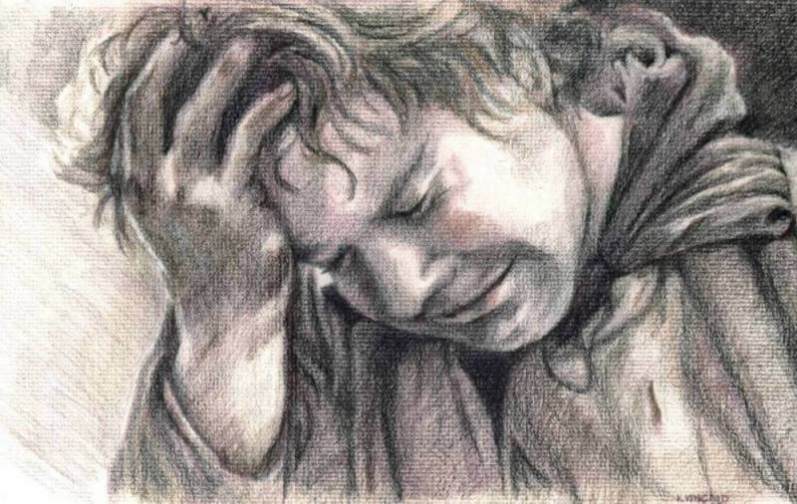
SORROW

Slide 13

POWERFUL

Slide 14

SADNESS

Slide 15

JOY

Slide 16
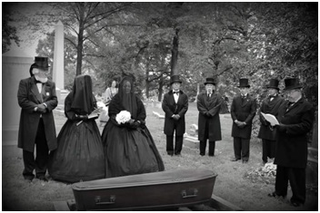
MOURNING

Slide 17

ENVY

Slide 18
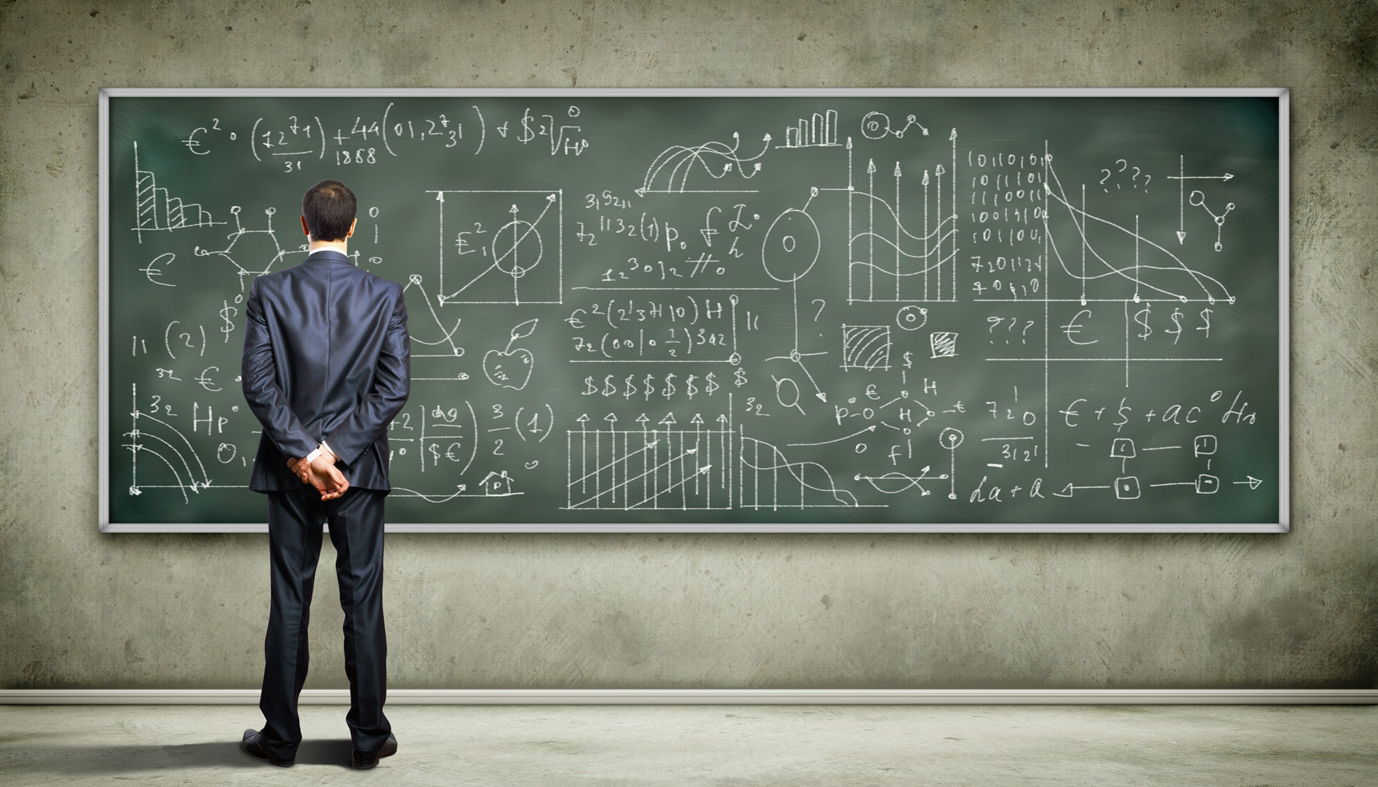
KNOWLEDGE

