Slide 1
FEELINGS AND PERSONAL STATES.

Slide 2

PASSION

Slide 3

prosperity

Slide 4

love

Slide 5
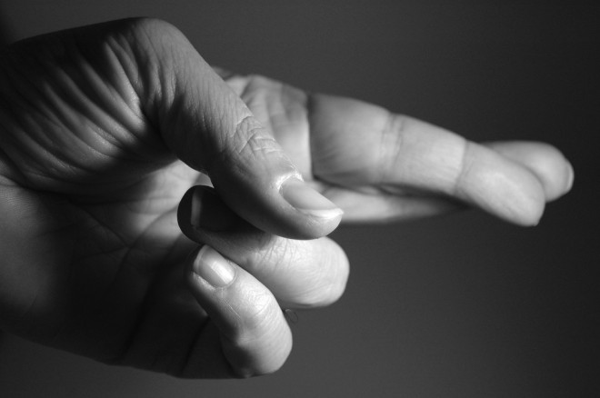
luck

Slide 6
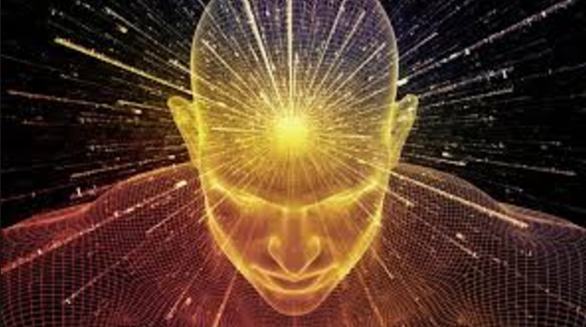
wisdom

Slide 7

COURAGE

Slide 8

ANGER

Slide 9

HATRED

Slide 10

HAPPINESS

Slide 11
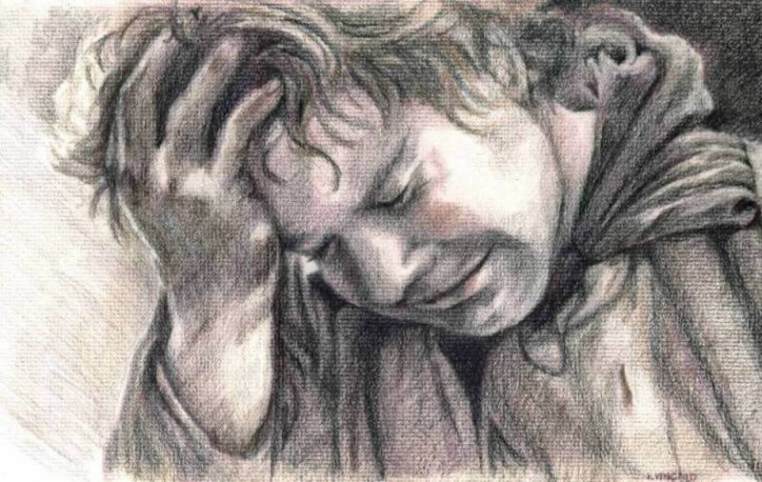
SORROW

Slide 12

POWERFUL

Slide 13

SADNESS

Slide 14

JOY

Slide 15
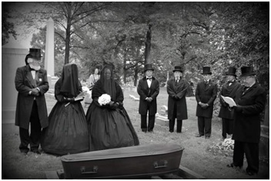
MOURNING

Slide 16

PRIDE / PROUD

Slide 17

ENVY

Slide 18
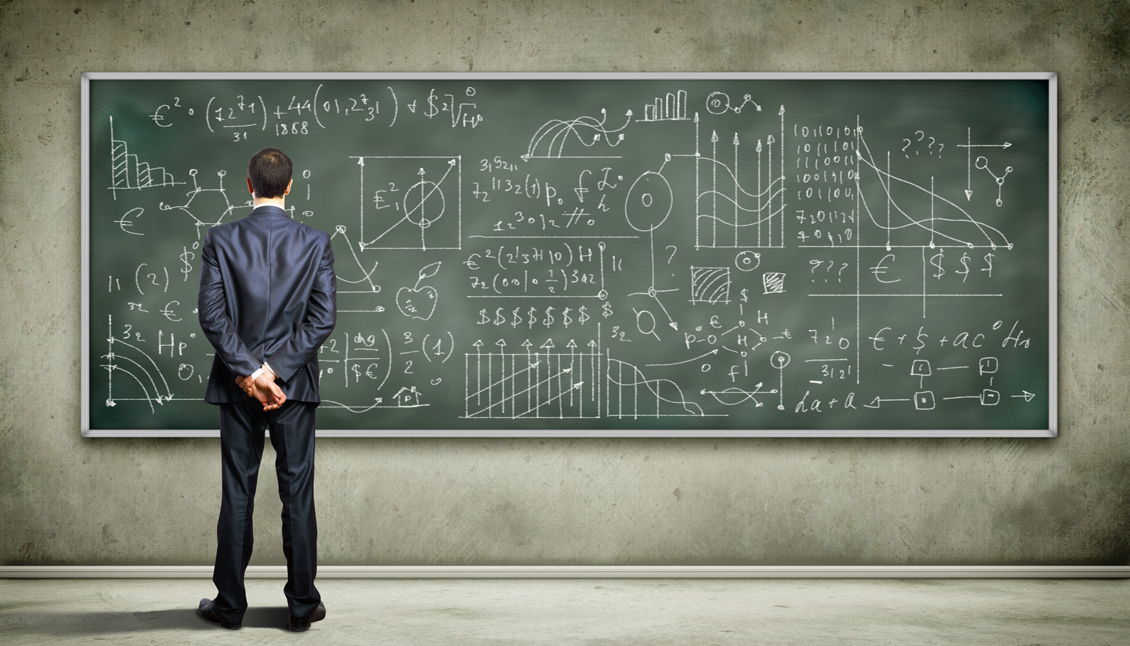
KNOWLEDGE

