Slide 1
EXERCISES

Slide 2
WHICH IS CORRECT?

Slide 3


I want a cup of coffee. I am wanting a cup of coffee.

Slide 4
We need to study. We are needing to study.

Slide 5
I think this exercise is difficult. I am thinking about going to Isla Mujeres next year.

Slide 6

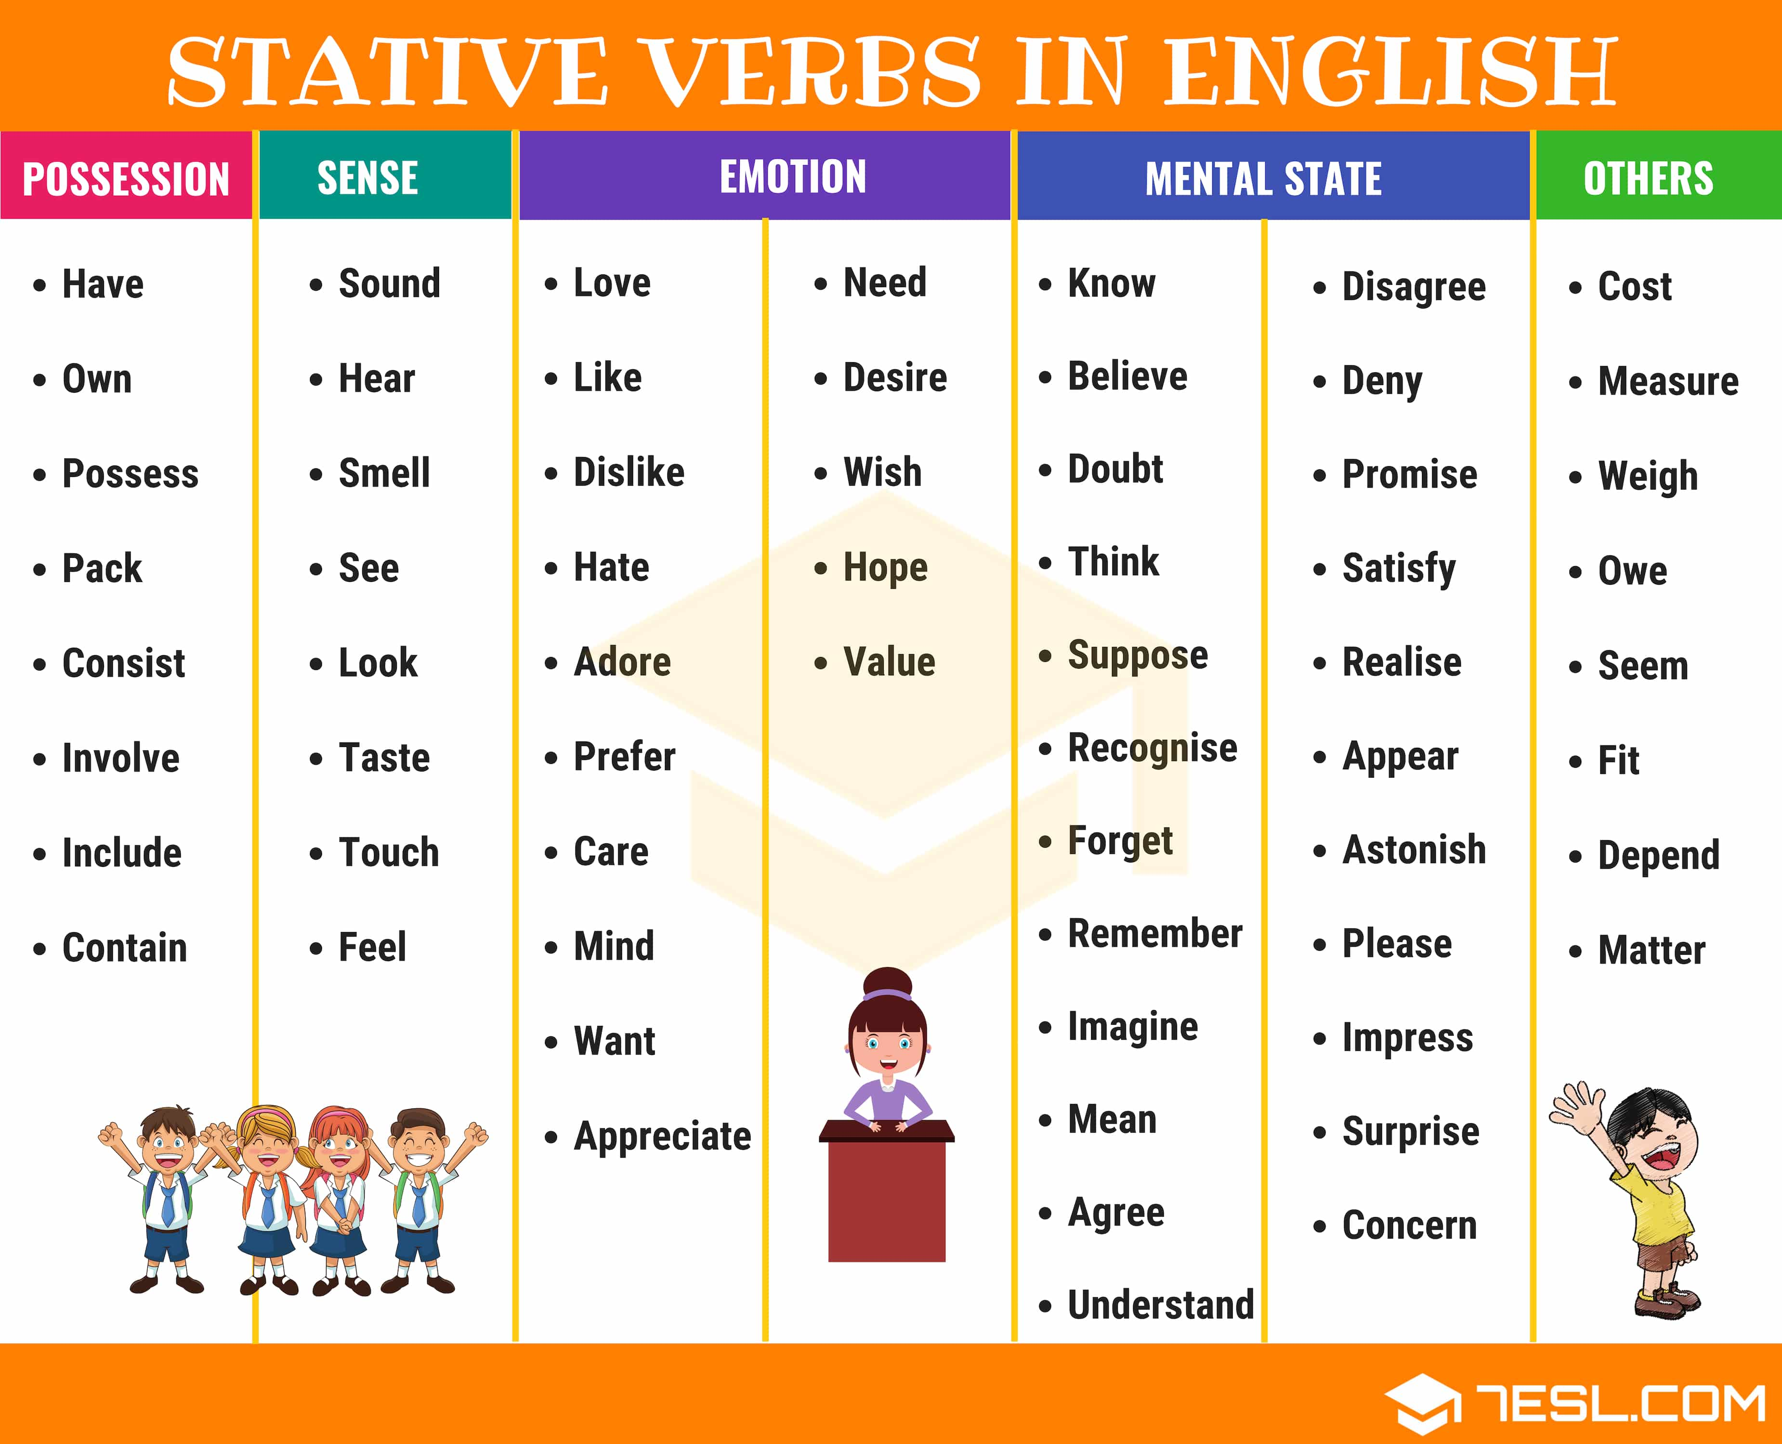
REMEMBER:
This verbs are only STATIVE:

Slide 7
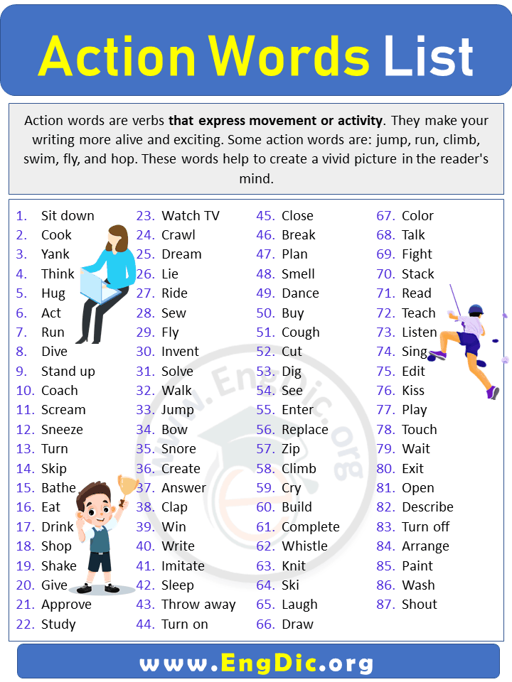
And here you have some DYNAMIC VERBS:
They express ACTION.

Slide 8


And others take the two forms. They can be STATIVE AND DYNAMIC.

Slide 9
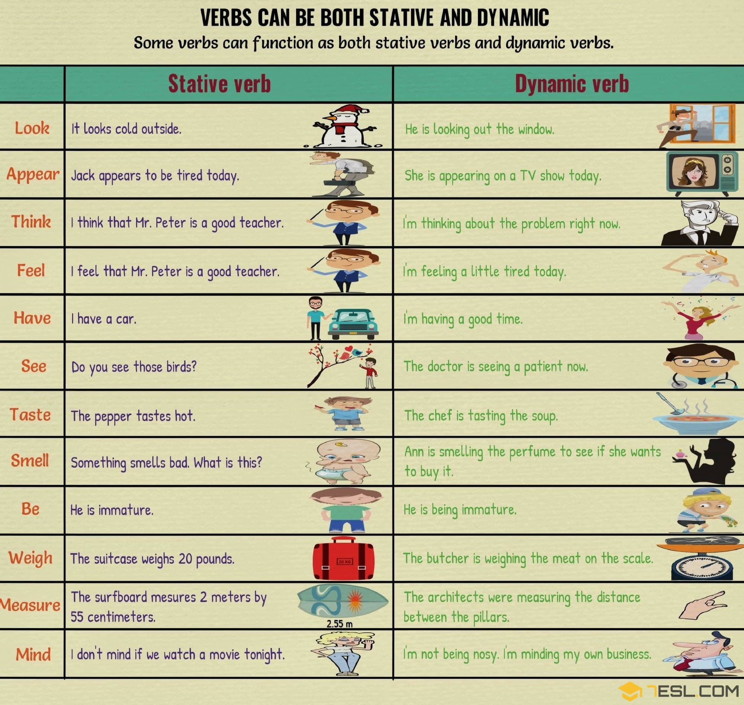

Slide 10
EXAMPLES BOTH: STATIVE AND DYNAMIC.
VICTOR HAS A NEW SHOWER BECAUSE he’s REDECORATING.
VICTOR IS HAVING A SHOWER NOW. HE’S GOING OUT TONIGHT.

Slide 11
taste
This cake tastes very sweet. You used too much sugar.
Where is your mother? She is in the kitchen cooking, she is tasting the rice and beans.

Slide 12
I. Are these verbs STATIVE or DYNAMIC?
Run _____________ ____________
Swim _____________ ____________
Feel _____________ ____________
Think _____________ ____________
Believe _____________ ____________
Eat ____________ ____________
Have ____________ ____________

Slide 13
II. Create sentences with these DYNAMIC VERBS.
eat
walk
sleep
talk

Slide 14
III. Create sentences with these STATIVE VERBS.
1. love
2. hate
3. like
4. prefer

Slide 15
1. Actually, that _______ (sound) wonderful. 2. We _________ (cook) right now. 3. I ________ (promise) to be back soon. 4. Frank and his wife ________ (disagree) on this matter. 5. He _________ (own) several large companies. 6. you ________ (hear) Richard's voice now? 7. you ________ (study) at the moment? 8. I ______ (-mean) to hurt you. 9. ______you _______ (mind) taking out the garbage? 10. I seriously _______ (doubt) it.

Slide 16
Are the sentences correct or incorrect?

Slide 17
1. Are they having a good time?
2. I am thinking you are a nice person.
3. It is tasting good.
4. You are looking great
5. He's been working since this morning.
6. He's having a huge house.
7. The food tastes good.
8- They are looking at the photo album.
9. They are designing a robot.
10. She is liking him very much.

