Slide 1
ECONOMY 2.

Slide 2

Go shopping

Slide 3

Go Grocery shopping

Slide 4

available

Slide 5
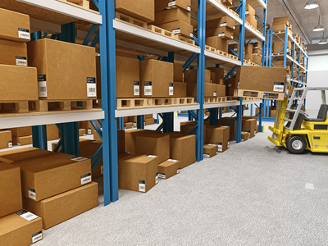
In stock

Slide 6
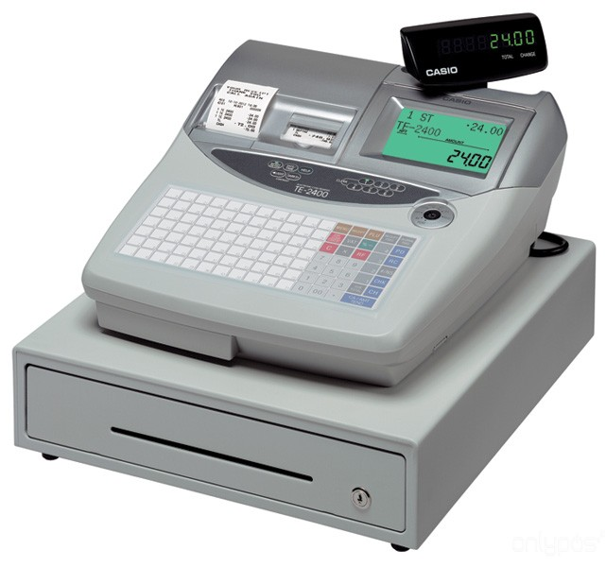
Cash register

Slide 7

Model name

Slide 8

delivery

Slide 9
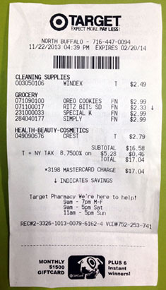
receipt

Slide 10

exchange

Slide 11
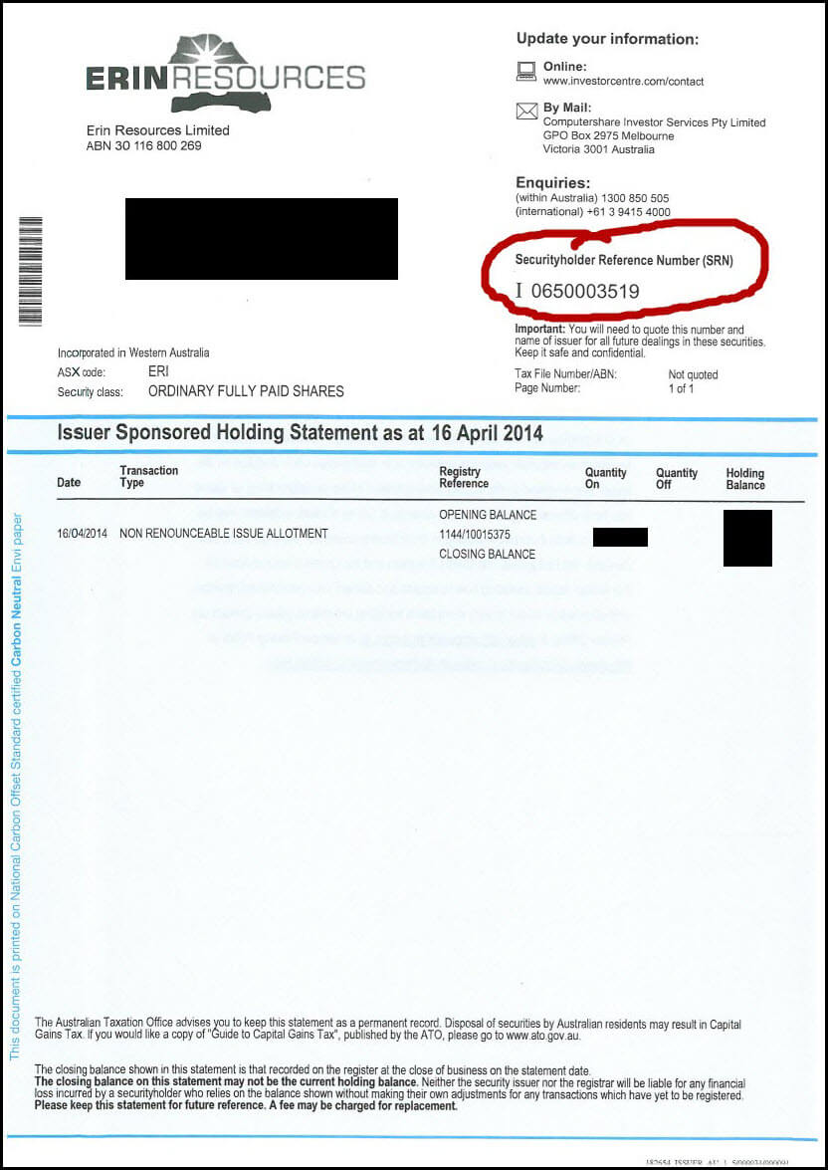
Reference number

Slide 12

Gift wrapping

Slide 13
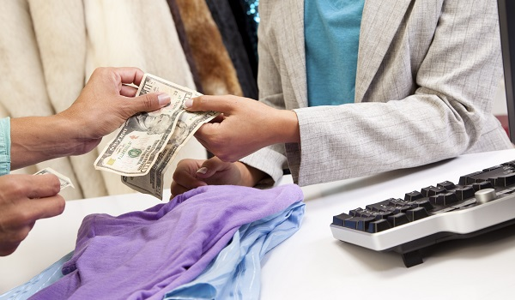
return

Slide 14
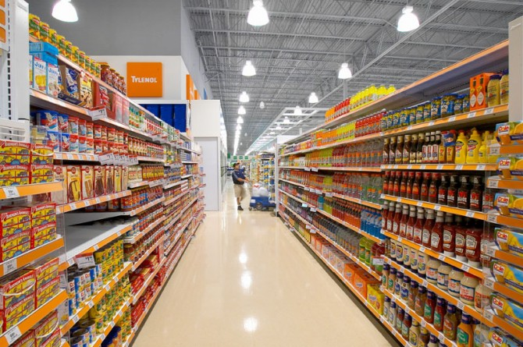
AISLE

Slide 15
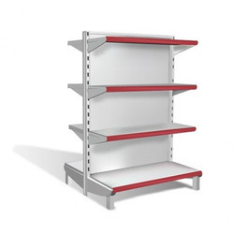
SHELF

