Slide 1
DESCRIBING PEOPLE.

Slide 2
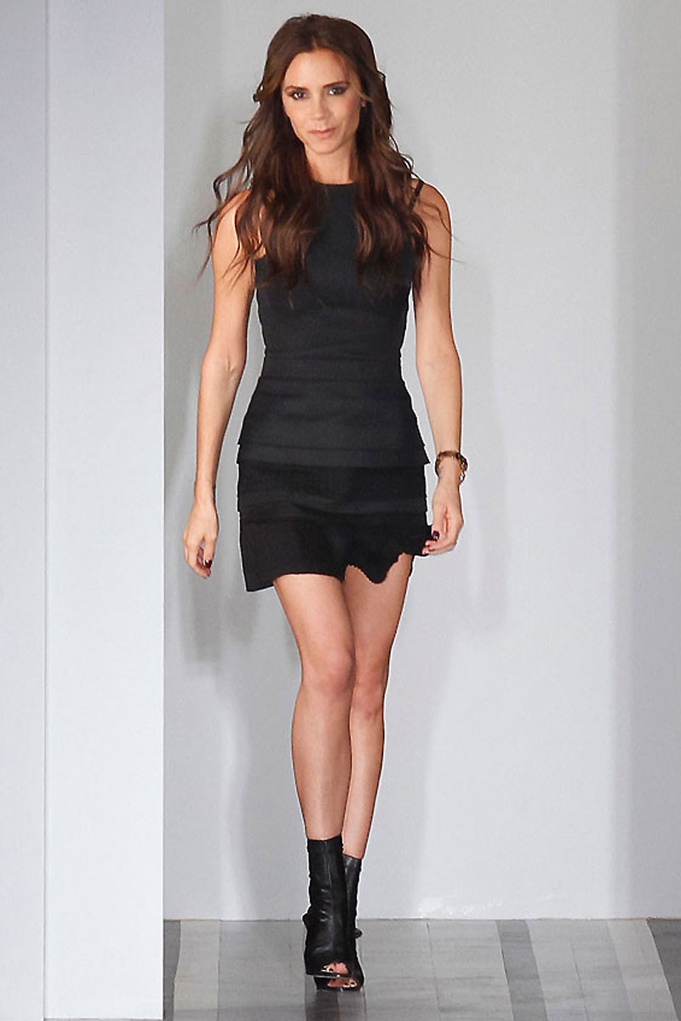
-She’s Victoria. -She is short and skinny. -Her hair is brown. -She has long and wavy hair. -She has white skin. -She is beautiful and she’s in her 40’s.

Slide 3
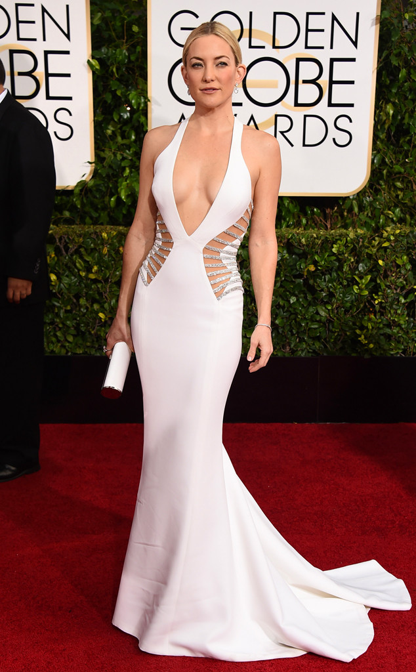
-She’s Kate. -She has long, straight and blond hair. -She has hazel eyes. -She is tall and thin. -Her skin is white. -She is very sexy and beautiful.

Slide 4
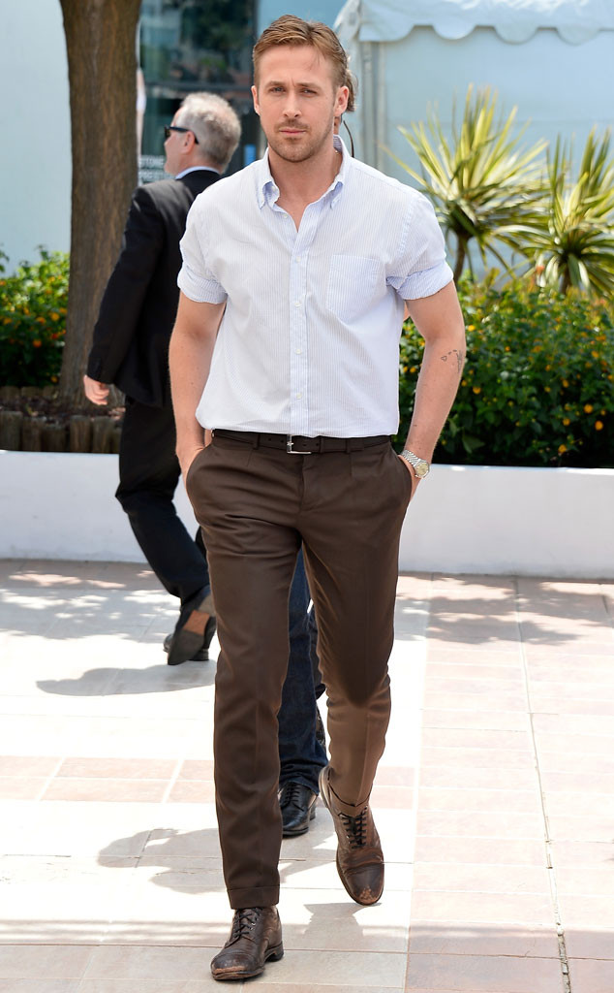
-He is Ryan. - He has short and brown hair. -His eyes are blue. -He is in great shape. -His skin is white. -He is 37 years old. -He is very handsome.

Slide 5
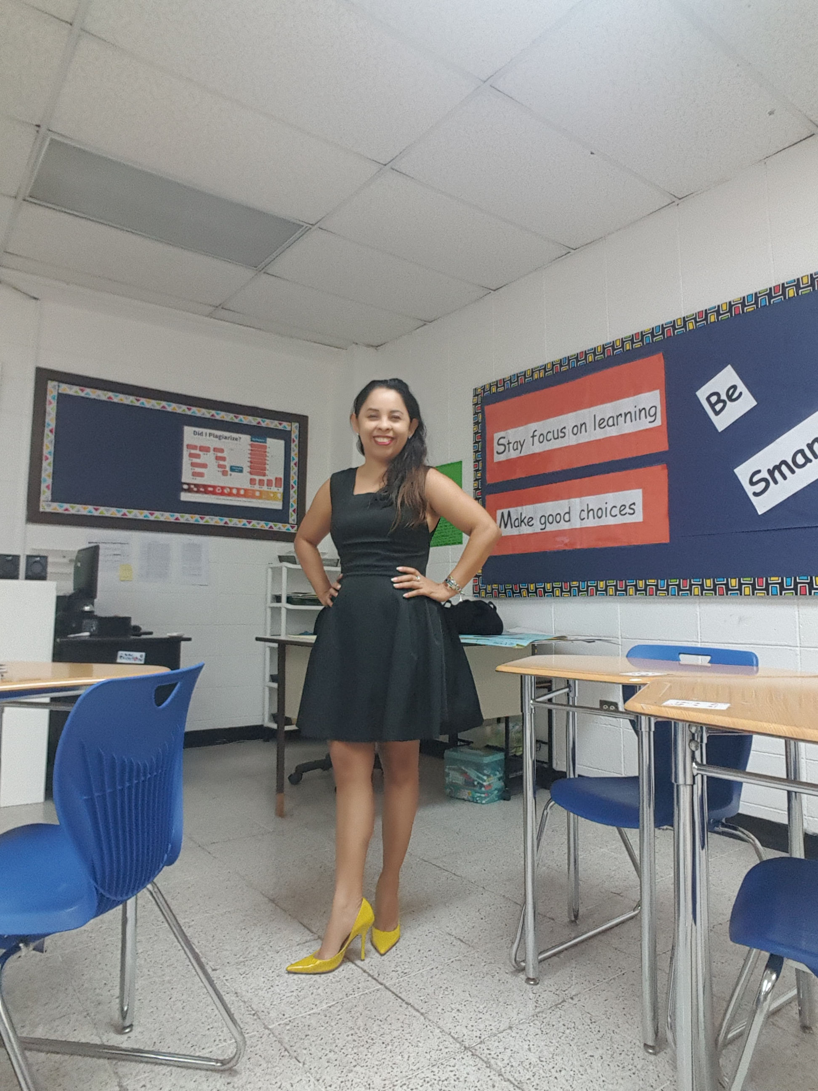
My name is Keny Hernandez. I have black, long and wavy hair. I am short, and thin. I have dark brown and small eyes. I have big teeth and a big smile. I am brunette and I am in my 40s. In this picture I am wearing a black short dress, a pair of yellow high heels, a black bra and black panties. I am also wearing a pair of silver earrings, a bracelet and a ring.

Slide 6
IS /ARE
Michael Jordan is tall. Nelson Nedd is short. His teeth are big. Scarlett Johansson is beautiful. My hair is black. His hair is blond. Eva Mendez is 40 years old. Van Dame is sexy. My eyes are dark brown.

Slide 7
HAVE / HAS
Oprah has dark skin. She has brown eyes. I have black, and long hair. Carlos has white skin. I have a big smile. They have a big nose.

Slide 8
HAVE GOT/HAS GOT (more formal) = HAVE/HAS
Brad Pitt has got blond hair.
Angelina Jolie has got green eyes.
I have got long hair.
We have got brown eyes.
She has got a beautiful smile.

Slide 9
Describe the people. What do they look like?

Slide 10
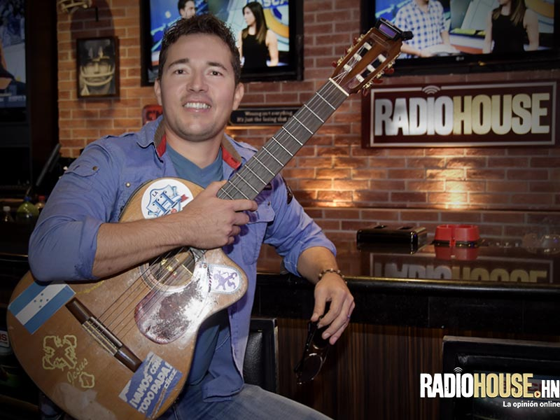

Slide 11
