Slide 1
What’s this?

Slide 2


What’s this?
This is a TV.

Slide 3
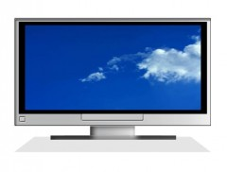
What’s that?
That is a computer.

Slide 4
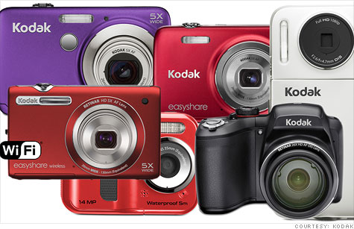
What are these?
These are cameras.

Slide 5
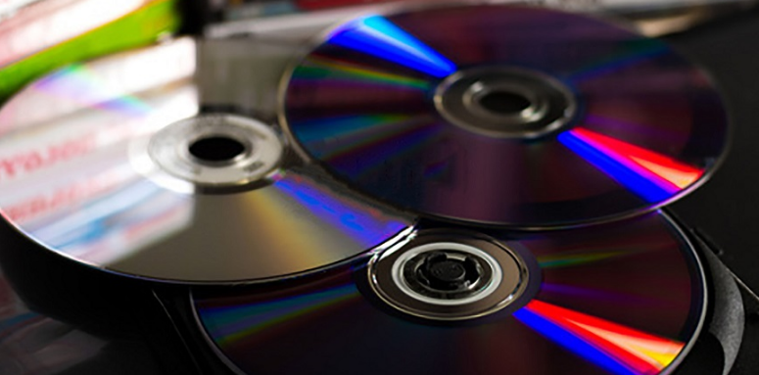
What are those?
Those are CDs.

Slide 6
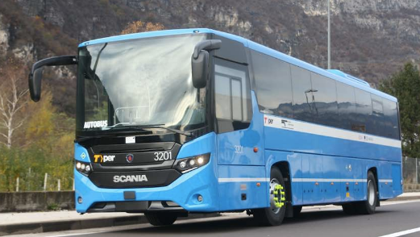
What’s that?
That is a bus.

Slide 7

What are those?
Those are flowers.

Slide 8
DEMONSTRATIVE
PRONOUNS.

Slide 9
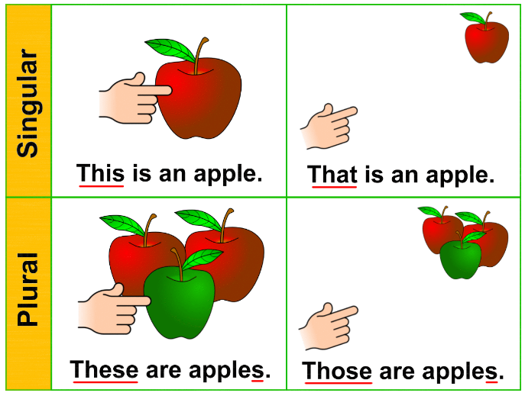

Slide 10
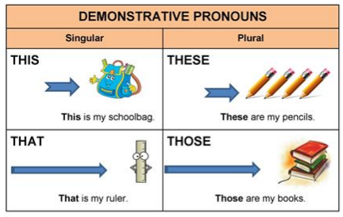

Slide 11
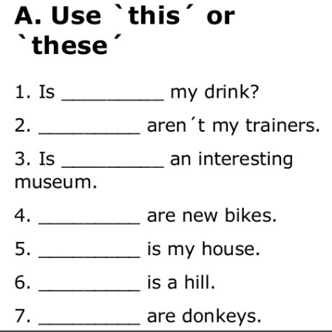

Slide 12
