Slide 1

COUNTABLE AND UNCOUNTABLE NOUNS

Slide 2
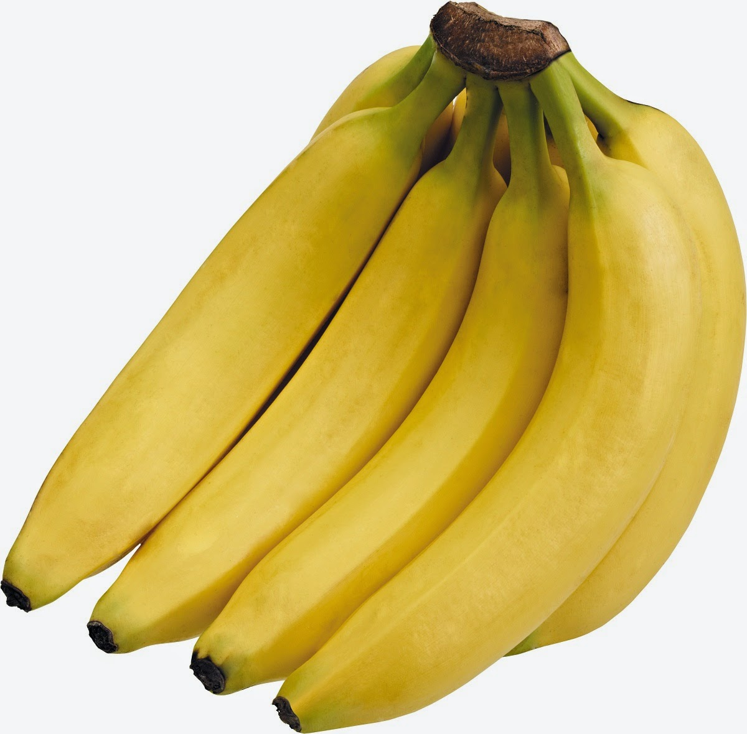
Hello!
COUNTABLE NOUNS :
can be 1. singular (banana) or 2. plural (bananas)
ONE BANANA/TWO BANANAS

Slide 3
PLURAL FORMS RULE#1
1
We add –s to most plural forms.
✓ apple apples✓ pineapple pineapples ✓ cucumber cucumbers✓ strawberry strawberries✓ grape grapes

Slide 4
PLURAL FORMS RULE#2
2
We add –es to nouns ending in -o.
✓tomato tomatoes ✓potato potatoes
But we just add -s to:✓radio /radios✓photo/ photos

Slide 5
UNCOUNTABLE NOUNS
are things we can’t count. An uncountable noun has only one form. (rice)Uncountable nouns are things we can’t count. We can’t put an ‘s’ on an uncountable noun.We can’t say ‘one rice’, ‘two rices’, etc.

Slide 6
UNCOUNTABLE
Space is an uncountable noun

Slide 7
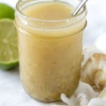
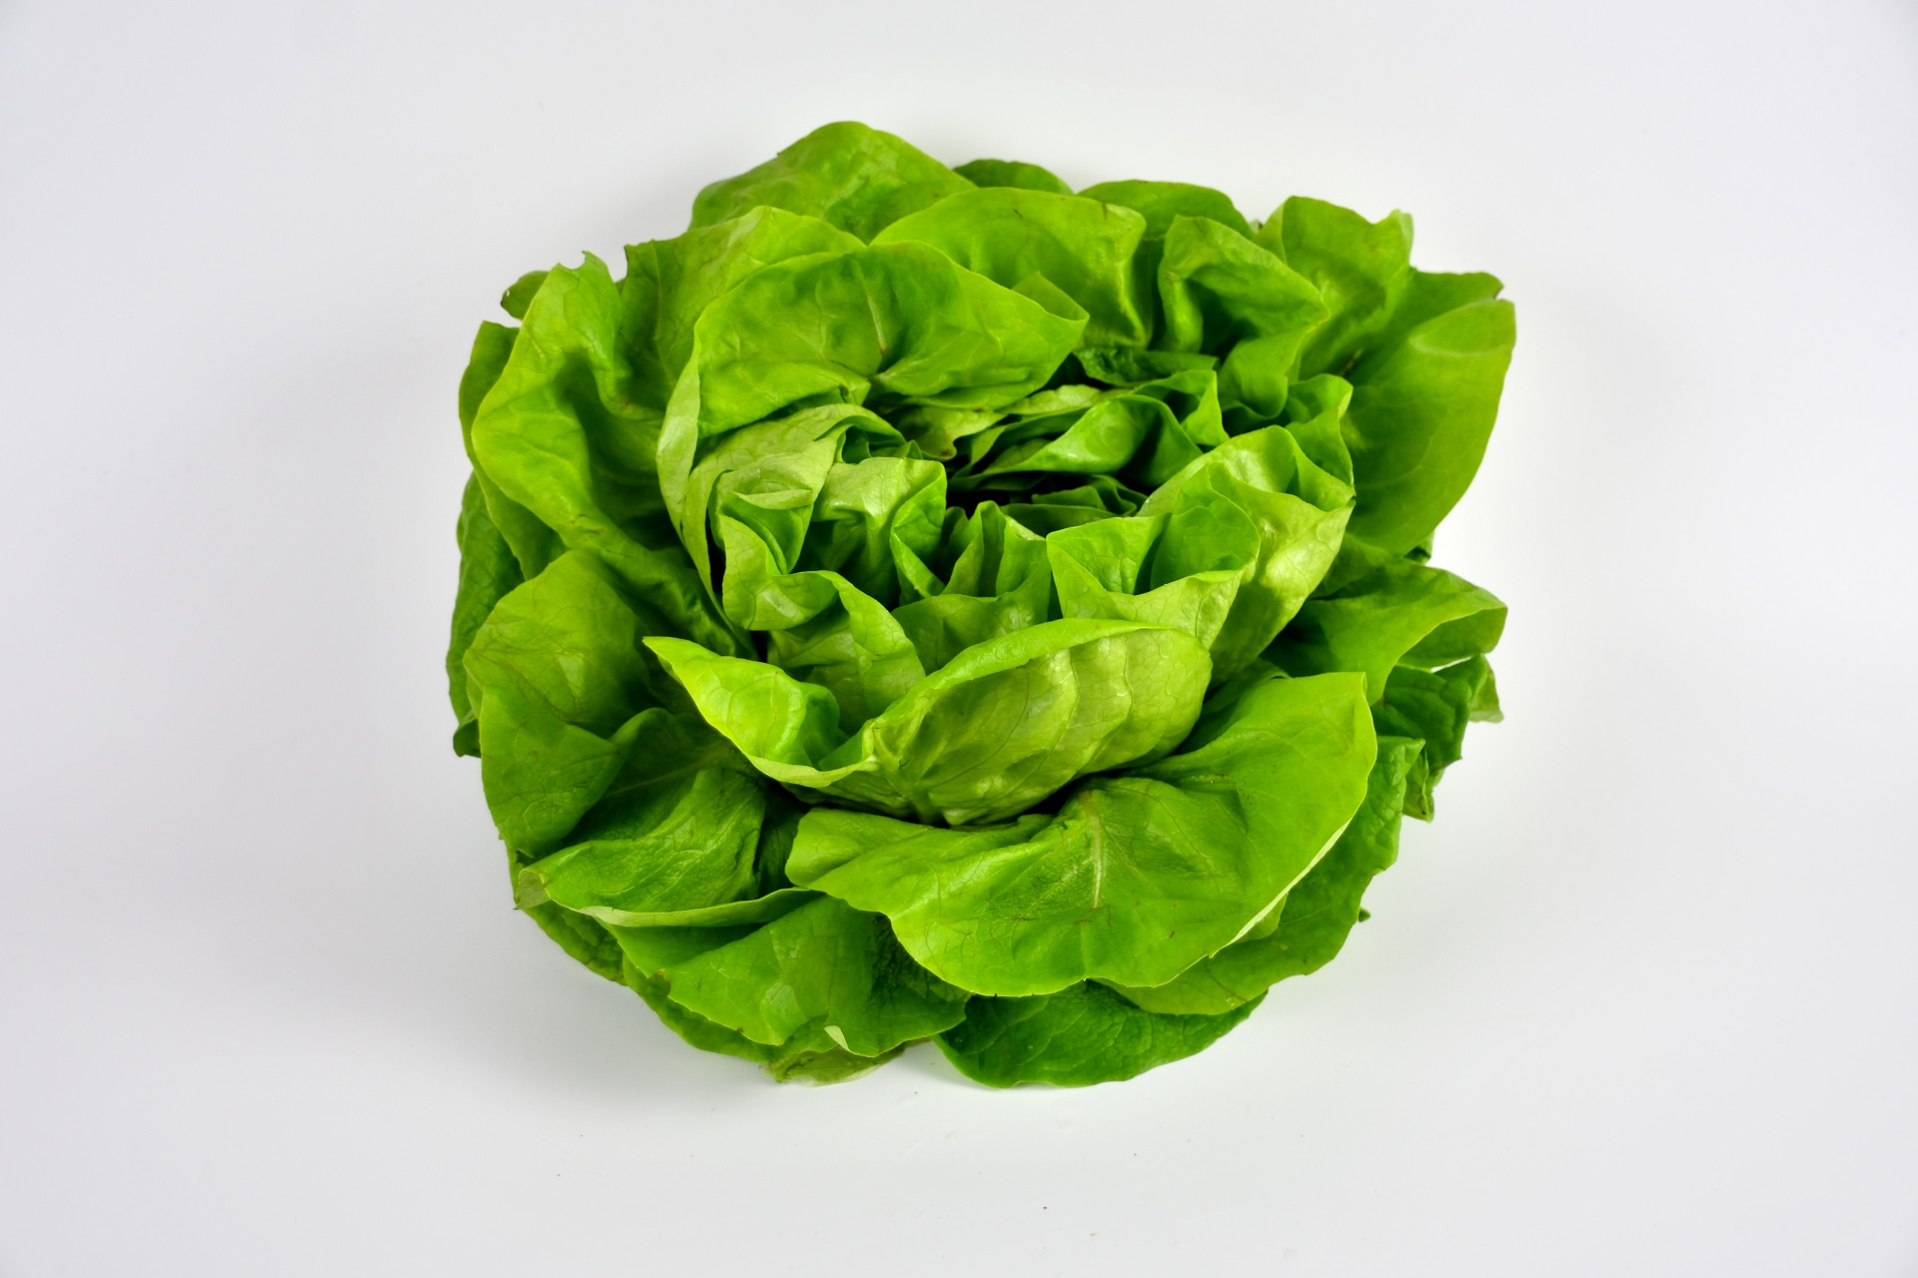

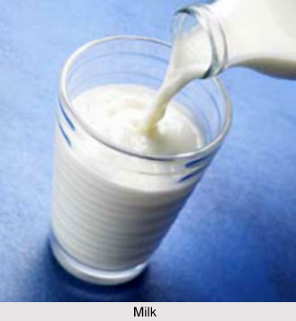
Examples of uncountable nouns:
salad dressing
lettuce
water
milk

Slide 8
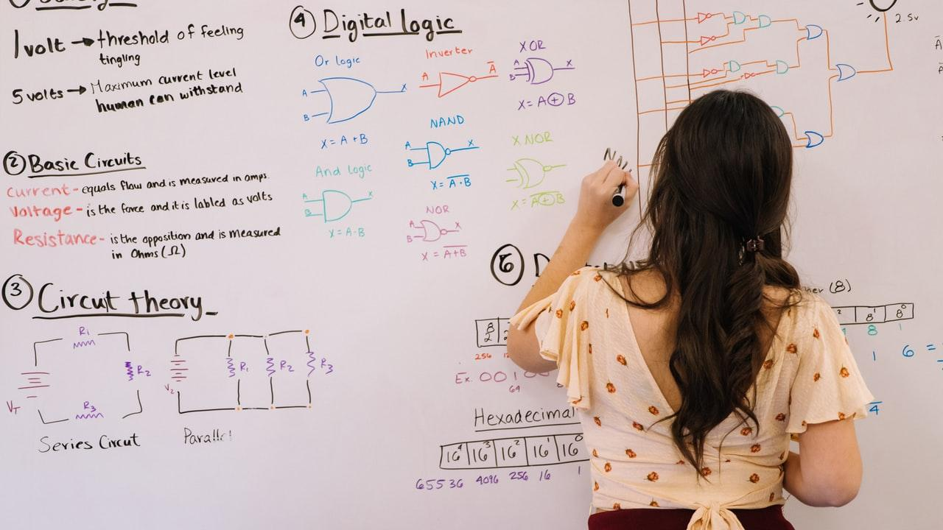
A picture is worth a thousand words
There is/There isn’t There are/There aren’t + some/any

Slide 9
There are/there is+ some:
We use ‘There is some’ when the noun is uncountable. (meat, cheese.)
We use ‘There are some’ when the countable noun is plural. (rulers, pencils.

Slide 10

There are/there is+ some:
There are some books on my desk. (books= countable noun)
There is some milk in the refrigerator. (milk=uncountable noun)

Slide 11
There aren´t/there isnt+ any:
There isn´t any water in the bucket. (water=uncountable noun)
There aren´t any papers on the teacher´s desk. (Papers=countable noun)

Slide 12

89,526,124
ASK OR START USING IS THERE? THERE IS….

Slide 13
Thanks!
Any questions?
Ask in class and participate!

Slide 14
Extra resources

