Slide 1
Comparatives and Superlatives

Slide 2
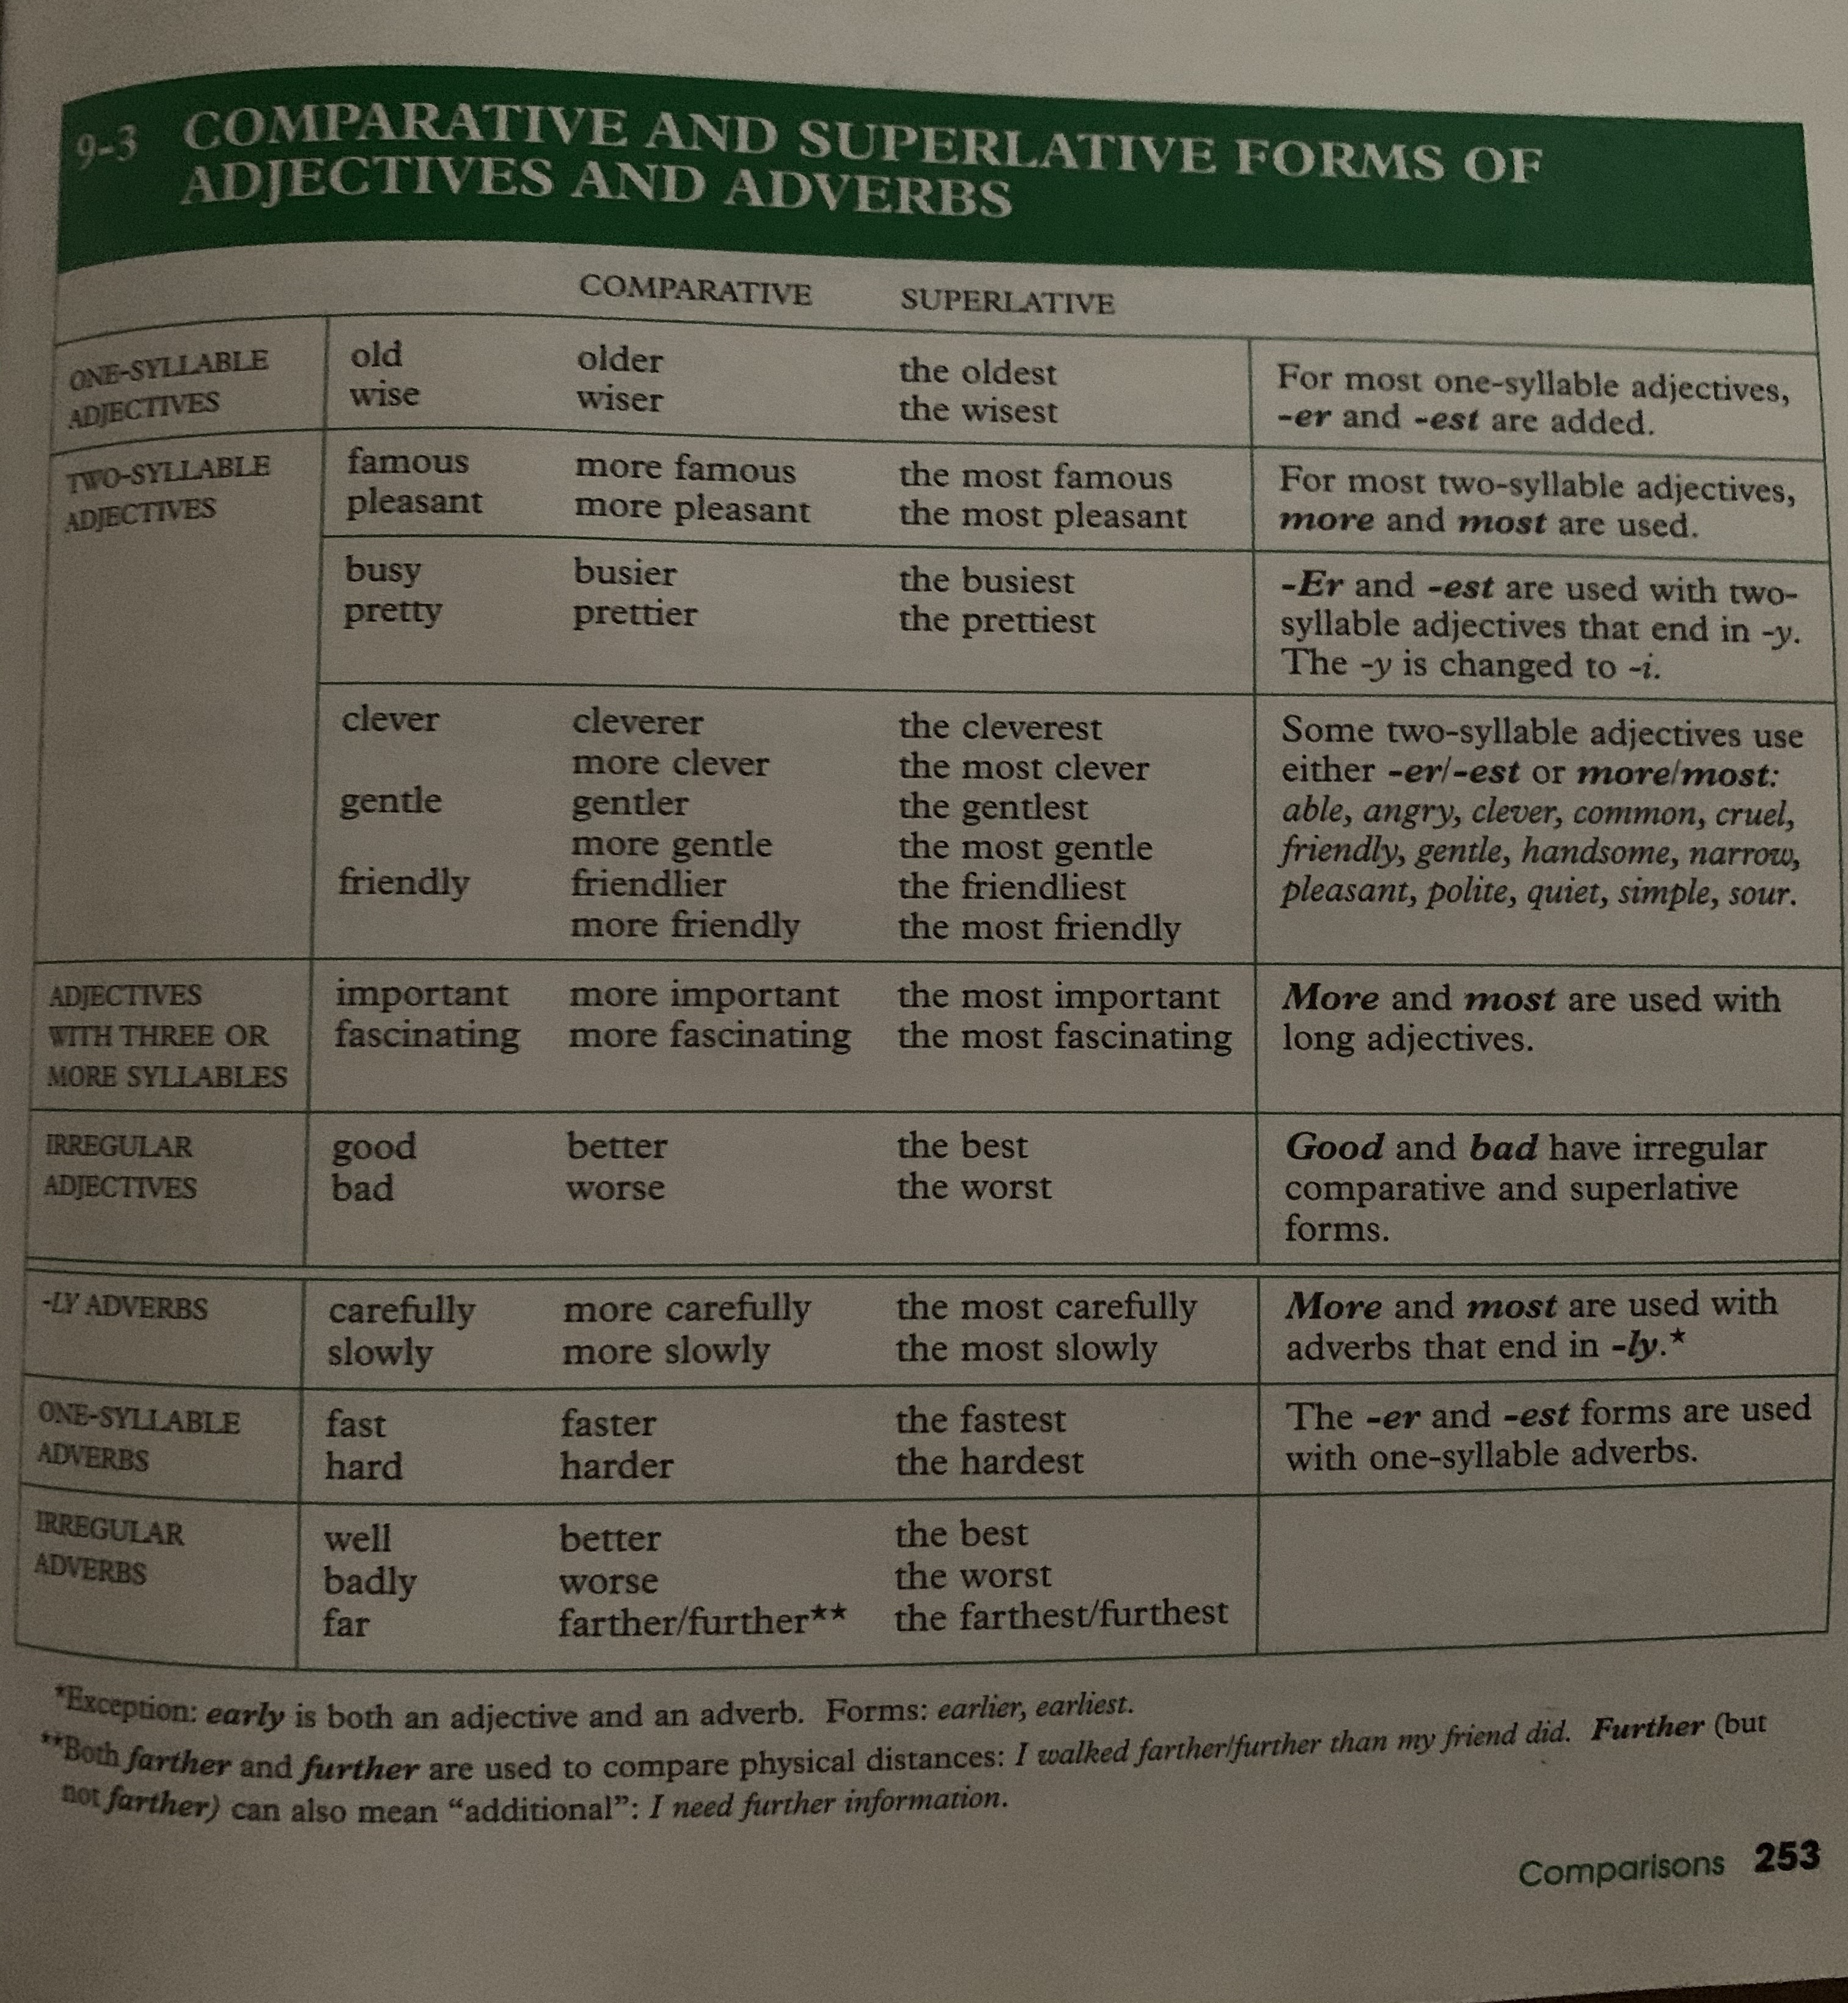

Slide 3
